Slide 1
What is Techno-Fundamental Analysis
Important for us to Understand What is Technical Analysis and What is Fundamental Analysis separately
Marriage of both the styles of analysing stock prices could be quite effective

Slide 2
Macros & Micros
Key Economic parameters and their impact
Interest Rates – Domestic : What happens if these go up?
____________________________________________________________
____________________________________________________________
Interest Rates – International : How do these impact our markets?
____________________________________________________________
____________________________________________________________
IIP Reading : What does it tell us?
____________________________________________________________
____________________________________________________________
Inflation – CPI & WPI : Which is more relevant for the markets? And why?
____________________________________________________________
____________________________________________________________

Slide 3
Macros & Micros
Sector Dynamics
My favourite sectors are:
____________________________________________________________
I like these sectors, because
I understand these sectors very well
They seem promising to me from an investment perspective
Its easier to predict how the sector will perform
Companies within the sector are of a higher quality
Other _________________
What are the factors that influence my favourite sectors?
____________________________________________________________
____________________________________________________________
Action point:
Identify parameters that should be tracked closely to anticipate impact on my chosen sectors

Slide 4
Macros & Micros
Sector Dynamics
Key Metrics to look at for every sector are different, yet simple!
Sector Metrics
Banking NIIs, NPAs, CASA, Provisioning, etc
Cement Capacity Utilisation, Power & Fuel Cost, Volume
Auto Average realisation, Margins, Market Share
Steel Iron Ore prices, Capacity utilisation, Power costs
EPC / Infra Working Capital, Order Execution, Interest costs
Technology Constant Currency Growth, Margins, Attrition
Oil & Gas GRM, Product Mix, Inventory
Consumer Goods Turnover ratios, Debtors, RM Costs
Real Estate Sales, Interest costs
Telecom ARPU, MPU, Subscriber base

Slide 5
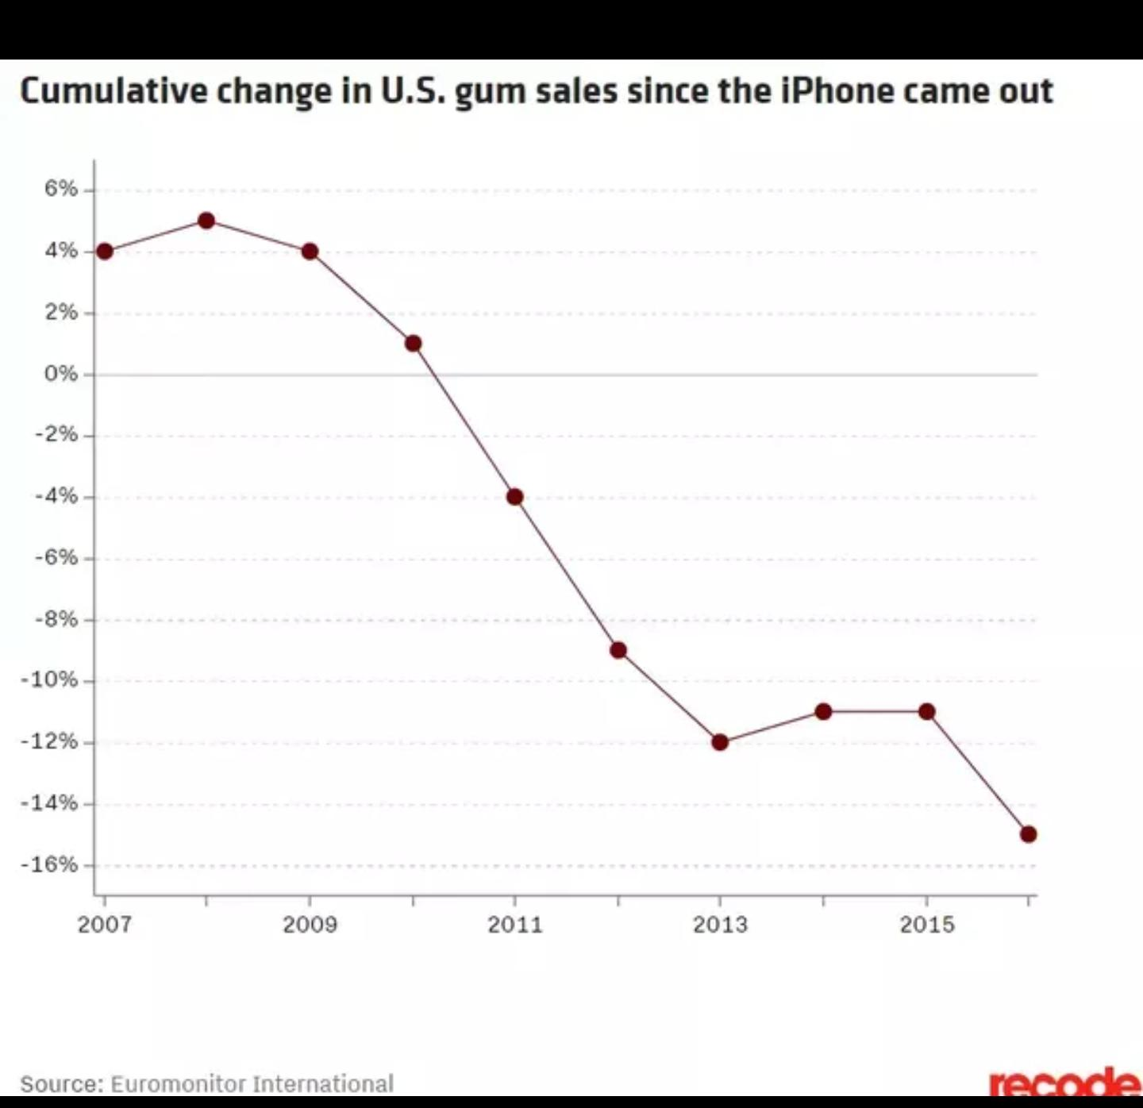
Macros & Micros
Sector Dynamics

Slide 6
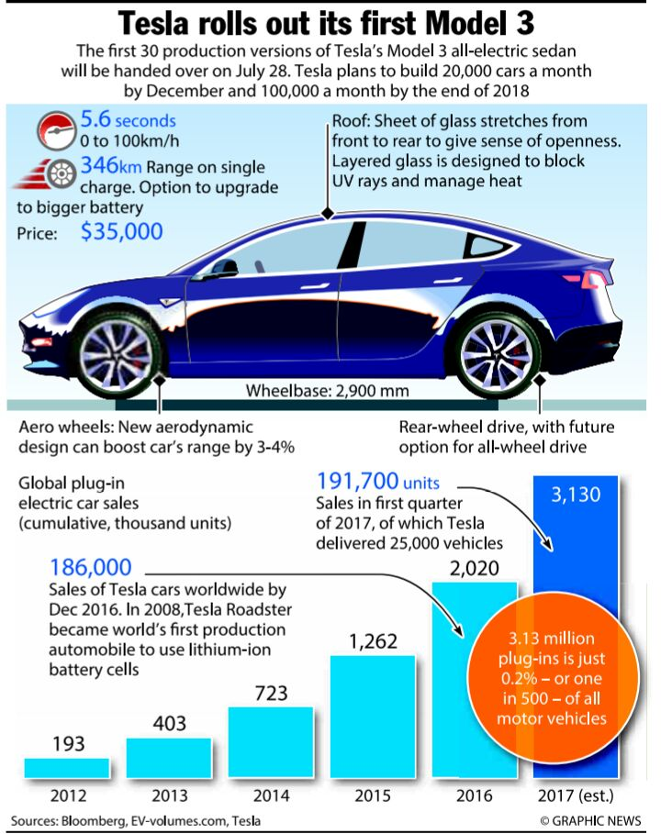
Macros & Micros
Sector Dynamics

Slide 7
Macros & Micros
Sector Dynamics

Slide 8
Macros & Micros
Company Fundamentals
Make your client Buy on the basis of VALUE, & not PRICE!
The VALUE of a Company reflects how good its business model really is and how well it is managed
The PRICE of a Company reflects what the market thinks about its business model & quality of management

Slide 9
Macros & Micros
Company Fundamentals
The VALUE of a stock is determined by parameters such as Cash Flows, Growth & risk
The PRICE on the other hand, is a function of Demand & Supply
Markets may not always perfectly assign the right PRICE to the real VALUE of a Co
A lot of wealth can get created if we can spot this Gap!

Slide 10
EPS
CMP
P/E
T 20 500 25
T + 1 24 501 21
T + 2 29 493 17
T + 3 35 490 14
Stock prices are a slave to earnings, but in the long run!

Slide 11
Macros & Micros
Company Fundamentals
If you think a Co is..
Market view on it is..
Good
+
Good
Ignore
=
Good
+
Bad
Buy
=
Bad
+
Good
Sell
=
Bad
+
Bad
=
Ignore
Thinking independent of the market view pays!

Slide 12
Macros & Micros
Company Fundamentals
Instead of focusing on
HOW TO ANALYSE A STOCK
It is important to focus on
WHICH STOCK TO ANALYSE!

Slide 13
Macros & Micros
Company Fundamentals
Instead of focusing on
WHAT TO BUY
It is important to focus on
HOW MUCH TO BUY

Slide 14
Macros & Micros
Company Fundamentals
Instead of focusing on
WHEN TO INVEST
It is important to focus on
HOW LONG TO BE INVESTED

Slide 15
Macros & Micros
Company Fundamentals
Key metrics & Why these are key?
___________________________________________________________________
___________________________________________________________________
___________________________________________________________________
___________________________________________________________________
What are the delta – creating metrics?
__________________________________________________________________
__________________________________________________________________
Action point:
Identify the list of Co-wise metrics and sources where you will track the changes in these metrics

Slide 16
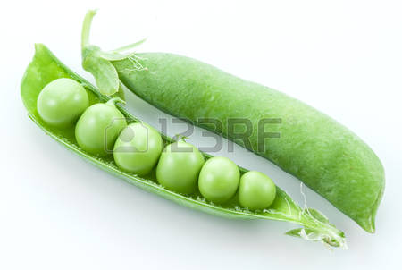
Simplifying the BUSINESS MODEL!
The Business
Peapod
People
Promise
Product
Pitfalls
Processes
Positioning

Slide 17
Simplifying the BUSINESS MODEL!
People
Who runs the biz?
How many people run the biz?
Wage Cost / Sales
Productivity / Employee
Product
How is the product/service sold?
Who are the existing buyers? New buyers?
How is the product/service priced?
Level of complexity/ Range/ Variants
Processes
Are these consistent across functions/geographies?
Stakeholder interest/bias captured in processes
Evolving v/s Revolving processes
Positioning
How is the Co’s product different from others?
Pricing Power?
Substitutes? Elevator Pitch?
Pitfalls
Past setbacks/failures? Chances of repetition?
Impact of Regulatory shifts
Changes in consumer behavior
Promise
Scalability
Headroom for growth

Slide 18
Simple Do-able stuff!
Interact with the Co as a Buyer/Customer
Use its product/ visit Exhibitions /Website Sales orientation
Create a Business URL for regular trade inquiries
Esp helpful in businesses that are more B2B
Talk to Ex-employees of the Co
Esp ones who have left in recent times
Interaction with Industry specialists is a MUST!
If you understand the game well, picking winning teams is easier!
Scan recruitment pages of leading newspapers
Hiring patterns tell a lot about the Co’s progress
Stay connected with co’s Vendors
Advt Agencies, Recuiters, Suppliers know things firsthand!
Be a part of the Co’s anecdotal progress
Try participating in launches, AGMs, Events

Slide 19
News & Noise
Understanding News Flow
News that can potentially influence markets on Monday!
___________________________________________________________________
___________________________________________________________________
___________________________________________________________________
___________________________________________________________________
What sectors/scrips are likely to be influenced? And how?
__________________________________________________________________
__________________________________________________________________
__________________________________________________________________

Slide 20
News & Noise
Understanding News Flow
(continued)
My favourite sources of news (in order of preference)
___________________________________________________________________
___________________________________________________________________
___________________________________________________________________
___________________________________________________________________
Action point:
Reach out to at least 1 decision maker from a Co / Regulator / Sector /Market Participant/ Industry Association / Stock Exchange every week and make the relationship a part of your network

Slide 21
News & Noise
Differentiating between News & Noise
The most commonly available sources of ‘news’ according to me are:
___________________________________________________________________
___________________________________________________________________
___________________________________________________________________
What are the sources out of the above which give you adequate reaction time?
____________________________________________________________________
____________________________________________________________________
Action point:
The rest is all NOISE! Take yourself off from WhatsApp groups/Social media platforms that do not give you adequate reaction time

Slide 22
News & Noise
Anticipation of Developments
What triggers according to you can influence scrip movement?
___________________________________________________________________
___________________________________________________________________
___________________________________________________________________
___________________________________________________________________
How many of the above, can you anticipate?
___________________________________________________________________
___________________________________________________________________
Action point:
Everyday, identify and diarize atleast 5 triggers/outcomes that have the potential to have impact in time to come

Slide 23
As the great Nobel Laureate, HERBERT A SIMON said:
“ A Wealth of information creates a poverty of attention”
Learning to differentiate between
NEWS & NOISE
can make a BIG difference!

Slide 24
Action & Reaction
Behavioural Finance
What, according to you is Behavioural Finance?
____________________________________________________________
____________________________________________________________
____________________________________________________________
____________________________________________________________
How is the behaviour of investors captured in the market metrics?
____________________________________________________________
____________________________________________________________

Slide 25
Action & Reaction
Behavioural Finance
Behavioral finance is a relatively new field that seeks to combine behavioral and cognitive psychological theory with conventional economics and finance to provide explanations for why people make irrational financial decisions.
Behavioral finance combines social and psychological theory with financial theory as a means of understanding how price movements in the securities markets occur independent of any corporate actions.
The role of behavioral finance is to help market analysts and investors understand price movements in the absence of any intrinsic changes on the part of companies or sectors.

Slide 26
Action & Reaction
Understanding Masses
List down top 5 triggers that investors/traders (not yourself necessarily) react to most
1. ____________________________________________________________
2. ____________________________________________________________
3. ____________________________________________________________
4. ____________________________________________________________
5, ____________________________________________________________
How can you take advantage of the mass behaviour?
____________________________________________________________
____________________________________________________________

Slide 27
Action & Reaction
Behavioural Finance
Basic Biases Influencing Investments
LOSS AVERSION bias – leads to inaction
CONFIRMATION bias – justifying notional beliefs
OWNERSHIP bias – things owned appear more valuable
GAMBLER’S FALLACY – predicting random events
HERD MENTALITY – blindly follow others
ANCHORING – rely too heavily on the first piece of information
PROJECTION bias – ignoring the distant past

Slide 28
Action & Reaction
Method in the Madness
For every 1% move in the following scrips, NIFTY would move how many points
ACC ____ ADANI PORTS ____ AMBUJACEM ____
ASIAN PAINTS ____ AUROPHARM ____ AXIS BANK ____
BAJAJ AUTO ____ BANK OF BARODA ____ BHARTI AIR ____
BOSCH ____ BPCL ____ CIPLA ____
COAL INDIA ____ DR REDDYS ____ EICHER MOT ____
GAIL ____ HCL TECH ____ HDFC ____
HDFC BANK ____ HERO MOTO ____ HINDALCO ____
HUL ____ ICICI BANK ____ INDIABULLS ____
INDUSIND ____ INFOSYS ____ IOC ____
ITC ____ KOTAK MAH ____ LARSEN ____
LUPIN ____ M&M ____ MARUTI ____
NTPC ____ ONGC ____ POWERGRID ____
RELIANCE ____ SBI ____ SUNPHARMA ____
TATA POWER ____ ULTRATECH ____ TATAMOTORS _____
TATAMOTOR (D) ____ TATA STEEL ____ TCS ____
TECH MAHINDRA ____ VEDANTA ____ WIPRO ____
YES BANK ____ ZEE ENT ____

Slide 29
Action & Reaction
Method in the Madness
Which stocks could possibly enter the NIFTY as part of the next revision?
___________________________________________________________________
___________________________________________________________________
Which could possibly be the new entrants in the F&O segment?
___________________________________________________________________
___________________________________________________________________

Slide 30
Who are YOU ..?
A
Trader ?
An
Investor?
OR

Slide 31
What would YOU need….?
If YOUR client is a
Trader ?
If YOUR client is an
Investor?
News
Information

Slide 32
News
Information
v/s
Reaction Time
30 to 60 seconds
5 to 10 mins
2 to 3 hours
Management Commentary
Press Release
Conference Call
www.bseindia.com
Newspapers
Corporate
Announcements
Results
Upgrades
Orders
Approvals
Board Meetings
TV Channels
www.nseindia.com
Magazines
Newswires
www.sebi.gov.in
Research Reports
Breaking News
Global
Regulatory /Policy
Disasters / Calamities

Slide 33
News
…is important for a
Trader !
News that has a shelf life of a FEW SECONDS, will help you make money in a FEW MINUTES!
News that is a FEW MINUTES old, will help you make money in a FEW HOURS!
News that came a FEW HOURS ago, will help you make money probably in a FEW DAYS
And News that is old by a FEW DAYS, can only help make money in a FEW MONTHS

Slide 34
Illustration of how News can help traders
Asian Paints Numbers --- All other paint Co’s --- Pidilite
Lower Crude Prices --- Aviation stocks
Weakness in YEN --- Maruti
PNB Results --- SBI
Capitalisation of Banks --- PSU Banks
Chinese environmental restrictions --- Chemical Companies

Slide 35
Information
…is what works for an
Investor !
Investors absorb INFORMATION and INFER from it
INFERENCE leads to ANALYSIS
ANALYSIS helps in ANTICIPATION of developments
ANTICIPATED developments later on become NEWS!

Slide 36
Illustration of how Information works for investors
Preview of MARUTI sales numbers for the month --- Monthly sales update
SEBI deadline for reaction from public on REITS --- DLF
Introduction of Airbags in 2017 --- impact on Passenger cars
Changes in environmental regulations in China --- Speciality Chemical co’s

Slide 37
Q & A

