Slide 1
AASB of ICAI and Rajkot Branch of WIRC of ICAI
Two Days Conference on
Bank Audit
Audit Planning & Documentation
CA Niranjan Joshi
19.03.2022
Rajkot
Restriction on Disclosure and Use of Data
The data in this document contains trade secrets and confidential or proprietary information of my firm, the disclosure of which would provide a competitive advantage to others. As a result, this document shall not be disclosed, used or duplicated, in whole or in part, for any purpose. The data subject to this restriction are contained in the entire document.

Slide 2
Disclaimer
These are my personal views and can not be construed to be the views of the ICAI or my firm.
No representations or warranties are made by the ICAI/RC/Branch/Study Circle with regard to this presentation.
These views do not and shall not be considered as a professional advice.
This presentation should not be reproduced in part or in whole, in any manner or form, without our written permission.
CA Niranjan Joshi

Slide 3
Agenda
Audit Planning
- Ethical Compliance
- Compliance with Standards on Auditing
- Compliance with Guidance Note
- Effective Reporting (Revised LFAR)
- Certification
Documentation
CA Niranjan Joshi

Slide 4
Agenda
Your Backbone – Strong Planing
Ethical Compliance
Compliance with Standards on Auditing
Compliance with Guidance Note
Effective Reporting (Revised LFAR)
Certification
CA Niranjan Joshi

Slide 5
Code of Ethics
Read and Follow
CA Niranjan Joshi

Slide 6
Guide to the COE
Part 1 | Complying with the Code, fundamental principle and conceptual framework | Section 100 to 199
Part 2 | Professional Accountants in service | Section 200 to 299
Part 3 | Professional accountants in public practice | Section 300 to 399
Part 4 | Independence Standards | Section 400 to 999
Part 4 A | Independence for Audit and Review Engagements | Section 400 to 899
Part 4 B | Independence for assurance engagements other than audit and review | Section 900 to 999
CA Niranjan Joshi

Slide 7
Fundamental Principles
Integrity - Straightforward and honest approach, Fair dealing and truthfulness, Do not associate with communication or information containing false or misleading information, Steps to disassociate with above information once known
Objectivity - Not to compromise professional or business judgment because of bias, conflict of interest or undue influence of others. Not to undertake a professional activity if it unduly influences the accountant’s professional judgment.
Professional Competence and due care - Attain and maintain professional knowledge and skill, Act diligently and in accordance with applicable technical and professional standards, Ensure appropriate training and supervision of subordinates
CA Niranjan Joshi

Slide 8
Fundamental Principles
Confidentiality - Maintain confidentiality of information acquired as a result of professional and employment relationships, Disclose information when required by law or authorised by the client, Consider relevant factors while deciding disclosure of confidential information, Maintain confidentiality even after the end of relationship with client
Professional Behaviour - Avoid activities that impair the reputation of the profession, Do not make exaggerated claims for services offered, and disparaging references or unsubstantiated comparisons with others, Do not advertise any professional/other facts which are in violation of Advertisement Guidelines of ICAI
Threats to avoid
Self Interest Threat, Self Review Threat, Advocacy Threat,
Familiarity Threat, Intimidation Threat.
CA Niranjan Joshi

Slide 9
Agenda
Your Backbone – Strong Planing
Ethical Compliance
Compliance with Standards on Auditing
Compliance with Guidance Note
Effective Reporting (Revised LFAR)
Certification
CA Niranjan Joshi

Slide 10
Standards on Auditing
SQC1 – Quality Control for Firms
SA 200 – Basic Principles Governing Audit.
SA 230 – Audit Documentation
SA 500 – Audit Evidence
SA 400 – Risk Assessment and Internal Control
SA 300 – Audit Planning
SA 220 – Quality Control for Audit Work
SA 299 – Joint Audit of Financial Statements
SA 310 – Knowledge of Business
SA 600 – Using work of another auditor
Knowledge about CAAT tools
CA Niranjan Joshi

Slide 11
Audit Execution
SA 320 – Audit Materiality
SA 520 – Analytical Procedures
SA 530 – Audit Sampling
SA 220 – Quality Control For Audit Work
Analyse and Evaluate the errors in samples selected
Get the rectification / MOC Passed
Work as per Audit Program and schedule
Prepare reports according to requirement
Qualify in Audit Report if necessary
CA Niranjan Joshi

Slide 12
SA 600 – Using work of Another Auditor
SBA is Component Auditors for SCAs
Reliance is placed by SCAs on work of SBAs
SA requires SCAs (principal auditor) to determine how the work of the SBAs (other auditor) will affect the audit.
Whether the SCAs has performed procedures to obtain SAAE, that the work of the SBAs is adequate for the SCAs purposes, in the context of the specific assignment
Communication through Closing Circular
CA Niranjan Joshi

Slide 13
SA 600 – Using work of Another Auditor
Informing matters requiring special consideration for SBAs
Informing changes in accounting policies to SBAs
The SCAs will consider the significant findings of the SBAs in their reports
Written confirmation may be obtained from SBAs confirming
Independence, KAM, acknowledgment for use of work of SBAs by SCAs, Confirming that insturctions have been followed
CA Niranjan Joshi

Slide 14
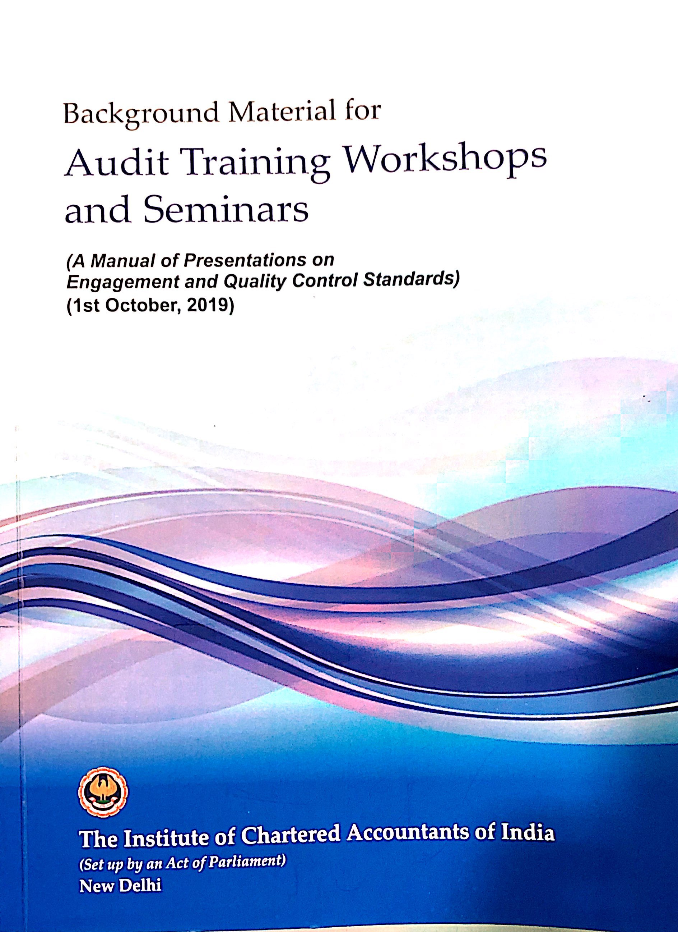
Background Material for SA’s
CA Niranjan Joshi

Slide 15
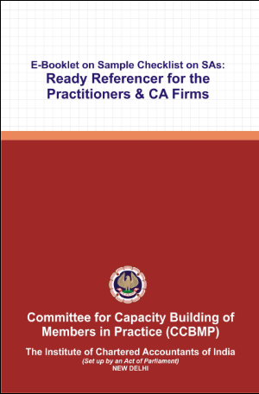
Sample Checklists
CA Niranjan Joshi

Slide 16
Audit Planning & Checklist
Applicable Act for the Bank
Appointment Letter / Acceptance Letter
Closing Manual of Bank
NOC of Previous Auditor.
Audit Engagement Letter.
Basic Information from branch.
Audit Program / Checklist
Study RBI Circulars
Attend Trainings / Workshops / Seminars
Have knowledge of current affairs
CA Niranjan Joshi

Slide 17
Audit Planning & Checklist
Have knowledge of the:
Economy
Banking Industry
Government Policies
Rules & Regulations applicable to the Bank
Products handled by Bank
Complexities involved
Applicability of Accounting Standards
Applicability Auditing and Assurance Standards.
FEDAI Guidelines
CA Niranjan Joshi

Slide 18
Audit Program
Define broadly the scope of audit.
Include Certificates in main audit plan.
Identify the thrust areas.
Set materiality levels standards for each area.
Lay down over all time schedule.
Training to Audit staff and special skill if required.
Weak areas identified during the Audit – extra focus.
Physical verification of cash and other securities / Sensitive Accounts
Frauds / Sundry Assets / Suspense Account / Inter Branch reconciliation
Contingent Liabilities
Contingent Liabilities not acknowledged
CA Niranjan Joshi

Slide 19
Verification – Checklist
Set up materiality
Selection of Sample
Testing of Sample Selected
Noting down the observations
Discussion with the branch Management
Reporting appropriately
CA Niranjan Joshi

Slide 20
Sample Selection - Advances
Cash Credit | 25% – 40% Sanction 25% – 40% Renewals
Overdraft | 5% – 10% Against Security 75% – 100% Clean
Term Loans | 20% – 30% Sanction
Import / Export | 15% – 25% of Sanction
BG | 15% – 20% of Sanction
LC | 15% – 20% of Sanction
Loc/BC | 50% – 75% of Sanction
10% of Total Advances of Branch OR Rs. 10 Crores whichever is lower – 100%
Schematic / Retail Loans at least 5% – 10% of each type (Housing/Vehicle/Personal/Against Deposit/Gold/Education/etc.)

Slide 21
Agenda
Your Backbone – Strong Planing
Ethical Compliance
Compliance with Standards on Auditing
Compliance with Guidance Note
Effective Reporting (Revised LFAR)
Certification
CA Niranjan Joshi

Slide 22
Objective
Compliance with:
- RBI / ICAI Guidelines
- Terms of Appointment
- Accounting Standards
- Standards on Auditing
Other Certification work
Effective Reporting
Completion of Work in Time
CA Niranjan Joshi

Slide 23
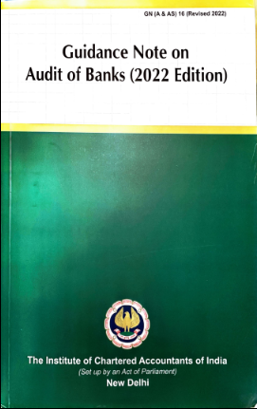
Branch Audit
Read and Follow

Slide 24
Ground Work at Office
Preliminary Work
Evaluation of Internal Controls
Prepare Audit Program
Overall Time & Manpower Planning
Laying Overall Audit Plan
CA Niranjan Joshi

Slide 25
Reached the Branch – What do I do?
“First hand feel” of Branch:
Previous Years Audited Return
Concurrent Audit Report.
Internal Inspection Report.
RBI Inspection Report.
Various Other Audit Reports
Review Compliance of these Reports.
CA Niranjan Joshi

Slide 26
Audit Trail
Manual Registers / Records
Core Banking Solution CBS
Management Information System
Data made available for remote audit
Lack of Adequate Information
Lack of Adequate Knowledge of system
Lack of audit Trail
CA Niranjan Joshi

Slide 27
RBI Circulars
Read and Check compliance for RBI Circulars hosted on website / available with bank branch
Index to RBI Circulars
https://www.rbi.org.in/Scripts/BS_CircularIndexDisplay.aspx
CA Niranjan Joshi

Slide 28
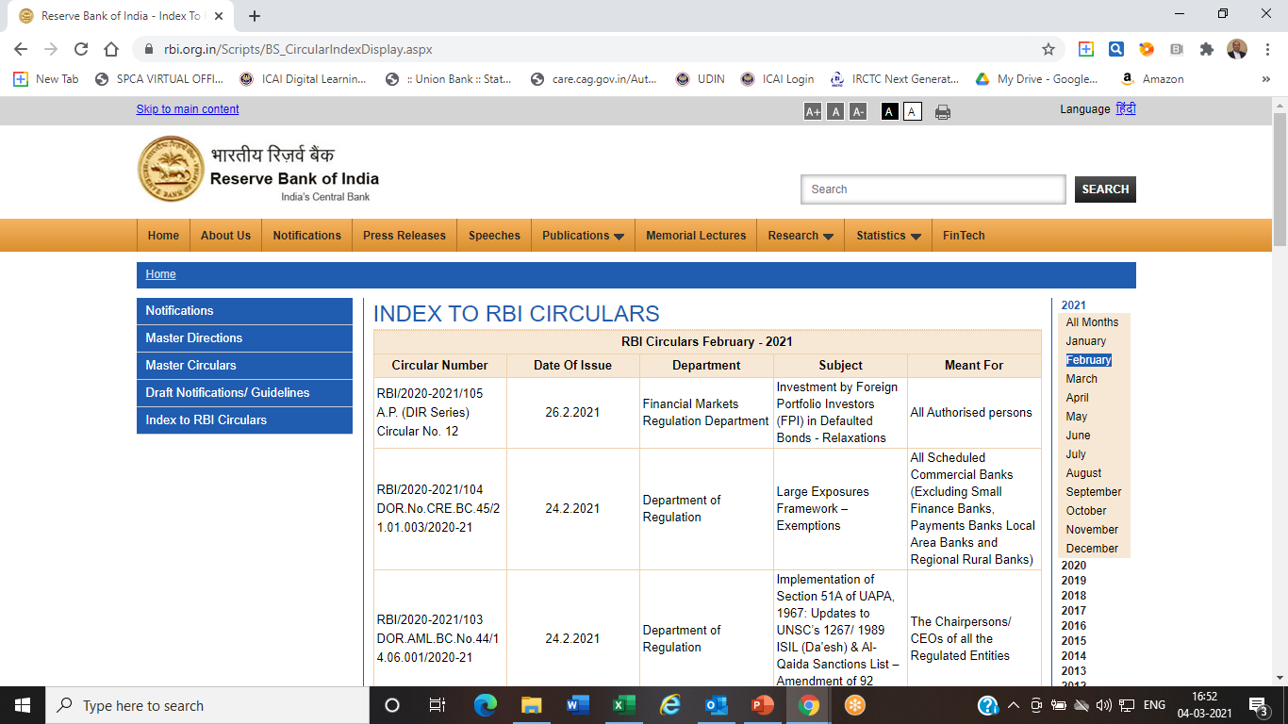
CA Niranjan Joshi

Slide 29
Agenda
Your Backbone – Strong Planing
Ethical Compliance
Compliance with Standards on Auditing
Compliance with Guidance Note
Effective Reporting (Revised LFAR)
Certification
CA Niranjan Joshi

Slide 30
Reporting
Statutory Audit Report – Addressed to SCA/Bank
SA 700 – Forming an opinion & Reporting on FS
SA 701 – Communicating Key Audit Matters
SA 705 – Modifications to the opinion
SA 706 – Emphasis of Matter or Other Matter Para
SA 720 – Auditors Responsibility Other Information
KAM / Modified Opinion / EOM / OM – all are different.
Qualifications can be through Memorandum of Changes or Specific remarks in the last para.
Illustrative Format Bank Audit Guidance Note 2022
Add annexures / supporting documents to the report wherever necessary
CA Niranjan Joshi

Slide 31
Reporting – MOC
Increase/Decrease:
Assets & Liabilities OR Income & Expenditure
Changes in Advances Classification, Gross NPAs & Provision on NPAs
Risk Weight Asset
Other changes (if any)
In case there is no change than MOC with NIL remarks is to be submitted.
Audit report is incomplete without MOC. Its part and parcel of Audit Report.
CA Niranjan Joshi

Slide 32
Memorandum of Changes – MOC
Memorandum of Changes (summary)
 | No. | Increase | Decrease
In respect of Income
In respect of expenditure
In respect of Assets
In respect of Liabilities
In respect of Gross NPAs
In respect of Provision on NPAs
In respect of Classification of Advances
In respect of Risk Weighted Assets
Other items (if any)
CA Niranjan Joshi

Slide 33
Long Form Audit Report
Internal control evaluation questionnaire
Comprehensive in scope and coverage
Covers Balance Sheet & Profit & Loss A/c
Important check list for Audit Plan
CA Niranjan Joshi

Slide 34
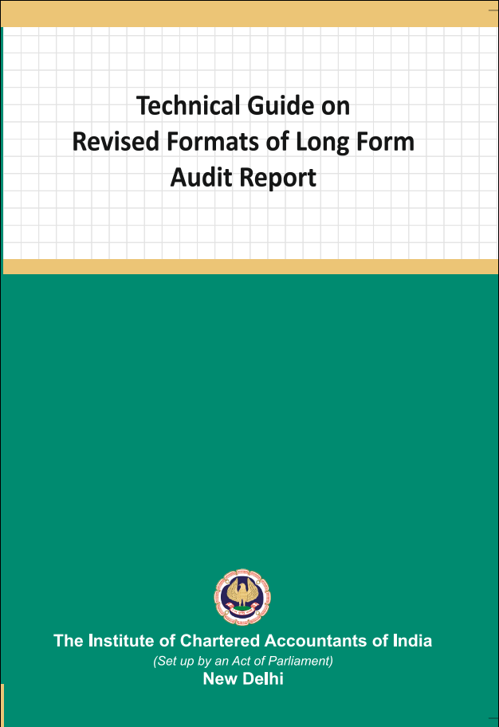
Technical Guide on Revised LFAR 2021
CA Niranjan Joshi

Slide 35
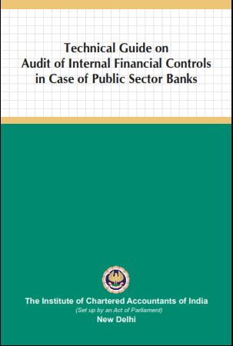
Technical Guide on IFCoFR 2021
CA Niranjan Joshi

Slide 36
LFAR Audit Approach
Read All questions in LFAR
Plan & Design Audit Program to cover all aspects of LFAR
Prepare separate checklists for each point to be reported.
Record the extent of checking / sample selected.
Proper documentation & collecting SAAE during the audit.
Write descriptive answers. Avoid Y/N/NA
Include facts, figures and examples to the extent possible in all answers to the questions.
CA Niranjan Joshi

Slide 37
LFAR Audit Approach
Observations resulting in adjustments to account heads needs to be reported along with MOC
Discuss the contents of report with Branch Management
Obtain Management Representation from Branch Manager on various matters based on Audit.
LFAR is an independent report, hence do not give cross reference or qualifications or MOC in LFAR.
It’s a very important report for readers such as SCA and Management of Bank.
CA Niranjan Joshi

Slide 38
You can please some of the people some of the time…
But you can’t please all of the people all of the time.
CA Niranjan Joshi

Slide 39
Revised LFAR – 05.09.2020
Long Form Audit Report for FY 2020 – 21
The format of LFAR, as mentioned below, have been revised:
Annex I for Statutory Central Auditors (SCA)
Annex II for Branch Auditors
An Appendix as part of Annex II for the specialized branches and
Annex III on Large / Irregular / Critical accounts for branch auditors.
CA Niranjan Joshi

Slide 40
Revised LFAR – 05.09.2020
The overall objective of the branch audit should be to have transaction testing and provide inputs to the SCAs on adequacy of implementation of various policy and regulatory requirements, including efficacy of the system and assurance functions (risk management, compliance and internal audit) at branch level.
The threshold fixed for different purposes for comments in the LFAR will decide that above the threshold, the transaction detailing needs to be seen and commented upon. However, below the threshold, the system and processes should be checked and commented upon.
Verification of data integrity and data related control systems and processes should be carried out and commented upon, with the special thrust on those data inputs which are to be used for MIS at corporate office level and for supervisory reporting purposes.
CA Niranjan Joshi

Slide 41
Revised LFAR – 05.09.2020
Where any of the comments made by the auditors in their LFAR is adverse, they should consider whether a qualification in their main report is necessary. It should not, however, be assumed that every adverse comment in the LFAR would necessarily result in a qualification in the main report. In deciding whether a qualification in the main report is necessary, the auditors should use their professional judgment in the facts and circumstances of each case.
CA Niranjan Joshi

Slide 42
Points to note for 31.03.2022
Expertise required for digitization / CBS / Software.
Remote Audit – Challenges on account of Covid 19 - Risks & Precautions
Internal Financial Control on Financial Reporting.
Increased Compliance from Regulators.
Frauds Risk & Control – EWS/RFA/OTMS/EFRMS
Cyber Security in Banks - related to transactions at Branches
Auto Classification and provisioning of NPAs
Internal Accounts - Controls & Reconciliation.
Certain recent regulatory changes
CA Niranjan Joshi

Slide 43
BS PL Review
Compare / analyse major items of GL/BS
[31.03.2021, 30.06.2021, 30.09.2021, 31.12.2021 & 31.03.2022 should be compared]
Assets – Advances, Suspense, Other Assets
Liabilities – Deposits, Sundries, Other Liabilities
Compare / analyse major items of IE
[31.03.2021, 31.03.2022 should be compared]
Income – Interest, Commission, Other Income
Expenditure – Interest, Salary, Rent, Others
CA Niranjan Joshi

Slide 44
Agenda
Your Backbone – Strong Planing
Ethical Compliance
Compliance with Standards on Auditing
Compliance with Guidance Note
Effective Reporting (Revised LFAR)
Certification
CA Niranjan Joshi

Slide 45
Other Certificates
Audit Report is a Reasonable Assurance
Audit Certificate is Absolute Assurance
Types of Certificates
- Branch Returns
- Audit Reports
- Memorandum of Changes
- LFAR
- Tax Audit Reports
- Jilani & Ghosh Certificate
- Other Certificates
CA Niranjan Joshi

Slide 46
Other Certificates
Returns to be verified. Closing balance to be reconciled with the GL Heads
Ensure the correctness of financial implication caused due to frauds
Ensure the correctness of financial / non-financial information given in certificates.
One UDIN will suffice for the Bank Audit Report including LFAR and certificates.
SBA’s may also refer Illustrative format of covering report for Certificates as prescribed in Guidance Note on Audit of Banks (Revised 2022)
“Covering Report for various Certificates issued by SBAs”
CA Niranjan Joshi

Slide 47
Other Certificates
Disclosure requirements - SLR/CRR, Provisions, Gross/Net NPA, ALM related returns, Exposure to Sensitive Sectors, UFCE, etc.
Certificates related to Ghosh /Jilani Reports/Certificates.
Certification relating to various subsidies, interest subvention, loan waivers, etc.
Certification relating to correctness of provisions and compliance of IRAC norms.
Memorandum of Changes (MOCs)
Certificates in respect of Physical custody of Branch
Contingent Liabilities not acknowledged as debt.
Compliance with SLR requirements on 12 odd dates.
Verification of fortnightly CRR/SLR returns.
Implementation of gold card scheme for exporters.
Process and Policy adherence to MCLR.
Computation of DICGC.
CA Niranjan Joshi

Slide 48
BASEL / CAPITAL ADEQUACY
Disclosure requirements - SLR/CRR, Provisions, Gross/Net NPA, ALM related returns, Exposure to Sensitive Sectors, UFCE, etc.
Meant for the protection of depositors and shareholders by prescriptive rules for measuring capital adequacy
Calculation of RWAs as certified by SBAs (as well as departmental auditors) is consolidated at the HO.
AUDITOR’s ROLE:
Go through RBI circulars dated October 12, 2020, October 16, 2020 and January 06, 2022
Verify proper bucketing of assets.
Latest credit ratings should be called.
Bucketing for non-fund based advances.
Proper classification of all advances.
Classification of Guarantees into Performance/Financial along with the cash margins.
CA Niranjan Joshi

Slide 49
GHOSH / JILANI COMMITTEE
Ghosh Committee Recommendations: (Yes/No Format)
The recommendations are divided into 4 groups
The report mainly deals with the issues related to day-to-day administrative functions and to ensure timely prevention and detection of frauds and malpractices.
Jilani Committee Recommendations: (Implemented/ Not Implemented Format)
The report contains 25 recommendations divided into 3 categories,:
dealing with the EDP environment,
dealing with the inspection/internal audit system
dealing with other miscellaneous aspects of functioning of bank
CA Niranjan Joshi

Slide 50
GHOSH / JILANI COMMITTEE
Auditor’s Responsibility is to certify the status of compliance with implementation of the recommendations :
SBA to enquire from branch management for the preparedness of the prescribed report.
SCA to obtain confirmation from management whether it has received the report on the implementation status from all the branches, Regional/ Zonal Offices
The report of the concurrent auditor should also be obtained.
CA Niranjan Joshi

Slide 51
OTHER CERTIFICATES
The branch auditors are required to issue reports/ certificates on the following matters besides their main audit report:
Certificate for IRAC & provisioning
Certificate of cash and bank balances.
Certificate for MOC entries of the previous year.
Certificate relating to credit/ deposit ratio.
Certification for advances to infrastructure project and income generated thereon.
Statement of accounts Re-structured/ Re-scheduled/ Re-negotiated related to CDR and non-CDR accounts.
Certificate of advances exceeding Rs.10 Crores.
Certificate for IRAC Status of Credit Exposure of NPI & borrowers having exposure with foreign offices.
Certificate of Contingent Liabilities
Certificate for interest subvention claims, crop loans, housing loans & education loans.
Certificate on UHFC
Certificate on exposure to sensitive sectors
Certificate in respect of ECGC claims.
CA Niranjan Joshi

Slide 52
Other Certificates
Make use of Guidance Note on Reports or Certificates for Special Purpose (Revised 2016) issued by ICAI in September 2016*.
Cover for all Certificates as suggested by Guidance note on Audit of Banks (Revised 2022) issued by ICAI *
Use Disclaimers in reports / certificate such as Ghosh and Jilani Certificates as suggested by Guidance note on Audit of Banks (Revised 2022) issued by ICAI.*
CA Niranjan Joshi

Slide 53
Agenda
Audit Planning
- Ethical Compliance
- Compliance with Standards on Auditing
- Compliance with Guidance Note
- Effective Reporting (Revised LFAR)
- Certification
Documentation
CA Niranjan Joshi

Slide 54
SA 230 – Audit Documentation
Prepare documentation that provides
Sufficient & Appropriate record of basis of auditor’s report
Evidence that audit was planned & performed in accordance with SAs
CA Niranjan Joshi

Slide 55
Documentation
SA 230 – Audit Documentation
Nature & Purpose of Audit Documentation
Evidence of Auditors basis for a conclusion about the achievement of overall objectives of the auditor and
Evidence that the audit was planned and performed in accordance with SAs and applicable legal and regulatory requirements.
CA Niranjan Joshi

Slide 56
Audit Files
Permanent Audit File
Working Papers File
CA Niranjan Joshi

Slide 57
Form and Contents
To understand:
The nature, timing and extent of the audit procedures performed.
Results of audit procedures performed, audit evidence obtained.
Significant matters arising during the audit, the conclusions reached thereon, and significant professional judgment made in reaching those conclusions.
CA Niranjan Joshi

Slide 58
Documentation
Audit Documentation depends on factors such as:
Size and complexity of entity
Nature of the audit procedures to be performed
Identified risks of material misstatements
Significance of the audit evidence obtained
Nature and extent of exceptions identified
Audit methodology and tools used
CA Niranjan Joshi

Slide 59
Documentation
Examples of Audit Documentation:
(Paper / Electronic/Other media)
Audit Programms
Analyses
Issues memoranda
Summary of Significant matters
Letters of confirmations and representations
Checklists
Correspondence regarding significant matters.
CA Niranjan Joshi

Slide 60
Peer Review
Inspection mainly consists of examination of documentation (working papers) and other records maintained by the practice unit.
Practice unit should have written guidelines for maintaining working papers (form and content)
Working papers should contain all audit evidence, and are cross-referenced.
Updation of audit working papers including permanent records. (Continuous Audit)
The working papers should be properly filed in order to ensure that they are easily retrievable.
CA Niranjan Joshi

Slide 61
Questions
CA Niranjan Joshi

Slide 62
CA Niranjan Joshi,
B.Com., FCA, DISA (ICAI)
Email: nvjca1@gmail.com
Cell: 8369577210

