Slide 1
Practical insight into filing of Income Tax Return for AY 2022-23
CA. Darshak M. Thakkar

Slide 2
Agenda
PRESS RELEASE DT 30-3-2022
NOTIFICATION NO. 37/2022 Dated 21-04-2022
Changes in ITR Forms for AY 2022-23
NOTIFICATION NO. 48/2022 DATED 29-4-2022 -
- Updated Return

Slide 3
PRESS RELEASE, DATED 30-3-2022
window of opportunity has been provided to taxpayers upto 31-03-2022 to intimate their Aadhaar to prescribed authority for Aadhaar-PAN linking without facing repercussions.
taxpayers will be required to pay fee of Rs. 500 up to three months from 1-04-2022 and a fee of Rs.1000 after that, while intimating their Aadhaar.
After 31-03-2023, PAN of taxpayers who fail to intimate their Aadhaar, shall become inoperative and all the consequences under the Act for not furnishing, intimating or quoting the PAN shall apply to such taxpayers.

Slide 5
Return of Income
Individual & HUF Firm, LLP, AOP, BOI, AJP, Local Authority, Co-operative society Trusts, political parties | Non-Audit Cases Non-Working Partner | 31-07-2022
As above All companies | Audit Cases Working Partner | 31-10-2022
In case of Transfer Pricing |  | 30-11-2022
Revised Return / Belated Return |  | 31-12-2022
Audit Report
44AB 44AB+92E |  | 30-09-2022 31-10-2022

Slide 6
NOTIFICATION NO. 37/2022 Dated 21-04-2022

Slide 7
S.N. | Section | Scenario
1 | 139(1)(a) | company/ firm
2 | 139(2)(b) | person other than company or a firm if income exceeds exemption limit.
3 | 139(1), read with fourth proviso | resident person (but other than not ordinarily resident) who is not required to furnish ROI under any other provision of S. 139(1) and who at any time during the previous year,— A holds (as a beneficial owner or otherwise) any asset (including financial interest in any entity) located outside India or has signing authority in any account located outside India, or B is a beneficiary in any asset (including any financial interest in any entity) located outside India.
Notes:
250000/- Resident Senior Citizen – 300000/- Resident Super Senior Citizen Rs. 500000/- but if opted for Alternative Tax Regime U/S 115BAC – Rs. 250000/-

Slide 8
S.N. | Section | Scenario
4 | 139(1)(b), read with sixth proviso | Individual/HUF/AOP/BOI/artificial juridical person is required to submit his/its ROI, if income [without claiming deduction U/S 10A, 10B, 10BA, 80C to 80U, (for the AYs 2017-18 and 2018-19) U/S 10(38) and (from AY 2020-21) U/S 54/54B/54D/54EC/54F/54G/54GA/54GB] exceeds the amount of exemption limit.
5 | 139(4A) | A person in receipt of income derived from property held under a trust for charitable or religious purposes is required to submit return of income if its income (without giving exemption under section 11 or 12) exceeds exemption limit.

Slide 9
S.N. | Section | Scenario
6 | 139(1)(b), read with seventh proviso (applicable w.e.f. AY 2020-21 | Any person (other than a company or a firm) who is not required to furnish ROI under any other provision of S. 139(1) and who during the previous year A has deposited an amount (or aggregate of the amounts) exceeding Rs. 1 crore in one (or more) current account(s) in a bank/co-operative bank; or B has incurred expenditure of an amount (or aggregate of the amounts) exceeding Rs. 2 lakh for himself (or any other person) for travel to a foreign country; or C has incurred expenditure of an amount (or aggregate of the amounts) exceeding Rs. 1 lakh towards consumption of electricity; or D fulfils such other conditions as may be prescribed.

Slide 10
NOTIFICATION NO. 37/2022 Dated 21-04-2022 After rule 12AA, following rule 12AB shall be inserted
Conditions for furnishing return of income by persons referred to in S. 139(1)(b) (in terms of clause (iv) of the seventh proviso to S. 139(1))
(i) turnover in business exceeds Rs 60 L; or
(ii) gross receipts in profession exceeds Rs 10 L; or
(iii) Aggregate of TDS and TCS is Rs. 25000/- or more; or
(iv) Deposit in one or more savings bank account, in aggregate, is Rs. 50 L or more
Notes:
Ref S. 139
Rule 12AB wef 21.04.2022

Slide 11
Income Tax Returns for AY 2022-23 Notification No. 21/2022, dated 30-03-2022 – ITR 1, 2, 3, 4, 5, 6 Notification No. 23/2022, dated 01-04-2022.- ITR 7

Slide 12
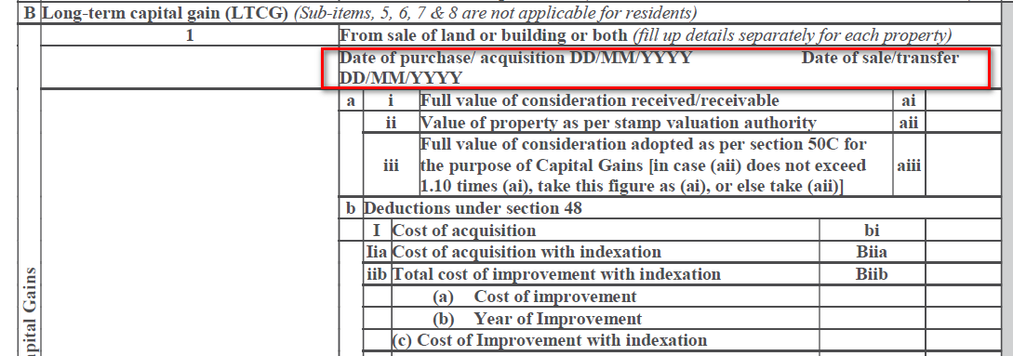
For ITR 2, 3, 5 & 6
Notes:
If there is any income arising from the transfer of land or building is taxable under the head of ‘Capital Gains’. It will be mandatory to furnish the date of purchase and date of sale of such land or building in the ITR.
This additional disclosure would enable the taxman to verify the eligibility of the assessee to claim of exemption under Section 54, 54EC and 54F of the Income-tax Act, 1961 (‘the Act’).

Slide 13
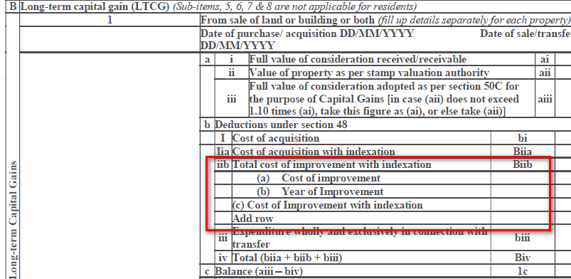
Year-wise details of the cost of improvement to land/building

Slide 14
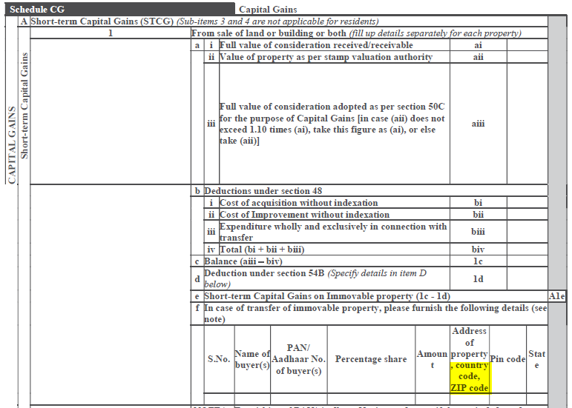

Slide 15
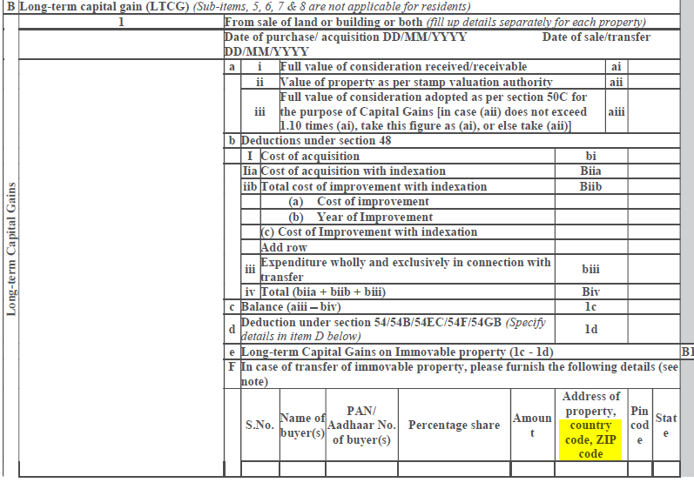

Slide 16
AY 2021-22
Short Term Capital Gain from Slump Sale
AY 2022-23
Notes:
F Act 2021 has amended Sec. 50B to provide that in case of a slump sale, the FMV of undertaking or division transferred shall be deemed as the FVC received or accruing as a result of the transfer of such capital asset. The CBDT was empowered to prescribe the method for determining the FMV of such undertaking or division.
In exercise of such power, CBDT has inserted a new Rule 11UAE. It provides that the higher of the following on the date of slump sale shall be deemed as Full value of consideration:
(a) FMV of the capital assets transferred by way of slump sale; or
(b) FMV of the consideration received or accruing due to transfer by way of slump sale.
The new ITR forms require reporting of the FMVs calculated as per Rule 11UAE.

Slide 17
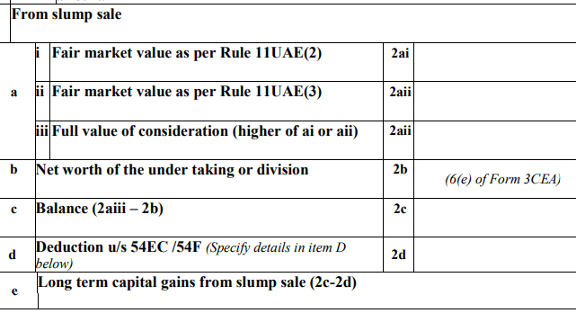
Long Term Capital Gain from Slump Sale
AY 2021-22
AY 2022-23

Slide 18
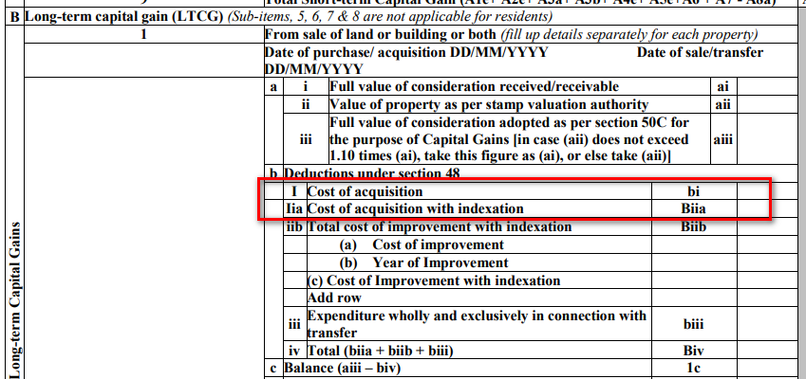
AY 2021-22
AY 2021-22

Slide 19
'Income on receipt of capital asset or stock in trade by specified person from specified entity'
Section - 9B - Inserted
Section - 45(4) – Substituted
Section - 48(iii) – Inserted
Rule 8AB - Inserted
Circular No. 14 of 2021 Dated 02.07.2021
Form 5C
Applicable in case of ITR 5

Slide 20
9B. Income on receipt of capital asset or stock in trade by specified person from specified entity.
Where a specified person receives during the previous year any capital asset or stock in trade or both from a specified entity in connection with the dissolution or reconstitution of such specified entity, then the specified entity shall be deemed to have transferred such capital asset or stock in trade or both, as the case may be, to the specified person in the year in which such capital asset or stock in trade or both are received by the specified person.
(2) Any profits and gains arising from such deemed transfer of capital asset or stock in trade or both, as the case may be, by the specified entity shall be—
(i) deemed to be the income of such specified entity of the previous year in which such capital asset or stock in trade or both were received by the specified person; and
(ii) chargeable to income-tax as income of such specified entity under the head "Profits and gains of business or profession" or under the head "Capital gains", in accordance with the provisions of this Act.

Slide 21
(i) "reconstitution of the specified entity" means, where— (a) one or more of its partners or members, as the case may be, of such specified entity ceases to be partners or members; or (b) one or more new partners or members, as the case may be, are admitted in such specified entity in such circumstances that one or more of the persons who were partners or members, as the case may be, of the specified entity, before the change, continue as partner or partners or member or members after the change; or (c) all the partners or members, as the case may be, of such specified entity continue with a change in their respective share or in the shares of some of them; (ii) "specified entity" means a firm or other association of persons or body of individuals (not being a company or a co-operative society); (iii) "specified person" means a person, who is a partner of a firm or member of other association of persons or body of individuals (not being a company or a co-operative society) in any previous year. ]

Slide 22
45(4) upto 01.04.2021
Profits or gains arising from transfer of a capital asset by way of distribution of capital assets on the dissolution of a firm or other AOP or BOI (not being a company or a co-operative society) or otherwise, shall be chargeable to tax as the income of the firm, association or body,
of the previous year in which the said transfer takes place and,
for the purposes of section 48, the FMV of the asset on the date of such transfer shall be deemed to be the FVC received or accruing as a result of the transfer.
Notes:
45 Capital gains
48 Mode of computation.

Slide 23
45(4) w.e.f. 01.04.2021
Notwithstanding anything contained in sub-section (1), where a specified person receives during the previous year any money or capital asset or both from a specified entity in connection with the reconstitution of such specified entity, then any profits or gains arising from such receipt by the specified person shall be chargeable to income-tax as income of such specified entity under the head "Capital gains" and shall be deemed to be the income of such specified entity of the previous year in which such money or capital asset or both were received by the specified person, and notwithstanding anything to the contrary contained in this Act, such profits or gains shall be determined in accordance with the following formula, namely:—

Slide 24
A = B + C - D
Where,
A = income chargeable to income-tax under this subsection as income of the specified entity under the head "Capital gains";
B = value of any money received by the specified person from the specified entity on the date of such receipt;
C = the amount of fair market value of the capital asset received by the specified person from the specified entity on the date of such receipt; and
D = the amount of balance in the capital account (represented in any manner) of the specified person in the books of account of the specified entity at the time of its reconstitution

Slide 25
Mode of computation.
48. The income chargeable under the head "Capital gains" shall be computed, by deducting from the full value of the consideration received or accruing as a result of the transfer of the capital asset the following amounts, namely :—
(i) expenditure incurred wholly and exclusively in connection with such transfer;
(ii) the cost of acquisition of the asset and the cost of any improvement thereto;
(inserted wef 01.04.2021)
(iii) in case of value of any money or capital asset received by a specified person from a specified entity referred to in subsection (4) of section 45, the amount chargeable to income-tax as income of such specified entity under that sub-section which is attributable to the capital asset being transferred by the specified entity, calculated in the prescribed manner:

Slide 26
AY 2021-22

Slide 27
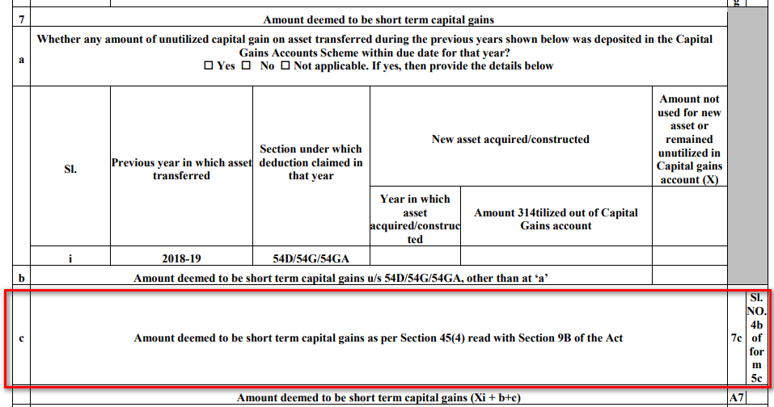
AY 2022-23

Slide 28
AY 2021-22

Slide 29
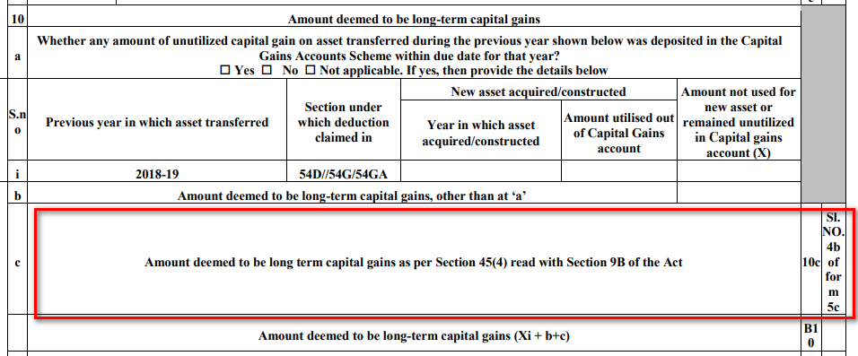
AY 2022-23

Slide 30
9B
45(4)
specified person receives capital asset / stock in trade from a specified entity
in connection with the dissolution or reconstitution of such specified entity
then it shall be deemed that specified entity have transferred capital asset / stock in trade to specified person - deemed transfer - in the year in which capital asset / stock in trade are received by specified person
specified person receives money or capital asset from a specified entity
in connection with reconstitution of such specified entity

Slide 31
9B
45(4)
profits and gains arising from such deemed transfer is deemed to be the income of such specified entity of the previous year in which such capital asset or stock in trade were received by the specified person. Further, it is chargeable to income-tax as income of such specified entity under the head " Profits and gains of business or profession" or under the head "Capital gains".
profits or gains arising from receipt of such receipt by the specified person shall be chargeable to income-tax as income of the specified entity under the head "Capital gains“
this income shall be income of specified entity of the previous year in which such money or capital asset were received by the specified person

Slide 32
9B
45(4)
FMV of capital asset / stock in trade on the date of its receipt by the specified person, shall be deemed to be FVC received or accruing as a result of such deemed transfer.

Slide 33
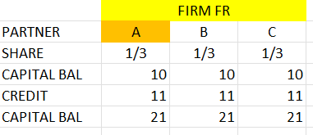
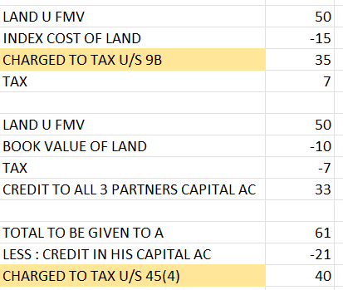
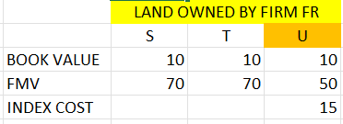
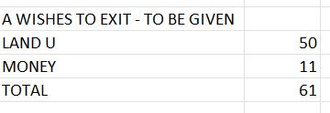

Slide 34
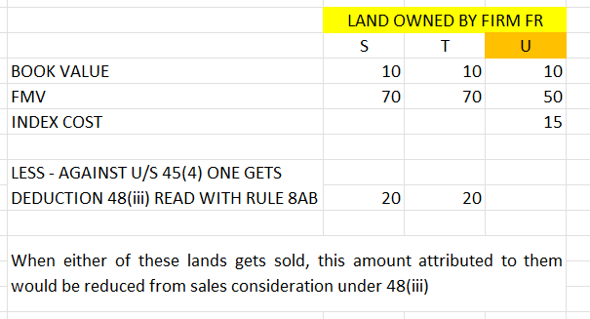

Slide 35
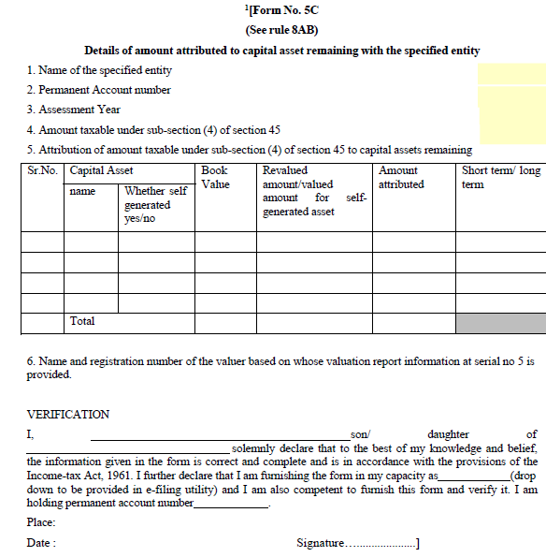

Slide 36
Deemed Dividend S. (2(22)(e)
AY 2021-22
AY 2022-23
Notes:
(e) any payment by a company, not being a company in which the public are substantially interested, of any sum (whether as representing a part of the assets of the company or otherwise) made after the 31st day of May, 1987, by way of advance or loan to a shareholder, being a person who is the beneficial owner of shares (not being shares entitled to a fixed rate of dividend whether with or without a right to participate in profits) holding not less than ten per cent of the voting power, or to any concern in which such shareholder is a member or a partner and in which he has a substantial interest (hereafter in this clause referred to as the said concern) or any payment by any such company on behalf, or for the individual benefit, of any such shareholder, to the extent to which the company in either case possesses accumulated profits ;

Slide 37
Significant Economic Presence
Notes:
Explanation 2A to Section 9(1)(i) provides that 'Significant Economic Presence' (SEP) of a non-resident in India shall constitute a business connection in India.

Slide 38
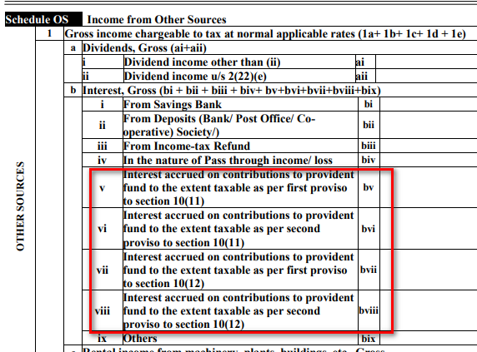
Interest accrued on Provident Fund
Notes:
ITR 2 & 3 The Finance Act 2021 has amended Sections 10(11) and 10(12) to provide that no exemption shall be allowed in respect of interest income accrued during the previous year in the recognised and statutory provident fund to the extent it relates to the amount or the aggregate of amounts of the contribution made by the employee exceeding Rs. 2,50,000 in any previous year on or after 01-04-2021.
The interest income accruing in respect of the employee's contribution over Rs. 2,50,000 shall be taxable under the head of “income from other sources”. However, if such person has contributed to a fund in which there is no contribution by the employer, the limit of Rs. 2,50,000 shall be increased to Rs. 5,00,000. The method for the computation of such interest income has been prescribed in Rule 9D.

Slide 39
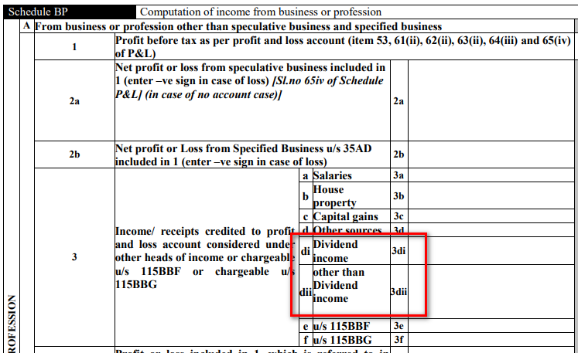
Exclusion of Dividend from Schedule BP
Notes:
ITR 3, 5 & 6
The new ITR Forms add “dividend” in the list to exclude it from the Schedule BP if it is credited to the Profit and Loss account.

Slide 40
AY 2021-22
AY 2022-23
Notes:
Search, requisition – assessment
New Tax Regime
Removal of reference of Section 153A and 153C for the return filed in response to a notice
[ITRs 1 to 6]
Background
As per the old provisions, where the search is initiated under Section 132 or books of account, other documents, or any assets are requisitioned under Section 132A, an assessment was made in the case of the assessee, or any other person, under Sections 153A, and 153C. The Finance Act, 2021 had introduced a sun-set clause and accordingly, the provisions of Section 153A/153C were made inapplicable from 01-04-2021.
Where the search is initiated or requisition is made on or after 01-04-2021, the assessments, reassessments or re-computation is made under Section 147, and the notice for the same is issued under Section 148. Hence, the assessee shall now file his return in such cases in response to notice under section 148 in new ITR forms.
Change in New ITR Form
The new ITR Forms remove the check-boxes of Sections 153A and 153C from the field of filing status of return income.
Disclosure for alternative tax regime opted under Section 115BAC
[ITR 3 & 4]
The following disclosures are required in ITR 3 and ITR 4 in respect of the alternative tax regime of Section 115BAC:
(a) Whether the assessee has opted for an alternative tax regime under Section 115BAC and filed Form 10-IE in AY 2021-22;
(b) For the AY 2022-23, the assessee has to choose from the following options:
• Opting in now
• Not opting
• Continue to opt
• Opt out

Slide 41
Alternative Tax Regime – Firms – ITR 5
AY 2021-22
AY 2022-23

Slide 42
Alternative Tax Regime – Companies – ITR 6
AY 2021-22
AY 2022-23

Slide 43
AY 2021-22 ITR 3, 5 & 6
Notes:
Additional information sought from the assessee not opting for the presumptive tax scheme
The audit under Section 44AB is mandatory if the total sales, turnover or gross receipt from the business during the previous year exceeds Rs. 1 crore. However, if the cash receipt and cash payment do not exceed 5%, the audit shall be mandatory if the turnover of the business assessee exceeds Rs. 10 crores during the financial year. For the purpose of computing the limit of 5%, payment or receipt by cheque drawn on a bank or by a bank draft, which is not an account payee, shall be deemed to be the payment or receipt in cash only. The old ITR Forms required the assessee to furnish the response regarding cash receipts and payments only, and it did not consider the receipt or payment through non-account payee cheque or DD.

Slide 44
AY 2021-23 ITR 3, 5 & 6
Notes:
Additional information sought from the assessee not opting for the presumptive tax scheme
The audit under Section 44AB is mandatory if the total sales, turnover or gross receipt from the business during the previous year exceeds Rs. 1 crore. However, if the cash receipt and cash payment do not exceed 5%, the audit shall be mandatory if the turnover of the business assessee exceeds Rs. 10 crores during the financial year. For the purpose of computing the limit of 5%, payment or receipt by cheque drawn on a bank or by a bank draft, which is not an account payee, shall be deemed to be the payment or receipt in cash only. The old ITR Forms required the assessee to furnish the response regarding cash receipts and payments only, and it did not consider the receipt or payment through non-account payee cheque or DD.

Slide 45
ITR - 6 - New Schedule IF - Investment made in unincorporated entity

Slide 46
Residential Status
AY 2021-22 ITR 2 & 3

Slide 47
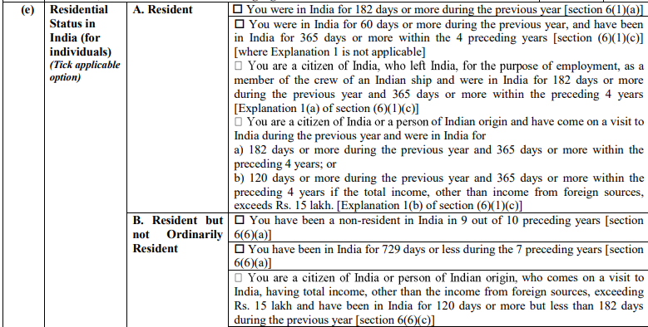
Residential Status
AY 2022-23 ITR 2 & 3

Slide 48
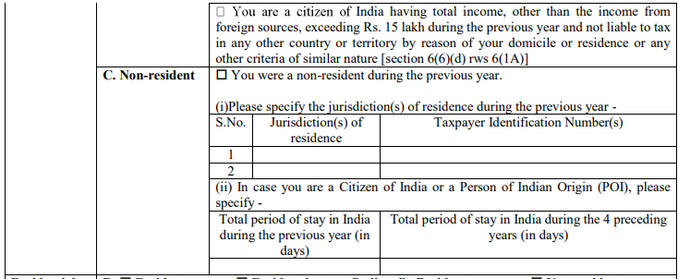
Residential Status
AY 2022-23 ITR 2 & 3

Slide 49
Rectification - case study

Slide 50
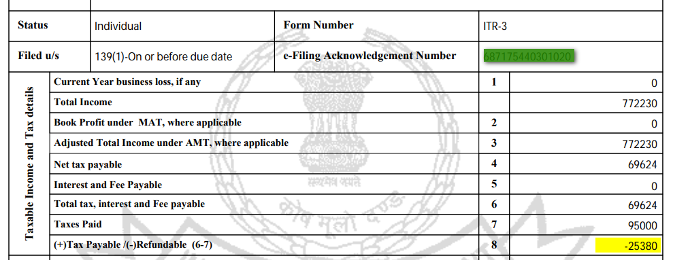

Slide 52
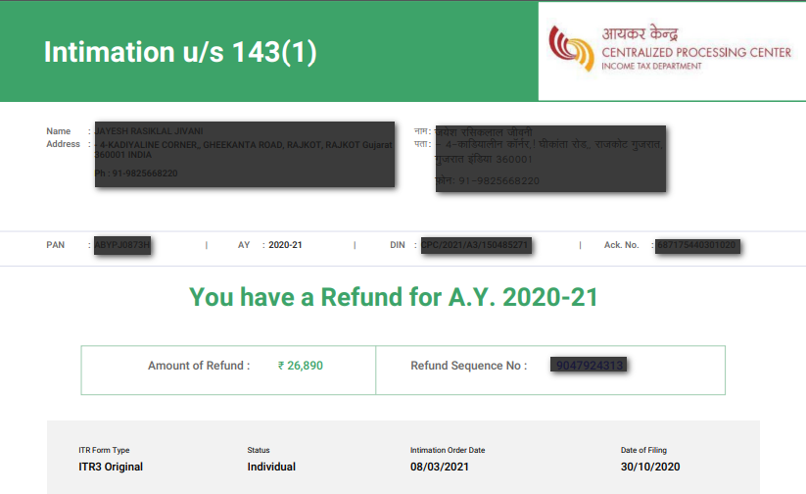

Slide 53
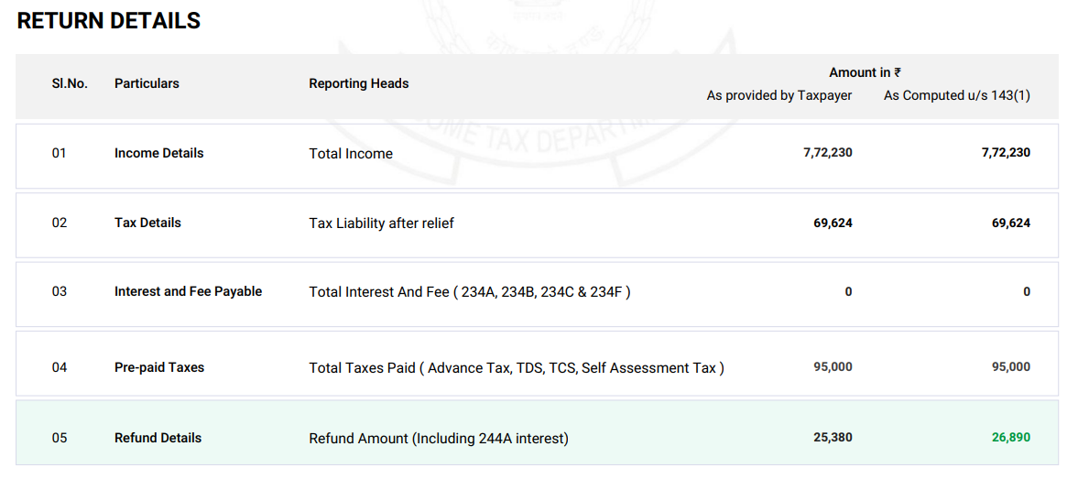

Slide 54
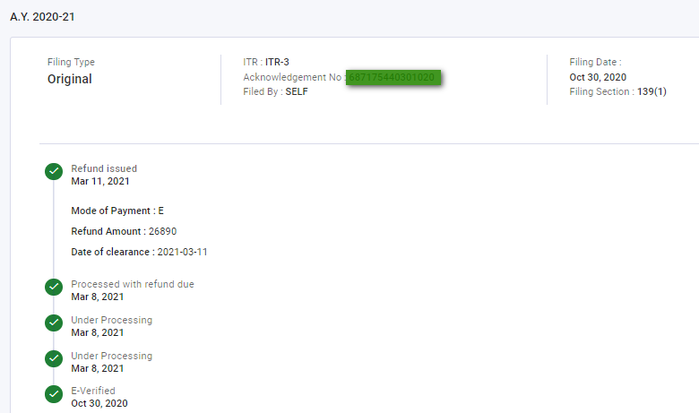

Slide 55
On 02-12-2021 client reports that for AY 2020-21
 | As shown in the ROI | Actual scenario
Tax Payable | ₹ 69624/- | ₹ 69624/-
Advance Tax | ₹ 50000/- | ₹ 70000/-
TDS | ₹ 45000/- | ₹ 60000/-
Total prepaid taxes | ₹ 95000/- | ₹ 130000/-
Refund Due | ₹ 25376/- | ₹ 60376/-
Refund was short by ₹ 35000/-

Slide 56
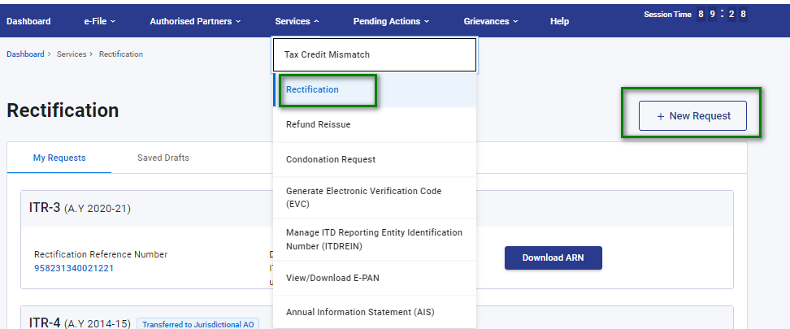

Slide 57
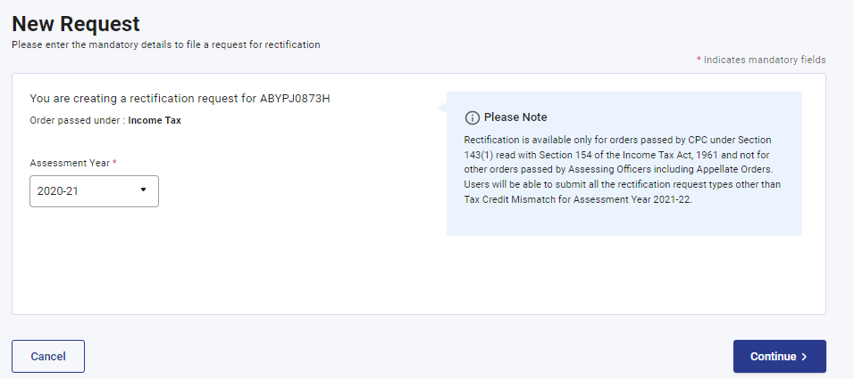

Slide 58
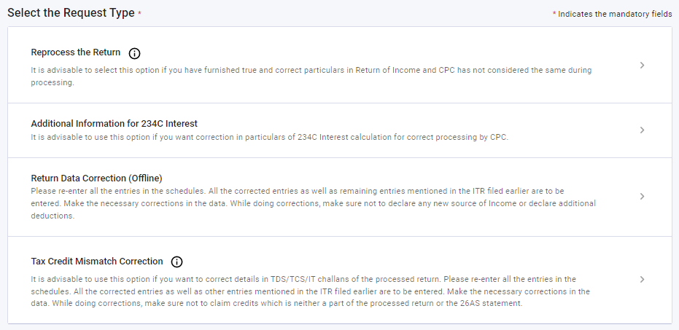

Slide 59
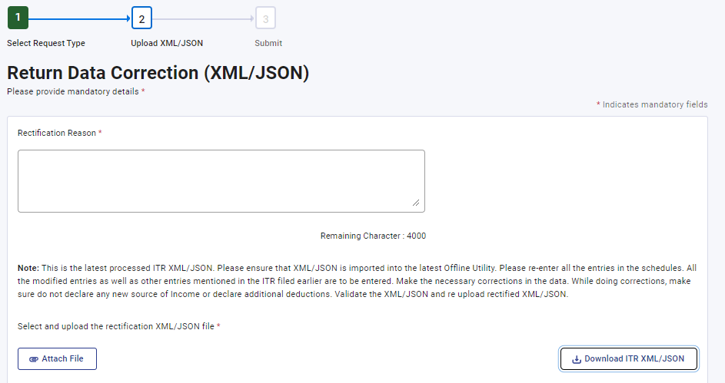

Slide 61
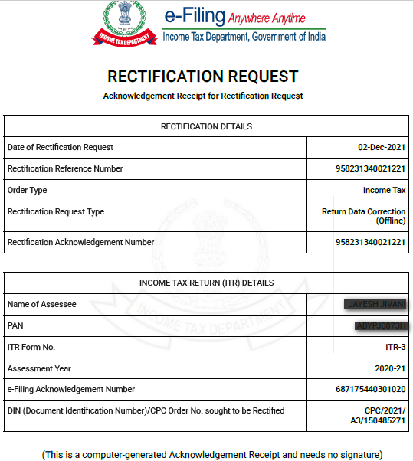

Slide 62
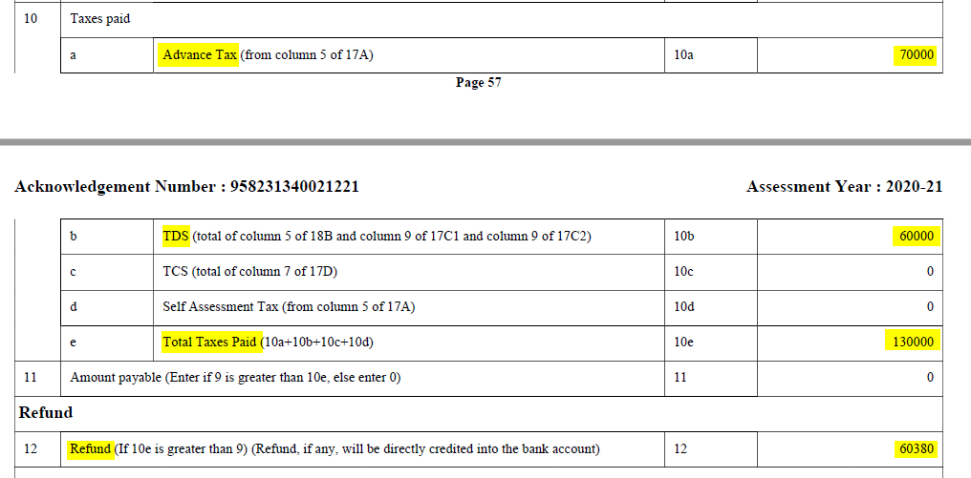

Slide 63
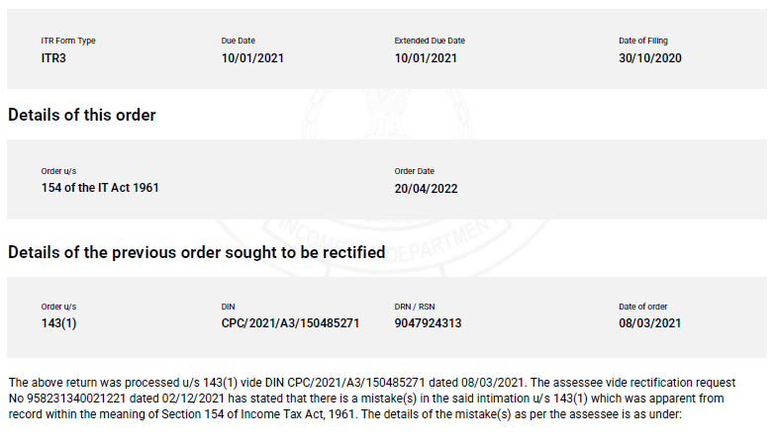

Slide 64
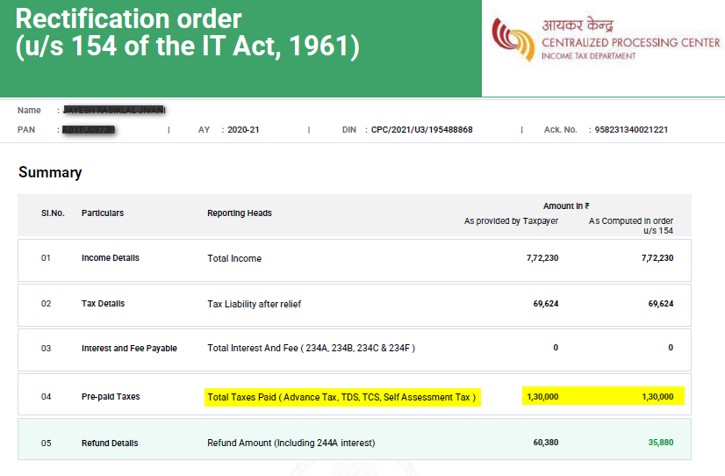

Slide 65
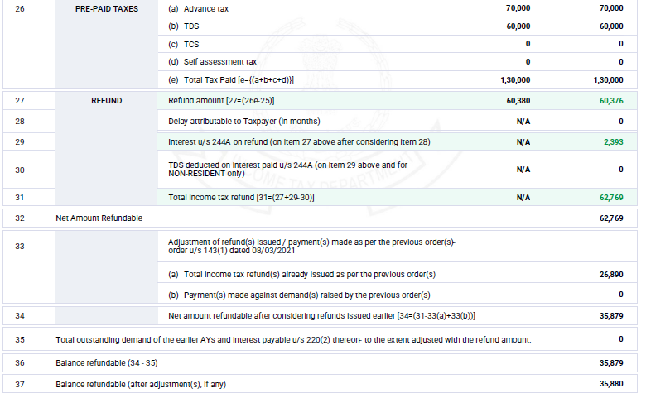

Slide 66
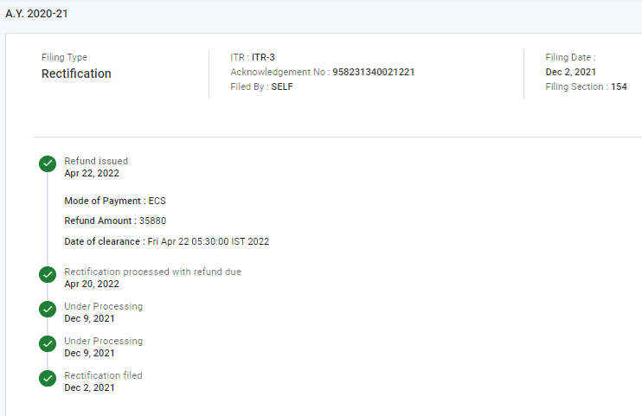

Slide 67
Updated Return

Slide 68
Section 139(8A)
“(8A) Any person, whether or not he has furnished a return
Under sub-section (1) or sub-section (4) or sub-section (5), for an assessment year (herein referred to as the relevant assessment year),
may furnish an updated return of his income or the income of any other person in respect of which he is assessable under this Act,
for the previous year relevant to such assessment year, in the prescribed form, verified in such manner and setting forth such particulars as may be prescribed, at any time within twenty-four months from the end of the relevant assessment year:
Notes:
Updated return for AY 2022-23 can be filed on or before 31.03.2025
139(4A) not covered ?

Slide 69
Provided that the provision of this sub-section shall not apply, if the updated return,—
(a) is a return of a loss; or
(b) has the effect of decreasing the total tax liability determined on the basis of return furnished under sub-section (1) or sub-section (4) or sub-section (5); or
(c) results in refund or increases the refund due on the basis of return furnished under sub-section (1) or sub-section (4) or sub-section (5),
of such person under this Act for the relevant assessment year:

Slide 70
Provided further that a person shall not be eligible to furnish an updated return under this sub-section, where—
(a) a search has been initiated under section 132 or books of account or other documents or any assets are requisitioned under section 132A in the case of such person; or
(b) a survey has been conducted under section 133A, other than sub-section (2A) of that section, in the case such person; or
(c) a notice has been issued to the effect that any money, bullion, jewellery or valuable article or thing, seized or requisitioned under section 132 or section 132A in the case of any other person belongs to such person; or
(d) a notice has been issued to the effect that any books of account or documents, seized or requisitioned under section 132 or section 132A in the case of any other person, pertain or pertains to, or any other information contained therein, relate to, such person,
Notes:
TDS survey is not considered. It is excluded.

Slide 71
for the assessment year relevant to the previous year in which such search is initiated or survey is conducted or requisition is made and any assessment year preceding such assessment year:

Slide 72
Provided also that no updated return shall be furnished by any person for the relevant assessment year, where—
an updated return has been furnished by him under this sub-section for the relevant assessment year; or
any proceeding for assessment or reassessment or recomputation or revision of income under this Act is pending or has been completed for the relevant assessment year in his case; or

Slide 73
(c) the Assessing Officer has information in respect of such person for the relevant assessment year in his possession under the Smugglers and Foreign Exchange Manipulators (Forfeiture of Property) Act, 1976 or the Prohibition of Benami Property Transactions Act, 1988 or the Prevention of Money-laundering Act, 2002 or the Black Money (Undisclosed Foreign Income and Assets) and Imposition of Tax Act, 2015 and the same has been communicated to him, prior to the date of furnishing of return under this sub-section; or

Slide 74
(d) information for the relevant assessment year has been received under an agreement referred to in section 90 or section 90A in respect of such person and the same has been communicated to him, prior to the date of furnishing of return under this sub-section; or
(e) any prosecution proceedings under the Chapter XXII have been initiated for the relevant assessment year in respect of such person, prior to the date of furnishing of return under this sub-section; or
(f) he is such person or belongs to such class of persons, as may be notified by the Board in this regard:

Slide 75
Provided also that if any person has sustained a loss in any previous year and has furnished a return of loss in the prescribed from within the time allowed under sub-section (1) and verified in the prescribed manner and containing such other particulars as may be prescribed, he shall be allowed to furnish an updated return where such updated return is a return of income:
Notes:
10 l loss to 2 lac lokk – not allowed
10 l loss to 10000 profit – updated return allowed

Slide 76
Provided also that if the loss or any part thereof carried forward under Chapter VI or unabsorbed depreciation carried forward under sub-section (2) of section 32 or tax credit carried forward under section 115JAA or under section 115JD is to be reduced for any subsequent previous year as a result of furnishing of return of income under this sub-section for a previous year, an updated return shall be furnished for each such subsequent previous year.”;
Notes:
Revised subsequent year return
You can file update return for revised retturn

Slide 77
Updated return to be accompanied by proof of payment of tax and additional income tax
in sub-section (9), in the Explanation, after clause (c), the following clause shall be inserted, namely:—
“(ca) the return is accompanied by the proof of payment of tax as required under section 140B, if the return of income is a return furnished under sub-section (8A);”.

Slide 78
After section 140A of the Income-tax Act, the following section shall be inserted, namely:—
140B. (1) Where no return of income under sub-section (1) or sub-section (4) of section 139 has been furnished by an assessee and tax is payable, on the basis of return to be furnished by such assessee under sub-section (8A) of section 139, after taking into account,—
(i) the amount of tax, if any, already paid as advance tax;
(ii) any tax deducted or collected at source;
(iii) any relief of tax claimed under section 89;
(iv) any relief of tax or deduction of tax claimed under section 90 or section 91 on account of tax paid in a country outside India;
(v) any relief of tax claimed under section 90A on account of tax paid in any specified territory outside India referred to in that section; and
(vi) any tax credit claimed to be set off in accordance with the provisions of section 115JAA or section 115JD,

Slide 79
the assessee shall be liable to pay such tax together with interest and fee payable under any of the provisions of this Act for any delay in furnishing the return or any default or delay in payment of advance tax, along with the payment of additional income-tax computed in accordance with sub-section (3), before furnishing the return and the return shall be accompanied by proof of payment of such tax, additional income-tax, interest and fee.

Slide 80
(2) Where, return of income under sub-section (1) or sub-section (4) or sub-section (5) of section 139 (referred to as earlier return) has been furnished by an assessee and tax is payable on the basis of return to be furnished by such assessee under sub-section (8A) of section 139,—
(a) after taking into account,—
(i) the amount of relief or tax referred to in sub-section (1) of section 140A, the credit for which has been taken in the earlier return;
(ii) tax deducted or collected at source, in accordance with the provisions of Chapter XVII-B, on any income which is subject to such deduction or collection and which is taken into account in computing total income and which has not been included in the earlier return;
(iii) any relief of tax or deduction of tax claimed under section 90 or section 91 on account of tax paid in a country outside India on such income which has not been included in the earlier return;
(iv) any relief of tax claimed under section 90A on account of tax paid in any specified territory outside India referred to in that section on such income which has not been included in the earlier return;
(v) any tax credit claimed, to be set off in accordance with the provisions of section 115JAA or section 115JD,which has not been claimed in the earlier return; and
(b) as increased by the amount of refund, if any, issued in respect of such earlier return,

Slide 81
the assessee shall be liable to pay such tax together with interest payable under any provision of this Act for any default or delay in payment of advance tax along with the payment of additional income-tax, as computed in accordance with sub-section (3), as reduced by the amount of interest paid under the provisions of this Act in the earlier return, before furnishing the return and the return shall be accompanied by proof of payment of such tax, additional income-tax, interest and fee.
Notes:
Fee U/S 234F

Slide 82
(3) For the purposes of sub-sections (1) and (2), the additional income-tax payable at the time of furnishing the return under sub-section (8A) of section 139 shall be equal to,—
(i) twenty-five per cent. of aggregate of tax and interest payable, as determined in sub-section (1) or sub-section (2), as the case may be, if such return is furnished after expiry of the time available under sub-section (4) or sub-section (5) of section 139 and before completion of the period of twelve months from the end of the relevant assessment year; or
(ii) fifty per cent. of aggregate of tax and interest payable, as determined in sub-section (1) or sub-section (2), as the case may be, if such return is furnished after the expiry of twelve months from the end of the relevant assessment year but before completion of the period of twenty-four months from the end of the relevant assessment year.
Explanation.—For the purposes of computation of “additional income-tax”, tax shall include surcharge and cess, by whatever name called, on such tax.

Slide 83
139(8A) and 80AC
80AC. Where in computing the total income of an assessee of any previous year relevant to the assessment year commencing on or after—
(i) the 1st day of April, 2006 but before the 1st day of April, 2018, any deduction is admissible under section 80-IA or section 80-IAB or section 80-IB or section 80-IC or section 80-ID or section 80-IE;
(ii) the 1st day of April, 2018, any deduction is admissible under any provision of this Chapter under the heading "C.—Deductions in respect of certain incomes",
no such deduction shall be allowed to him unless he furnishes a return of his income for such assessment year on or before the due date specified under sub-section (1) of section 139.

Slide 84
Part C. – Deductions in respect of certain incomes
Section 80H Deduction in case of new industrial undertakings employing displaced persons, etc.
Section 80HH Deduction in respect of profits and gains from newly established industrial undertakings or hotel business in backward areas
Section 80HHA Deduction in respect of profits and gains from newly established small-scale industrial undertakings in certain areas
Section 80HHB Deduction in respect of profits and gains from projects outside India
Section 80HHBA Deduction in respect of profits and gains from housing projects in certain cases
Section 80HHC Deduction in respect of profits retained for export business
Section 80HHD Deduction in respect of earnings in convertible foreign exchange
Section 80HHE Deduction in respect of profits from export of computer software, etc.
Section 80HHF Deduction in respect of profits and gains from export or transfer of film software, etc.
Section 80I Deduction in respect of profits and gains from industrial undertakings after a certain date, etc.
Section 80IA Deductions in respect of profits and gains from industrial undertakings or enterprises engaged in infrastructure development, etc.

Slide 85
Section 80IAB Deductions in respect of profits and gains by an undertaking or enterprise engaged in development of Special Economic Zone
Section 80IAC Special provision in respect of specified business.
Section 80IB Deduction in respect of profits and gains from certain industrial undertakings other than infrastructure development undertakings
Section 80IBA Deductions in respect of profits and gains from housing projects.
Section 80IC Special provisions in respect of certain undertakings or enterprises in certain special category States
Section 80ID Deduction in respect of profits and gains from business of hotels and convention centres in specified area
Section 80IE Special provisions in respect of certain undertakings in North-Eastern States
Section 80JJA Deduction in respect of profits and gains from business of collecting and processing of bio-degradable waste
Section 80JJAA Deduction in respect of employment of new employees
Section 80LA Deductions in respect of certain incomes of Offshore Banking Units and International Financial Services Centre
Section 80O Deduction in respect of royalties, etc., from certain foreign enterprises

Slide 86
Section 80P Deduction in respect of income of co-operative societies
Section 80Q Deduction in respect of profits and gains from the business of publication of books
Section 80QQA Deduction in respect of professional income of authors of text books in Indian languages
Section 80QQB Deduction in respect of royalty income, etc., of authors of certain books other than text-books
Section 80R Deduction in respect of remuneration from certain foreign sources in the case of professors, teachers, etc.
Section 80RR Deduction in respect of professional income from foreign sources in certain cases
Section 80RRA Deduction in respect of remuneration received for services rendered outside India
Section 80RRB Deduction in respect of royalty on patents

Slide 87
NOTIFICATION NO. 48/2022 DATED 29-4-2022
Rule 12AC. Updated return of income.-
(1) The return of income to be furnished by any person, eligible to file such return under the sub-section (8A) of section 139, relating to the assessment year commencing on the 1st day of April, 2020 and subsequent assessment years, shall be in the Form ITR-U and be verified in the manner indicated therein.

Slide 88
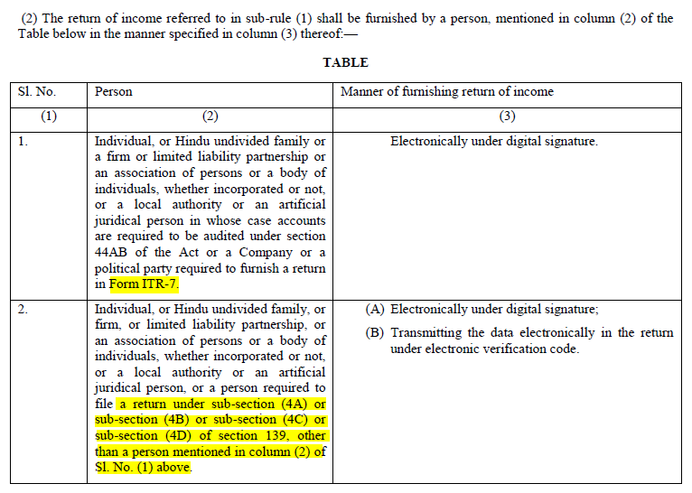

Slide 89
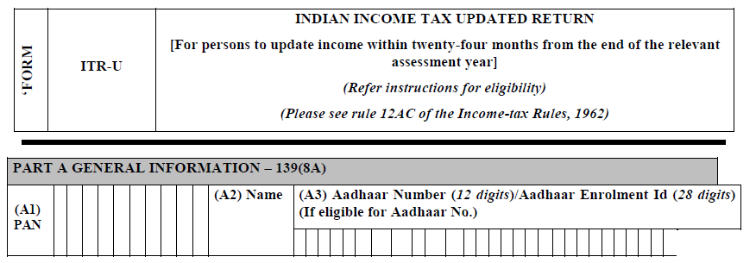

Slide 90
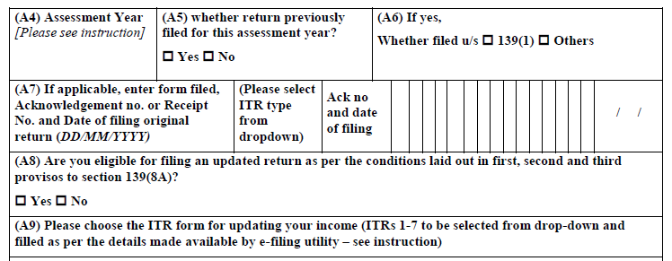

Slide 91
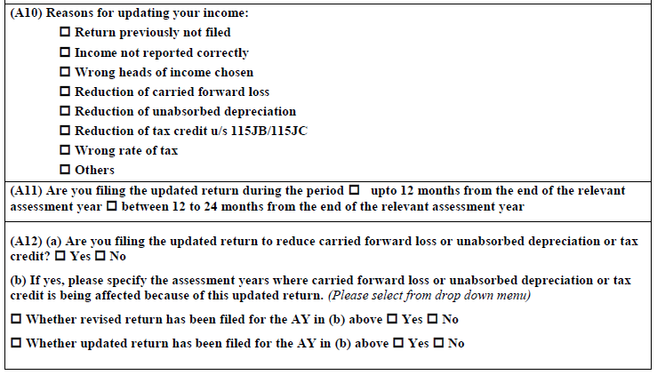

Slide 92
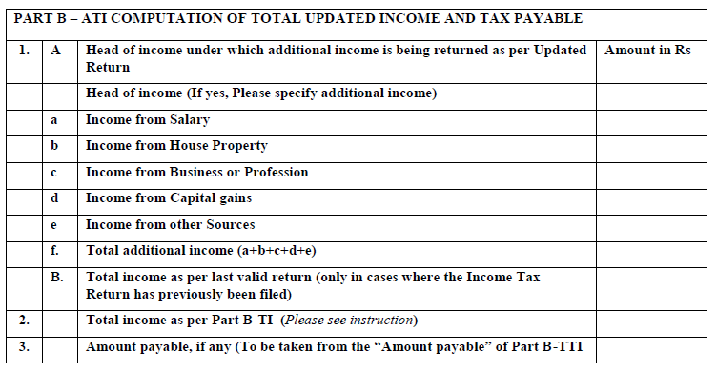

Slide 93
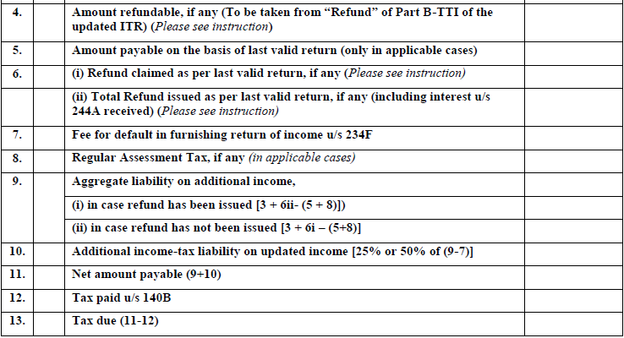

Slide 94
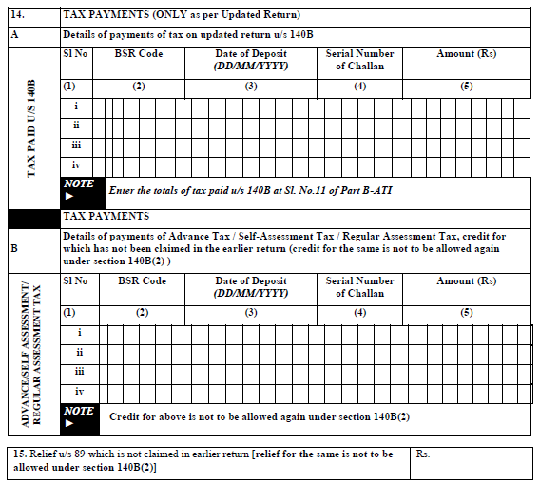

Slide 96
Thank you

Slide 98
Books of accounts to be maintained

Slide 99
Specified violations

Slide 100
13(10)

Slide 101
115BBI – Specified Income

