Slide 1
RTI - Law and Practise Case Study
CA Mahadev Birla
+91 97123 78191
md.birla@gmail.com
Adv. (CA.) Nipun Singhvi
+91 98290 31411
nipunsinghvi@yahoo.com

Slide 2
RTI Act,2005
Information is the oxygen
that any citizen needs
to live in the social structure of the society
and maintain its
democratic balance

Slide 3
What is RTI
Right to Information is a Statutory Right
Available to Citizen of India
Part of Constitutional Right under Article 19(1) i.e. fundamental rights of the Constitution.
Available to everyone
Article 19 (1) says that every citizen has freedom of speech and expression.

Slide 4
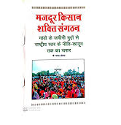
History and Development
First grassroots campaign for the introduction of RTI started by Mazdoor Kisan Shakti Sangathan (MKSS) in 1994.-
Demand of Information related to development work in rural Rajasthan.
MKSS had formulated a specific demand for copies of financial records of expenditure incurred in the local government institutions including Panchayats.
National Campaign for People’s Right to Information (NCPRI) was formed in 1996 following the 40 day long historic sit-in strike in Beawar.
Between 1994-1998 Rajasthan Govt Resisted RTI Act
The opposition party adopted MKSS Program
The opposition Congress party promised a RTI legislation in the State in its election manifesto in 1998.

Slide 5
History and Development
In 1998, Chief minister, Ashok Gehlot, appointed a committee of bureaucrats to draft a RTI bill
MKSS and the NCPRI raised objections as no citizens’ representative was included the committee
State government and the committee invited MKSS and NCPRI to assist to prepare the draft bill
The MKSS and NCPRI held public consultations in each divisional headquarters of Rajasthan and formulated a draft bill.
The government committee drew heavily from the citizens’ draft for its recommendations even though they shied away from accepting the citizens’ draft in toto.
The Rajasthan Act, as it was finally adopted, retained many of the suggestions of the RTI movement, but diluted others.
Apart from the Act, Rajasthan also has Right to Information provisions in the Rules of its Panchayati Raj Act.

Slide 6
History & Development
Tamil Nadu became first Indian state to pass RTI law in 1997
In 1997 Govt refer the draft bill to committee headed by the HD Shoure and Shoure Committee submitted its report.
After five year Centre enacted Freedom of Information (FOI) Act, 2002
Which Could not be implemented
Bill for current RTI Act passed on recommendations of National Advisory Council (NAC) in May 2005, and became fully operational on October 12, 2005

Slide 7
Object of RTI Act, 2005
Setting Practical Regime of RTI for citizens
Promote Transparency and Accountability
To secure access to information which is under control of Public Authorities
Constitution of a Central/State Information Commission

Slide 8
Information
Section 2(f) "information" means any material in any form, including records, documents, memos, e-mails, opinions, advices, press releases, circulars, orders, logbooks, contracts, reports, papers, samples, models, data material held in any electronic form and information relating to any private body which can be accessed by a public authority under any other law for the time being in force;

Slide 9
Information
The appellant sought information regarding the widening of National Highway 10 (NH10), including the names of Chief Engineer and others who were involved in the widening of the road. He also sought enquiry reports prepared by various research laboratories to which the Engineers India Limited (EIL) had sent the construction material. The Public information Officer (PIO) gave a point wise reply to the queries asked by the appellant. The appellant alleged that sub-standard material was used in constructing the road and so he had asked for a sample of the road for core testing. During the hearing, the respondent pointed out that there was no sample left and they were willing to provide a small sample from a portion of the road on payment of Rs.7,500/. The appellant expressed his willingness to pay for the sample.
The Central Information Commission (CIC) directed the PIO provide a realistic estimate (indicating the complete breakup) of money to the appellant that needs to be deposited for obtaining the sample. The Commission also asked the PIO to allow the appellant to inspect the records relating to the construction of road and to provide him with attested copies of documents sought by him.
Citation: Shri Deepak Yadav v. Public Works Department in File No. CIC/AD/A/2012/000740

Slide 10
Information
"information" Which is recorded and stored and disseminated by the Public authority.
News is not information
Information which is otherwise open and available are not information.
E.g. Information about the railway or airway timing.
Information may be of facts or law, it may come from external source or even from material already on record.
An advice or opinion sough by the public authority from an outside agency and which is part of record . A citizen can not solicit the opinion from PIO.
Future Course of action is not information.

Slide 11
Information
“EVM” information or not ? Delhi HC Says “NO”
Hon’ble SC:- Civil Appeal No.6454 of 2011, arising out of SLP[C] No.7526/2009 in the case of Central Board of Secondary Education & Anr. Vs Ajitya Bandopadhyay & Ors
The RTI Act provides access to all information that is available and existing. This is clear from a combined reading of section 3 and the definitions of `information’ and `right to information’ under clauses (f) and (j) of section 2 of the Act.
If a public authority has any information in the form of data or analyzed data, or abstracts, or statistics, an applicant may access such information, subject to the exemptions in section 8 of the Act. But where the information sought is not a part of the record of a public authority, and where such information is not required to be maintained under any law or the rules or regulations of the public authority, the Act does not cast an obligation upon the public authority, to collect or collate such non- available information and then furnish it to an applicant.

Slide 12
Information
“
A public authority is also not required to furnish information which require drawing of inferences and/or making of assumptions. It is also not required to provide `advice’ or `opinion’ to an applicant, nor required to obtain and furnish any `opinion’ or `advice’ to an applicant. The reference to `opinion’ or `advice’ in the definition of `information’ in section 2(f) of the Act, only refers to such material available in the records of the public authority. Many public authorities have, as a public relation exercise, provide advice, guidance and opinion to the citizens. But that is purely voluntary and should not be confused with any obligation under the RTI Act.”
Accordingly, you can get all information, except information pertaining to section 8 & 9 of the RTI Act, from government that is available and existing.

Slide 13
Information
How to obtained “Information" of private body trough public authority subject to permission of law.
Eg.
Information of
Private Bank - RBI
School - Educational Department
Public Limited Company-ROC or SEBI
Cooperative Society -Registrar of Cooperative Societies
Trusts - Charities Commissioner

Slide 14
Information
Status of the application of the School for CISCE affiliation.
Information on losses on foreign derivative contracts by Bank
Information on the Annual inspection report
Bank-wise breakup of the mark-to-market losses
OTS Scheme
No of beds available in hospitals – oxygen & non-oxygen
No of vials available ‘Remdesivir’ – Filed and pending
Covid Deaths – Certificates issued and deaths reported by authorities

Slide 15
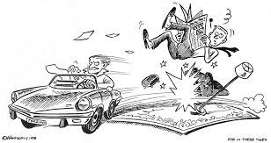
Information
An RTI query has revealed that the Maharashtra government does not have any papers on actor Salman Khan’s 2002 hit-and-run case as the files pertaining to it were gutted in a fire at Mantralaya
Information Sought
from the State Law and Judiciary department
the names and the total number of counsels, solicitors, advocates and legal advisors, public prosecutors appointed by the State government for this case.

Slide 16
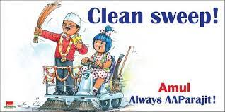
An RTI reply dated April 08 has revealed that
the Arvind Kejriwal-led Delhi government
spent Rs 150 crores
from January 2021 to March 2021
on advertisements and publicity through
various mediums
Kejriwal government has spent over 800 crores in advertisement expenses in past two years

Slide 17
Public Authority
Section 2 (h) "public authority" means any authority or body or institution of self- government established or constituted—
(a) by or under the Constitution;
(b) by any other law made by Parliament;
(c) by any other law made by State Legislature;
(d) by notification issued or order made by the appropriate Government,
and includes any—
(i) body owned, controlled or substantially financed;
(ii) non-Government organisation substantially financed,
directly or indirectly by funds provided by the appropriate Government

Slide 18
Non Government School:- Public Authority?
Substantially Financed by State Govt-Directly or indirectly → Grant in aid for payment of Teacher Salary- Yes, it is Public Authority
(Dhara Singh Girls High School Vs State of Uttar Pradesh AIR 2008 All 92)
Private Aided College:-Public Authority?
Substantially grant in aid was received from Government-
Yes, it is Public Authority
To fall under the ambit of ‘ substantially financed ’ the organization should receive a large sum of finance and it need not more than 50% . government funding even though made up for 45% of the total finances it still funded nearly 95% of the salary of the teaching staff.
DAV College Trust and Management Society Vs Director of Public Information ( CA 9828/2013 SC)

Slide 19
Universities:- Public Authority?
University is 'an authority' as defined under Section 2(c) of the Karnataka Right to Information Act, 2000 and
University is 'an authority' within the meaning of Article 12 of the Constitution.
Yes it is Public Authority
University is bound to supply information as per the Right to Information Act.
(Shivanna Naik vs Bangalore University-Karnataka High Court)
Mr. Shivanna applied for the post of teacher and his application was rejected. He sought the information under RTI seeking information regarding selection and the RTI application was rejected with the reason that there is no such provision under Bangalore University regulation.

Slide 20
Success stories
GVFL Vs Anubhav Singhi & Ors.
(Writ SCA No. 8353/2006 Judgement dated 22.05.2020)
Gujarat Venture Finance Limited challenged the order of State Information Commissioner
Its not government company as the no financial assistance is taken from State government
AOA of the CO- Managing Director of the GIIC Limited which is a Government owned company should be an ex-­officio chairman

Slide 21
GVFL Vs Anubhav Singhi & Ors.
(Writ SCA No. 8353/2006 Judgement dated 22.05.2020)
Unless a body is either owned, controlled or substantially financed by the appropriate Government, such body would not qualify as a public authority
Funding
Controlling
Constitution

Slide 22
Public Authority
Any authority or body which we consider
as Government in common parlance-
All Ministries and their departments, Municipal Bodies, Panchayats
Courts, Public Sector Undertakings- Nationalised Banks, LIC, and UTI
Establishments of the Parliament, Legislatures, Judiciary, President and the Governors

Slide 23
Act Not Applicable
Intelligence and Security organisations
1. Intelligence Bureau | 2. Research and Analysis Wing of the Cabinet Secretariat
3. Directorate of Revenue Intelligence | 4. Central Economic Intelligence Bureau
5. Directorate of Enforcement | 6. Narcotics Control Bureau
7. Aviation Research Centre | 8. Special Frontier Force
9. Border Security Force | 10. Central Reserve Police Force
11. Indo-Tibetan Border Police | 12. Central Industrial Security Force
13. National Security Guards | 14. Assam Rifles
15. Sashtra Seema Bal | 16. Directorate General of Income-tax (Investigation
17. National Technical Research Organisation | 18. Financial Intelligence Unit, India
19. Special Protection Group | 20.Defence Research and Development Organization
21. Border Road Development Board | 22. National Security Council Secretariat

Slide 24
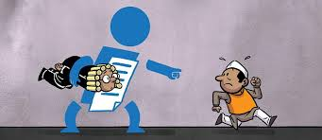
Information
Section 2(j) "right to information" means the right to information accessible under this Act which is held by or under the control of any public authority and includes the right to—
(i) inspection of work, documents, records;
(ii) taking notes, extracts or certified copies of documents or records;
(iii) taking certified samples of material;
(iv) obtaining information in the form of diskettes, floppies, tapes, video cassettes or in any
other electronic mode or through printouts where such information is stored in a computer or in any other device;

Slide 25
Drafting of RTI
Request for information
Medium : Online or offline
Language: English-Hindi-Official language of the area
Reason for RTI request- Yes or No
Fees
To Whom: Central/State Public Information Officer
What to Write: Particular of Information Sought
Transfer of Application
Help of CPIO/SPIO

Slide 26
Fees
Application Fees: Rs 10/ Rs 20
Other fees
Rs 2 per page-A3 or A4
Larger size paper:- Actual Cost
For Inspection:- First 30 Min- No Fees
After 30 Min- Rs 20 Per 30 Min
Floppy or Disc – Rs 50/-
Mode of payment-Cash/DD/Postal Order
DD in favour of :-PIO…. Department Name

Slide 27
RTI Reply
30 Days
Provide Information on payment
Or
Reject with reason
Life or liberty of person: Within 48 Hrs
No Reply
Deemed refusal
Information-Free of Charges

Slide 28
Exception from Disclosure of Information's
Information which affects :
Sovereignty and integrity of India 8(1)(a)
Security, scientific , strategic and economic interests
of the State. 8(1)(a)
Relation with foreign State 8(1)(a)
Lead to incitement of an offence 8(1)(a)
Expressly forbidden by court of law. 8(1)(b)
Parliamentary and Legislative privileges. 8(1)(c)
Commercial confidence & Trade Secrets. 8(1)(d)

Slide 29
Exception from Disclosure of Information's
Information available in fiduciary relationship 8(1)(e)
Information received in confidence from foreign
Government 8(1)(f)
Information which endanger life /physical safety 8(1)(g)
which impede the process of Investigations and prosecutions. 8(1)(h)
Cabinet matters. 8(1)(i)
Privacy of individuals 8(1)(j)

Slide 30
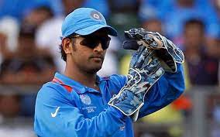
Appeal
First Appeal
Non receipt of Information
Or
Aggrieved by the decision of CPIO/SPIO
30 Days appeal time period
Second Appeal-SIC/CIC
90 Days time period
State Information Commission

Slide 31
Appeal
Order of CIC/SIC
Appeal to High Court
No provision under RTI
Appeal to Supreme Court
Remedy ?

Slide 32
Penalty
Denying information
Providing Incorrect, incomplete or
misleading information or
Destroyed information
Penalty
Rs 250 each day till information furnished
Max Rs 25000/-
Disciplinary action

Slide 33
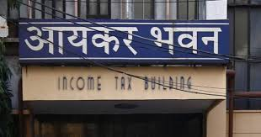
Use of RTI income Tax Act
Common issue:
Information on
*Tax Refunds
*Rectification Applications
*Income Tax Returns of third parties
*Search, Seizure, Raids
*status of tax evasion petitions

Slide 34
Drafting of RTI
Writing the RTI:- Know/Understand what is the purpose of RTI?
Can question be asked in RTI:- No
Then what?
Request !
E.g. “Why is my Income Tax Refund not being processed/released?”
“Please provide the status of my Income Tax Refund”
Single RTI for refunds pertaining to multiple assessment years- Yes
RTI to be filed by CA or assessee – assessee

Slide 35
Posers
Can CA file RTI on behalf of client?
Is “WHY” information ?
Bench constitution can be questioned
Photographs/Camera be used for taking copies
Can information be used as an Evidence

Slide 36
In Appeal No. CIC/AD/A/09/00125, the Central Information Commission has decided as below in order dated 23022009:
“The Commission invokes Section 2(j)(iv) of the RTI Act to allow use of camera by the Appellant to take photos of documents required. Accordingly, the CPIO is directed to provide all the information as requested by the Appellant in his RTI request dt. 18.8.08 and also allow the use of photographic camera for taking photographs of records in the file which the BSNL had agreed to show to the Appellant. The information to be provided within 15 days of the receipt of this Order.”

Slide 37
Drafting of RTI
Income Tax return of third parties
Income Tax Returns of third parties (i.e., any person other than self) are confidential information which are exempted from the purview of disclosure u/s. 8(1)(j) of the RTI Act.
Exceptions:
a. larger public interest’ derived from obtaining the ITRs can be proved.
b. ITR is requested as a Shareholder/Stakeholder in the Public Authority/ Private Institution
c. ITR pertains to a Political Party
d. Matters relating to ‘dowry’ have a larger public interest for the society and hence disclosure of information required for defense in alleged false dowry cases is permitted
In the matter of Shri Girish Ramchandra Deshpande vs. CIC and others (2012) 351 ITR 472 (SC) the Hon’ble Supreme Court held:
“The details disclosed by a person in his income tax returns are ‘personal information’ which stands exempted from disclosure under clause (j) of Section 8(1) of the RTI Act, unless it involves a larger public interest.

Slide 38
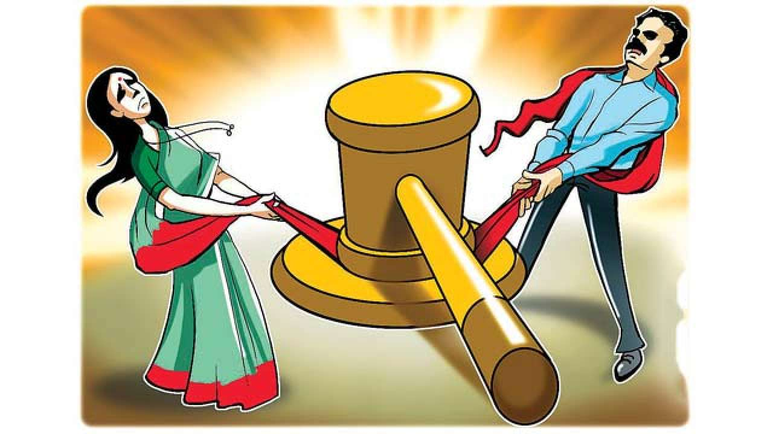
Income Tax Act
GST Act
RTI Act
Suneeta Virmani Vs CPIO, GSTN and GST dept
(CIC/DGSTI/A/2017/609398-BJ dated 19.06.2019)
Matrimonial disputes

Slide 39
GST Act and
RTI Act
Suneeta Virmani Vs CPIO, GSTN and GST dept
(CIC/DGSTI/A/2017/609398-BJ dated 19.06.2019)
Income Tax Act & RTI Act
Rahat bano Vs Income tax
(Second Appeal No. CIC/CCITJ/A/2019/108747)
Income Tax Act
Vs
RTI Act
Milap Choraria v. CBDT CIC/AT/A/2008/000628 dated 15.06.2009
Girish
Ramchandra Deshpande vs. Central Information
Commission & ors. SLP(C) No. 27734 of 2012
dated 03/10/2012

Slide 40
Disputes

Slide 41
RERA RTI-Physical Hearing
Information Sought | Reply
Information/order relating to directions issued by Gujarat Real Estate Regulatory Authority to remain physically present case wise from 01.07.2020 till 10.01.2021 | Respective court has given verbal information.
Information/order relating to number of persons/litigants/complainants/respondents present physically in the hearing from 01.07.2020 to 10.01.2021 | During this period in 19 cases physical hearing was conducted. You can check the filed/record by visiting in person and copy of required documents will be given as per process.
Provide the steps taken to comply with the Para 6, 7 and 8 of order dated 20.03.2020 of Hon’ble High Court in the Writ Petition (PIL) no. 42 of 2020 with Civil Application No.1 of 2020 titled as Suo moto Vs State of Gujarat & Ors. | Due to Covid-19 situation, information was given on GujRERA portal to avoid the physical presence for the meetings. For physical hearing, arrangements were made for Thermal scanning Mask Social distancing in waiting area Hand sanitizer Cleaning of floors

Slide 42
RERA RTI- Extension of Project
Information Sought | Reply
Details/information about the application for extension of registration of the real estate project for the period from 01.05.2017 to 28.02.2021. | Application for 1381 project for extension and 1335 application approved .
Details/information about the application for extension of the real estate project rejected by the Authority for the period from 01.05.2017 to 28.02.2021 | 14 Application rejected
Details/information about the application for extension of real estate project received according with the Order No. Order-33/2020 dated 13.04.2020 and Order No. GujRERA/Order-35 dated 16.05.2020 for the period from 17.05.2020 to 28.02.2021 | 122 Projects applied for extension
Provide the information/details of the project for which application for extension of registration is received and extension is not granted or pending as on 28.02.2021 | 30 Projects

Slide 43
RERA RTI
Information Sought | Reply
Copy of all general order or specific order passed, directing the matter to be heard by single bench of either Chairperson or any of the Members of the Authority | The information you asked for is not available after checking records of this office primarily. Thus, it shall be construed as ‘Nil’. However, the records of can be checked by visiting the office physically
Basis of distribution of work(business roaster), related to specific matter/issues/cases to be heard by the single bench of Chairperson, bench of Chairperson and Member(s), and bench of two members of the Authority | The information you asked for is not available after checking records of this office primarily. Thus, it shall be construed as ‘Nil’. However, the records of can be checked by visiting the office physically.
Information's on noting’s in File
Application for RERA Registration Rejected
Applied Certified Copies
Actual Reason for Rejection with details documents

Slide 44
SC directs installation of CCTV’s in police stations
PARAMVIR SINGH SAINI vs. BALJIT SINGH [SLP (CRIMINAL) NO.3543 of 2020] dated 02.12.2020
Para 19 – CBI, NIA,ED, NCB, DRI, SFIO
Any other agency which carries out interrogations and has the power of arrest.

Slide 45
Government fee/dues not paid : Limitation Act
Air India Ex-Pilot filed RTI and obtained the dues outstanding in the books of account
Filed Insolvency case against the Indian Airlines (Air India merged). They settled the case out of court.
NCLT Delhi bench- Captain Subodh Kumar Vs Indian Airlines Ltd.(2018)

Slide 46
RTI filed with Ministry of Personnel
DOP&T/R/E/20/06668
Revealed that huge vacancies in PSU for appointment

Slide 47
RTI filed with Ministry of Personnel
Source : DOP&T/R/E/20/06668
Huge penalty imposed
Rs.6 Crores on PSU

Slide 48
Information Sought
1.Information relating to Number of vacancies of independent directors in PSU listed on Bombay Stock Exchange as on 30.09.2020 or last available date.
2.Amount of Penalties levied by Stock exchange/SEBI/ROC for violation due to non-appointment of independent directors in companies under point 1 for the period of between 1.1.2019 to 30.09.2020.
3. Documents relating to Steps taken to rectify the default for companies under point1.
RTI filed with Ministry for Independent Directors

Slide 49
Client declared as Fraud or NPA?
Status and Amount in the books of the bank.
Wilful defaulter list was
disclosed after First Appeal
Nipun Singhvi Vs PIO,SBI
RBI list :
Wilful defaulters
Fraud
https://www.livelaw.in/news-updates/sbi-denies-list-of-loan-defaulters-under-rti-act-145974?infinitescroll=1

Slide 50
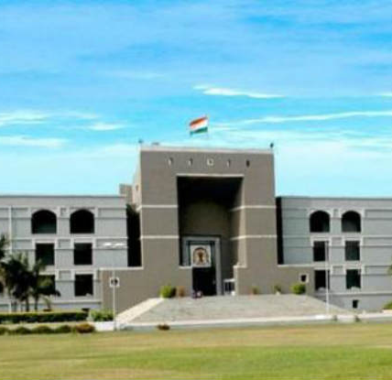
Penalty initiated against RTI officer : Gujarat HC
PIO gave evasive reply denied on ground of third party
In appeal said record destroyed in earthquake
Sureshchandra Maneklal Dholakiya
Vs State Of Gujarat
Sca 6941/2020

Slide 51
FIR to be uploaded in 24 hours
Youth Bar Association Vs Union of India
WP (Criminal) No. 68/2016 [SC] dated 07.09.2016
Criminal complaint closed with Police
Available under RTI
Complaint can also be demanded under RTI
In case the complaint is closed

Slide 52
Applied under RTI for appointment details and resources
RERA-Tribunal was working in Food- Tribunal as designated one.
Details under RTI helped for immediate action by Gujarat High Court in PIL
RERA-Tribunal got formed in record time and PIL got disposed off.
RERA
Appellate
Tribunal
Nipun Praveen Singhvi Vs State of Gujarat
PIL No. 208/2019
Nipun Praveen Singhvi Vs State of Rajasthan
DB Civil Writ Petition 649/2021

Slide 53
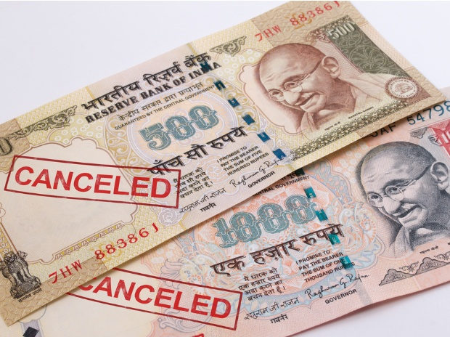
RBI COMPELLED TO DISCLOSE DEMONETISATION MEETING MINUTES AFTER CIC'S PENALTY SHOW CAUSE NOTICE UNDER RTI ACT
Board of RBI was not aware of the Demonetisation less than 6 hr being prior to the meeting
Deputy governor was working on the project for last 6 mnths.
Venkatesh Nayak Vs CPIO, RBI (Second Appeal No. CIC/RBIND/A/2017/127956 )

Slide 54
Rtionline.gov.in

Slide 55
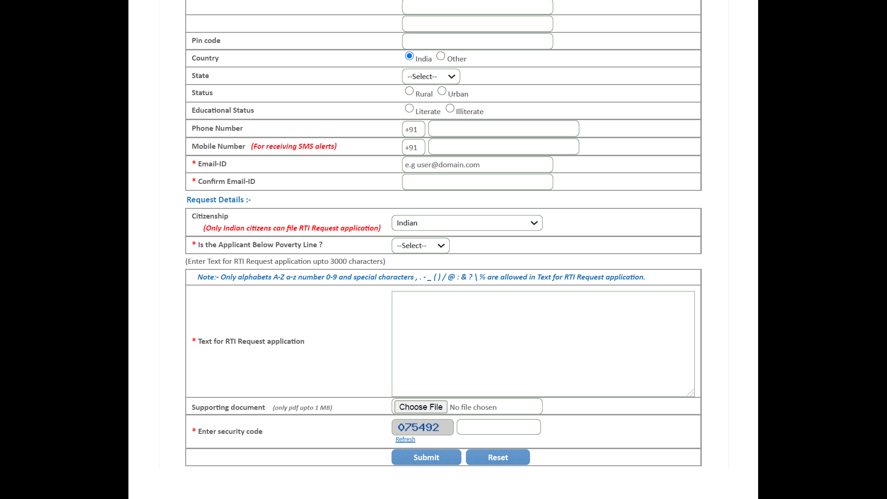

Slide 56
Nipun Singhvi
Advocate
B.Com.(Hons.), BCCD, LLB, LLM (Corporate), CS, FCA, M&A (IIM-A), IFRS Certified, Forensic Certified, Con. Bank Audit Certified, Qualified ID (MCA)
+91 98290 31411
nipunsinghvi@yahoo.com
nipun@nsalegal.in
CA Mahadev Birla Mahadev Birla & Associates Chartered Accountants
+91 97123 78191
md.birla@gmail.com

