Slide 1
PROJECT ALTERATION & EXTENSION

Slide 2
LAWS GOVERNING RERA
The Real Estate (Regulation and Development) Act, 2016
Gujarat Real Estate (Regulation and Development) (General) Rules, 2017
Various Departmental Circulars and Orders
Portal Law/ Officer Law

Slide 3
Section 14(2)(ii) – Alteration of Project
Section 14(2):
Notwithstanding anything contained in any law, contract or agreement, after the sanctioned plans, layout plans and specifications and the nature of the fixtures, fittings, amenities and common areas, of the apartment, plot or building, as the case may be, as approved by the competent authority, are disclosed or furnished to the person who agree to take one or more of the said apartment, plot or building, as the case may be, the promoter shall not make—

Slide 4
Section 14(2)(ii) – Alteration of Project
(i) any additions and alterations in the sanctioned plans, layout plans and specifications and the nature of fixtures, fittings and amenities described therein in respect of the apartment, plot or building, as the case may be, which are agreed to be taken, without the previous consent of that person:

Slide 5
Provided that the promoter may make such minor additions or alterations as may be required by the allottee, or such minor changes or alterations as may be necessary due to architectural and structural reasons duly recommended and verified by an authorised Architect or Engineer after proper declaration and intimation to the allottee.
"minor additions or alterations" excludes structural change including an addition to the area or change in height, or the removal of part of a building, or any change to the structure, such as the construction or removal or cutting into of any wall or a part of a wall, partition, column, beam, joist, floor including a mezzanine floor or other support, or a change to or closing of any required means of access ingress or egress or a change to the fixtures or equipment, etc.

Slide 6
Alteration under Section 14(2)(ii)
Any other alterations or additions in the sanctioned plans, layout plans and specifications of the buildings or the common areas within the project without the previous written consent of at least two-thirds of the allottees, other than the promoter, who have agreed to take apartments in such building.
Change/Alteration in Approved Building Plan
With Prior Written Consent of 2/3rd Allottees except Promoter

Slide 7
Various Scenarios under RERA Alteration
Categorization of Plan change applications as addition/alteration under Section 14 or as phase registration under Section 3 vide Circular No.8/2018 dtd.13th June, 2018.
Project Alteration to be considered only for registered project.
If any additional land procured application to be considered as new phase and registration required according to section 3.

Slide 16
Fees For Alteration Application
Notification dtd. 31st August, 2019
In case of Housing Project:- Rs.8/- per carpet sq. mt. (Min. Rs.10000/- & Max. Rs.10 Lakhs)
In case of Mixed Project:- Rs.15/- per carpet sq. mt. (Min. Rs.12000/- & Max. Rs.12 Lakhs)
In case of Commercial Project:- Rs.20/- per carpet sq. mt. (Min. Rs.15000/- & Max. Rs.15 Lakhs)
In case of Plotted Development Project:- Rs.10/- per carpet sq. mt. (Min. Rs.5000/- & Max. Rs.5 Lakhs)

Slide 17
Time Limit for Project Alteration
Order 52 dtd.16.09.2021 – Maximum time limit one month
Order 71 dtd. 24.08.2022 – Revised Time Limit
Sr. No. | Time Limit from Revised Plan | Project Cost
 |  | Upto 50 crores | From 50 to 100 crores | Above 100 crores
1 | Upto 3 months | 0 | 0 | 0
2 | From 3 to 4 months | 15000/- | 25000/- | 50000/-
3 | From 4 to 6 months | 30000/- | 50000/- | 75000/-
4 | Above 6 months | As per Suo-moto Proceedings

Slide 18
Documents Required
Encumbrance certificate
Commencement Certificate
Building plans
Layout
Draft AFS
Area development plan
Draft Allotment letter
Draft Sale deed
Title clear report
Draft Brochure
All NOC (Revised EC etc)
RERA Bank statement
Affidavits from promoter
Consent letter
Parking plan/details
GANTT Chart
Means of finance
Form 1-2-2Annexure -3

Slide 20
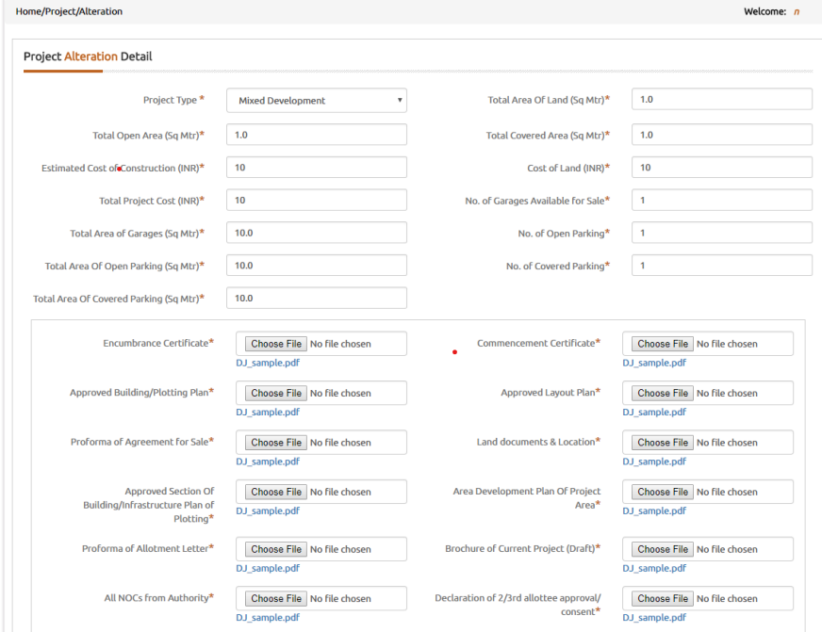

Slide 21
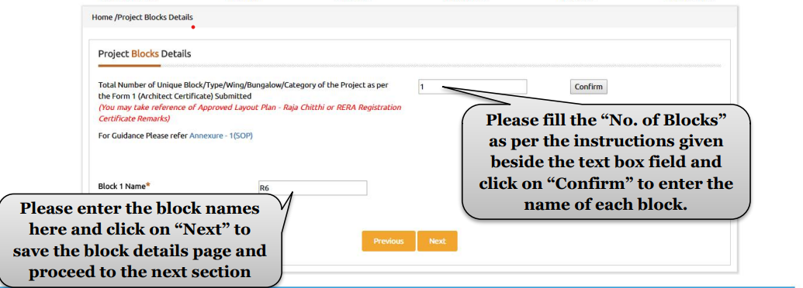

Slide 22
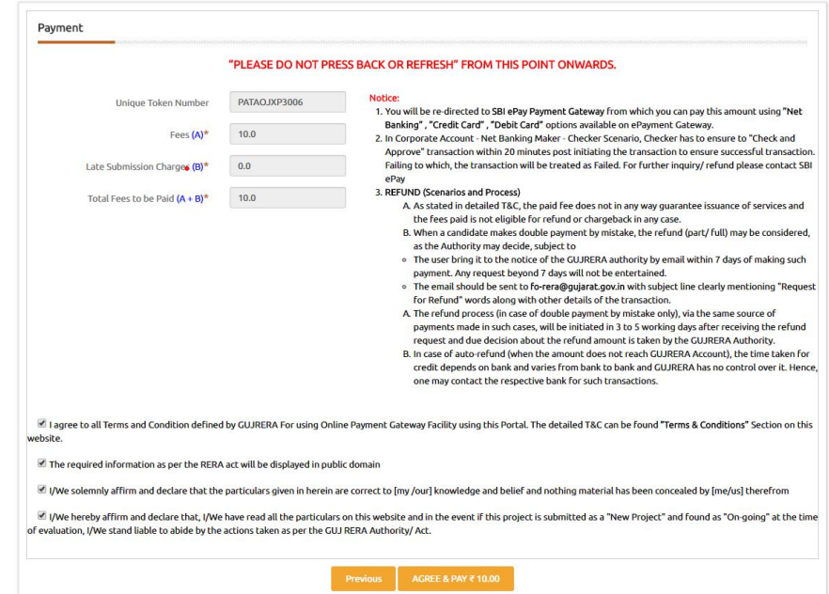

Slide 23
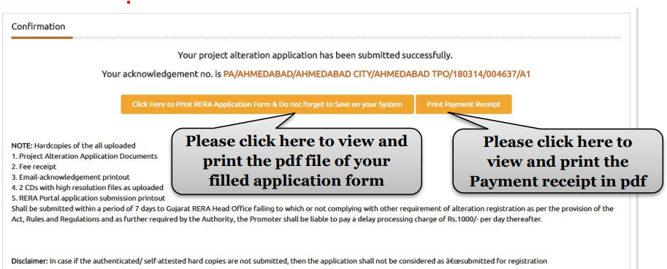
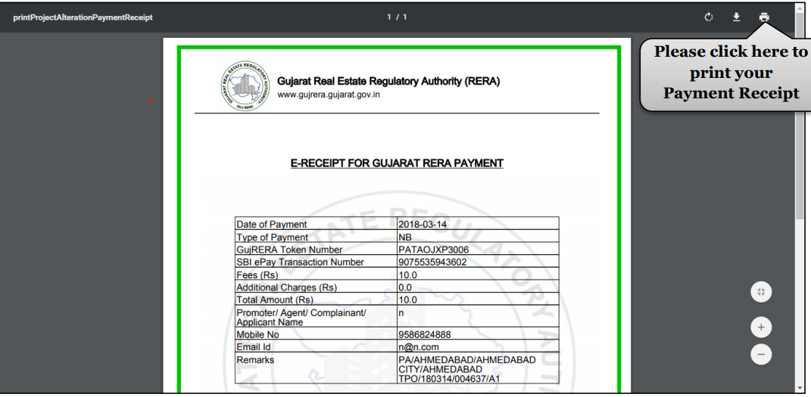

Slide 24
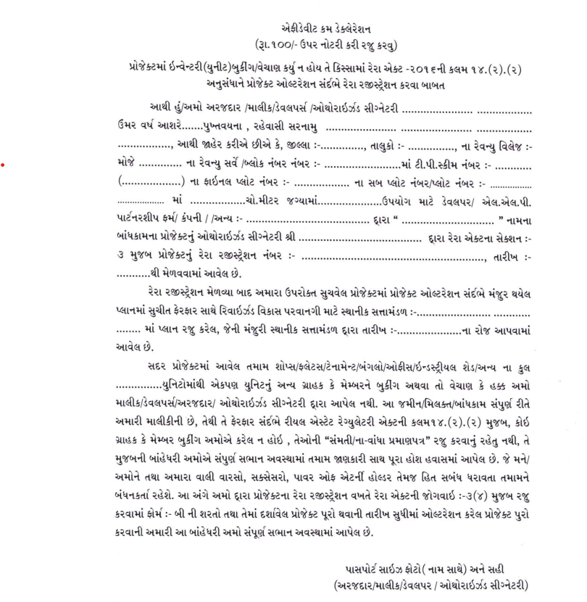

Slide 25
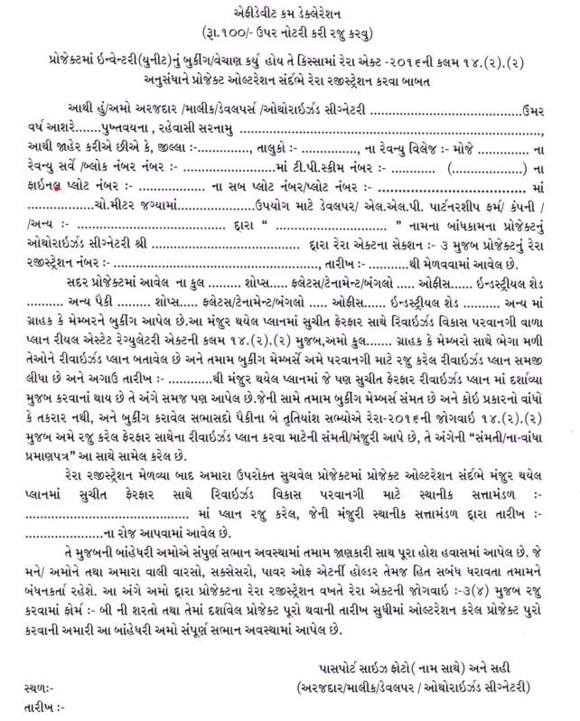

Slide 26
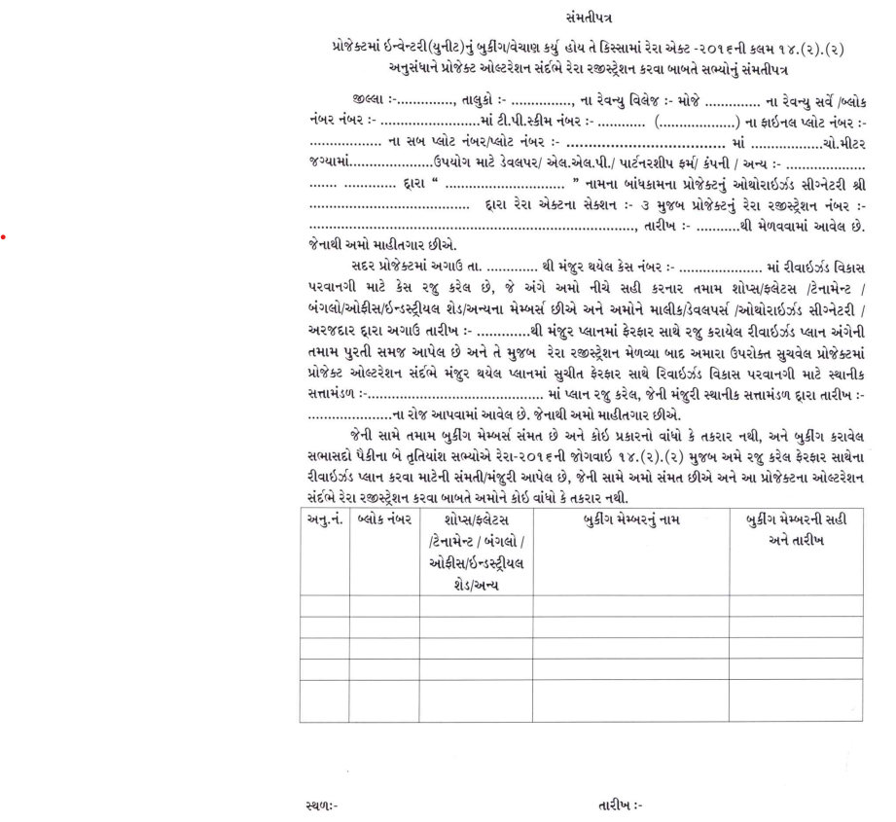

Slide 27
QUERIES AND NOTICES YOU MAY FACE
Notice for Non-execution of AFS
In case of Shaligram Properties LLP penalty was made for 2 Lac for non execution of AFS.
Notice for received in amount for altered units before approval
Bank name not as per guidelines.
Encumbrance revised not registered.
Mention loan amount in Draft AFS and Draft sale deed.

Slide 28
EXTENSION OF RERA PROJECT
Section 6 of the RERA Act, 2016
The registration granted under section 5 may be extended by the Authority on an application made by the promoter due to force majeure, in such form and on payment of such fee as may be specified by regulations made by the Authority.
Provided that the Authority may in reasonable circumstances, without default on the part of the promoter, based on the facts of each case, and for reasons to be recorded in writing, extend the registration granted to a project for such time as it considers necessary, which shall, in aggregate, not exceed a period of one year.

Slide 29
EXTENSION OF RERA PROJECT
Provided further that no application for extension of registration shall be rejected unless the applicant has been given an opportunity of being heard in the matter.
Explanation.— For the purpose of this section, the expression "force majeure" shall mean a case of war, flood, drought, fire, cyclone, earthquake or any other calamity caused by nature affecting the regular development of the real estate project.

Slide 30
EXTENSION OF RERA PROJECT
Rule 7 of Gujarat Real Estate Rules, 2017
(1) An application for extension of the real estate project shall be made to the Authority, in Form “E”, along with an explanatory note setting out the grounds and reasons for delay in the completion of the real estate project and the need for extension, along with documents supporting such grounds and reasons: Provided that, where extension of registration is due to force majeure the Authority may at its discretion waive the fee for such extension granted to any real estate project.

Slide 31
EXTENSION OF RERA PROJECT
(2) The grant of extension of registration to a real estate project, shall be in Form “F". The Authority shall supply a copy thereto to the Promoter and in case of rejection of the application for extension of registration, the authority shall, after giving to the applicant an opportunity of being heard as provided in the second proviso of section 6, inform the promoter about the same, in Form “D”. The intimation thereof shall also be given to the respective Competent Authority and Statutory Authorities.
(3) The application for extension of Real Estate Project shall be accompanied with fees for an amount equivalent to half the registration fees as prescribed under sub-rule (3) of rule-3.

Slide 32
PROJECT DATE COMPLETION
Circular No.4/2017 dtd.16.09.2017
Date to be mentioned in Form B.
Section 4(2)(1)(C) of the Real Estate (Regulation and Development) Act, 2016 state the an affidavit cum declaration to be signed by the promoter or authorized person specifying the time period to complete the project.
Date of Completion of the project indicated in “Form B”.
Section 5(3) of the Real Estate (Regulation and Development) Act, 2016 state that registration granted under this section will valid for a period declared by promoter under Section 4(2)(1)(C) of this act.

Slide 33
WHEN IS PROJECT CONSIDERED AS COMPLETED?
Has finished the construction of whole project including common amenities.
Obtain Occupancy/Completion Certificate from Competent Authority.
Incorporated Society or Section 8 Company for association of allottees.
Handover the management of common areas and amenities to association of allottees (Section 17).
In case of Plotting scheme, Occupancy certificate to be taken from Architect.

Slide 34
DOCUMENT REQUIRED FOR FILING QE
Order 30
Form 1-2-2Annexure and 3
All NOC including lift Noc, fire Noc, etc to be uploaded with Form 1
Form 4 certifying completion of construction and common amenities by architect
BU permission
Society or section 8 company incorporation certificate as per order 18
Affidavit as per order 11 with list of common areas and facilities
Revenue record (property card etc.) in favor of association of allotees
BU Map if applicable

Slide 35
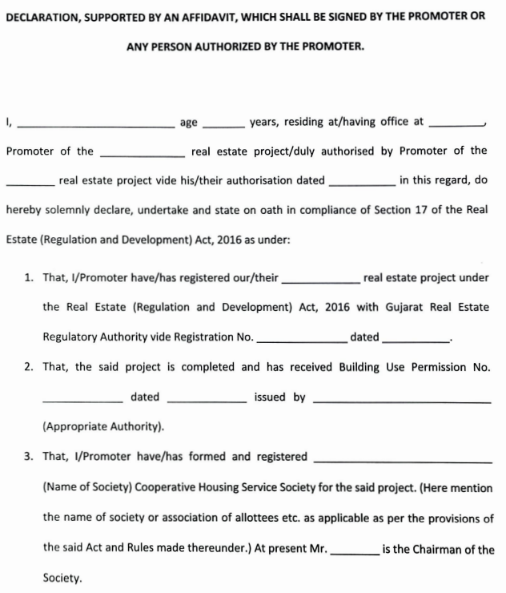

Slide 36
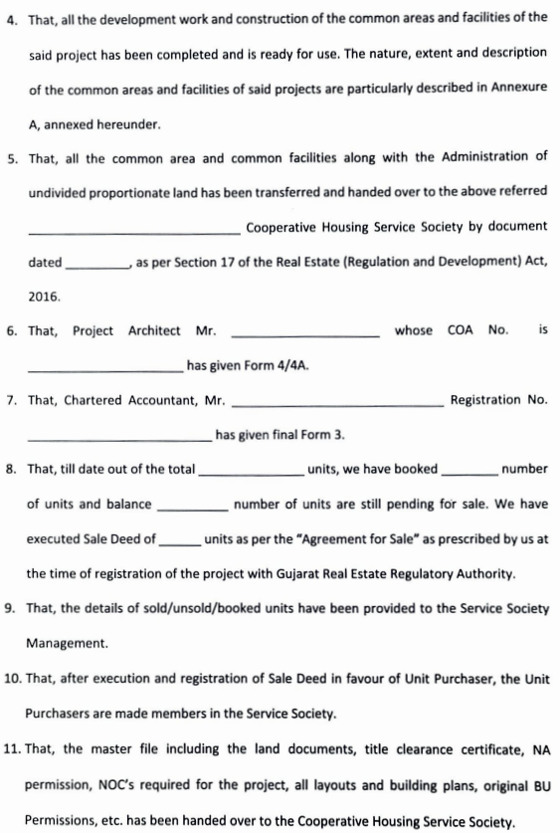

Slide 37
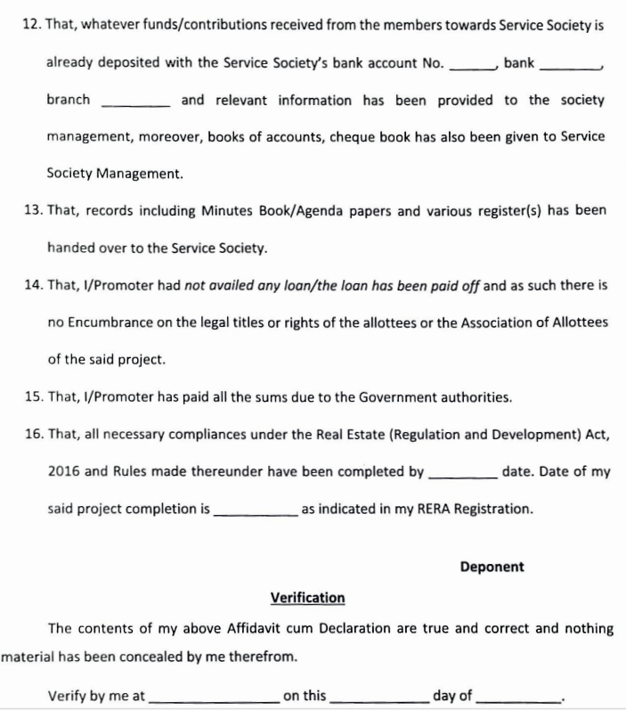

Slide 38
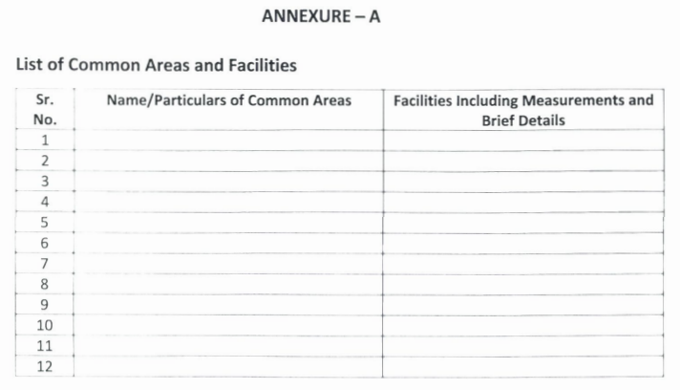

Slide 39
TIME LIMIT FOR EXTENSION APPLICATION
Order 71 dtd. 24.08.2022
Sr.No. | Time Limit from Project End Date | Project Cost
 |  | Upto 50 crores | From 50 to 100 crores | Above 100 crores
1 | Within 1 month | 5000/- | 10000/- | 25000/-
2 | Within 3 months | 15000/- | 25000/- | 50000/-
3 | Within 6 months | 30000/- | 50000/- | 75000/-
4 | Above 6 months | As per Suo-moto Proceedings

Slide 40
DOCUMENT REQUIRED FOR EXTENSION
Order No.45 dtd. 13.01.2021
Reason for Extension
Commencement Certificate
Affidavit in Form B
Various NOC received
Color Photograph
Affidavit for No complaint, No dues, No further extension
GANTT Chart
Form 1, 2, 2 Annexure and 3
In case of Extension Application for more than 1 year, separate 2/3rd consent of Allottees

Slide 44
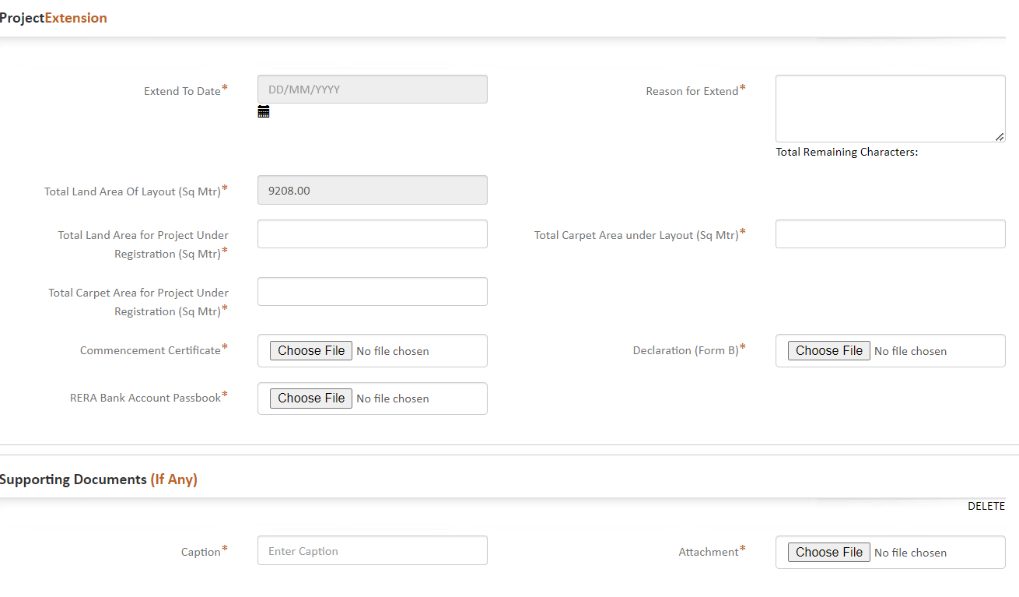

Slide 45
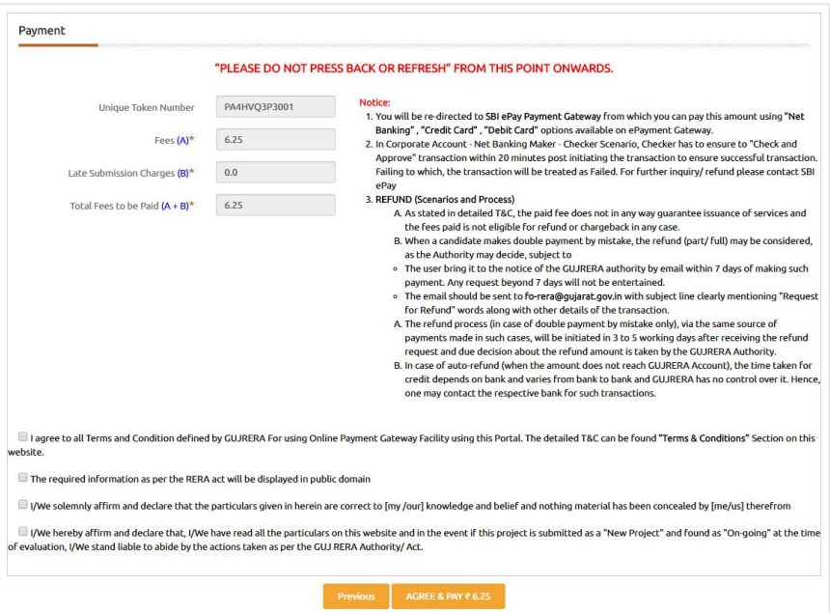

Slide 46
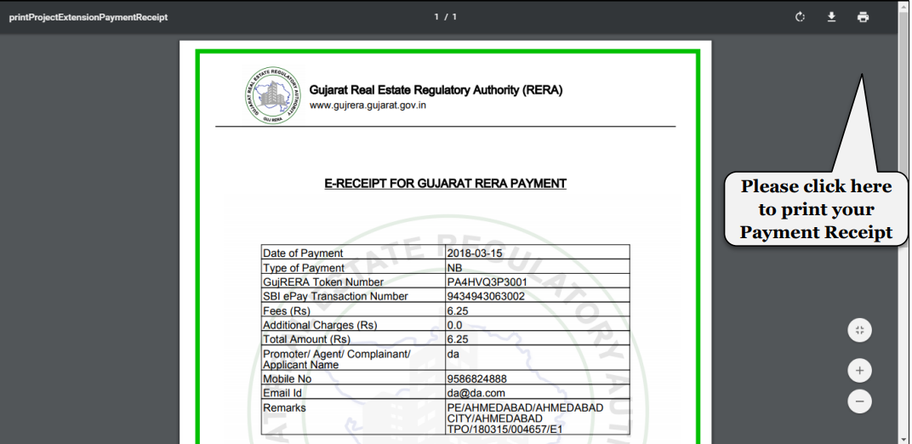

Slide 47
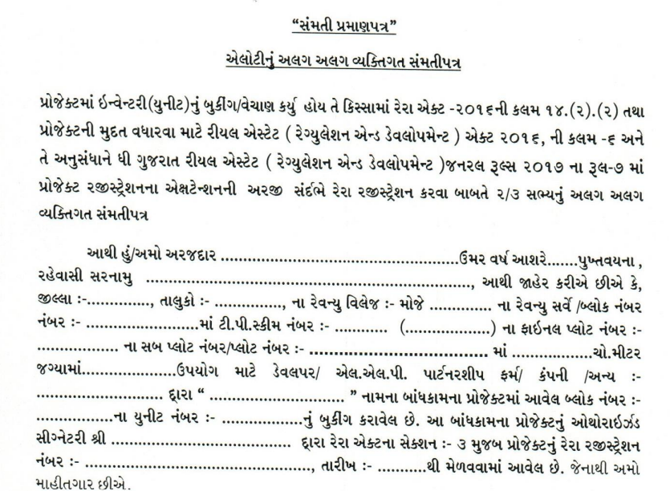

Slide 48
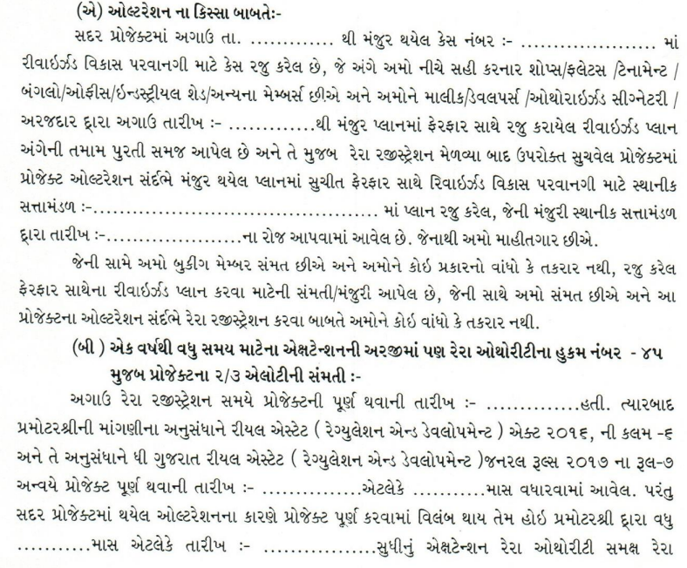

Slide 49
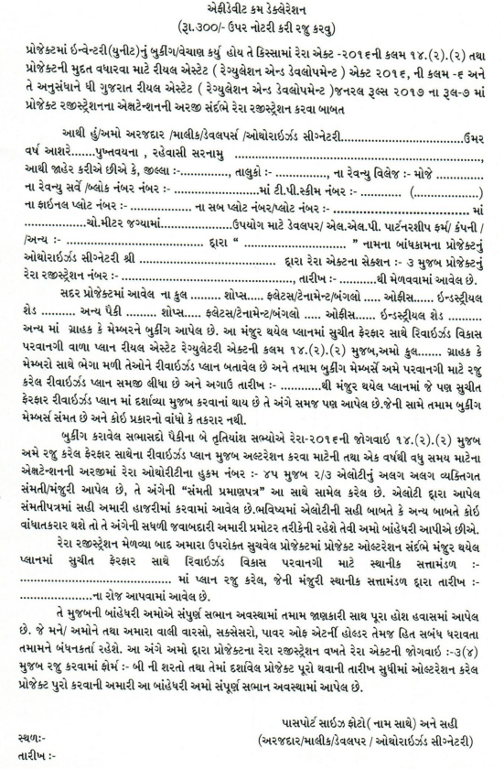

Slide 50
PERFORMA FOR GANTT CHART

Slide 52
IMPACT OF RERA ON OTHER LAWS
Income tax
GST
Khanij Department
Nagar Vikas Sakha for Labour Cess
Bankers

Slide 54
CA Maulik M. Mehta
(M)+91 9429502486
Email: maulikmht13@gmail.com
Disclaimer: The information contained herein is of a general nature and is not intended to address the circumstances of any particular individual or entity. Although we endeavor to provide timely and accurate information, there can be no guarantee that such information is accurate as of the date it is received or that will continue to be accurate in the future. Noone should act on such information without appropriate professional advice after a thorough examination of the particular situation.

