Slide 1
Navigating International Taxation for Individuals and India-US DTAA
By CA Rishabh Mehta, CPA
MNP & Associates Chartered Accountants Office No. 1212, RK World Tower 150 Ft. Ring Road, Shital Park Circle Rajkot - 360006

Slide 2
Session Objectives
Understand basics of international taxation for Individuals
Learn key provisions of NRI taxation.
Explore what is a DTAA, types of DTAAs and how a DTAA works.
Check the DTAA with United States of America as a model DTAA as it is one of the most widely used DTAA
Practical insights for tax compliance and planning, from both sides of the coin, American Compliances and Indian Compliances

Slide 3
Concept of Double Taxation
Double taxation occurs when the same income is taxed in two different jurisdictions. This can happen in two ways:
Jurisdictional Double Taxation – When two countries tax the same income under their respective tax laws. For example, if an individual is a tax resident in Country A (residence-based taxation) but earns income in Country B (source-based taxation), both countries may impose taxes on the same income.
Economic Double Taxation – When the same income is taxed twice in the hands of different taxpayers. For example, a company pays corporate tax on profits, and when those profits are distributed as dividends, shareholders also pay tax on them.

Slide 4
Types of International Taxation
Residence based taxation : Residence-based taxation means a country taxes individuals or entities based on their residency status, regardless of where their income is earned. Residents are taxed on their global income, while non-residents are taxed only on income sourced within the country. Tax residency is typically determined by factors like the number of days spent in the country or permanent ties.
Source Based Taxation : Source-based taxation means a country taxes income that is generated within its borders, regardless of the taxpayer's residency status. Under this system, both residents and non-residents are taxed on income earned from sources within the country. This approach is commonly used for withholding taxes on foreign investors, business profits, and employment income earned locally.

Slide 5
DTAA (Double Taxation Avoidance Agreements)
Double taxation agreement are classified on the basis of
1) Parties involved:
a)Bilateral treaties: the agreement on double taxation entered between two countries. Defines which country has the right to tax specific types of income (e.g., salary, business profits, dividends). b) Multilateral Treaties: the agreement on double taxation entered between a groups of countries. Primarily aimed at preventing tax evasion and standardizing taxation rules. (Example : OECD’s Multilateral Instrument (MLI) – Modifies existing DTAAs of over 100 countries to prevent tax avoidance strategies., OPEC Countries and Nordic Tax Treaty)
2) Scope / Coverage :
a) Comprehensive DTA: The taxes on income and capital gains the taxpayers in both the countries would be treated equally in respect of issues related to Double taxation. Commonly signed between countries with significant trade, investment, and people-to-people relations. b) Limited DTA: the specified limit to the tax on income from shipping, air, transport or estates, inheritance and gifts. (Example : Afghanistan, Iran, Bhutan, Oman, Maldives etc.)

Slide 6
Taxability of Foreign Income
India has signed DTAA with 88 countries out of which 85 have been entered into force which specifies the agreed rates of tax and jurisdiction on specific types of incomes levied in a country to a tax resident of another country. the income earned outside India will be subject to taxes on the basis of residential status.
Resident Individuals:
1) If a DTAA exists with the foreign country:
Tax is levied charged in India at the domestic tax rate on the global income and the FTC is Available under Sections 90 or 90A at the lower of: DTAA rate, or Domestic income tax rate.
2) If no DTAA exists:
Taxes are levied under Indian domestic tax law, with no FTC, but unilateral relief can be claimed
Non-Resident Individuals:
Income earned outside India is not subject to Indian taxes, except if it arises from Indian sources.

Slide 7
Relief to the Taxpayer
To mitigate this issue, countries employ two primary methods:
Exemption Method
The income earned in the source country is exempted from taxation in the residence country.
Common for specific income types like pensions or government salaries under tax treaties.
Example: India exempts certain foreign employment income under Section 10(4).
Credit Method
The residence country allows a tax credit for taxes paid in the source country.
The credit is typically limited to the tax liability in the residence country on the same income.
Example:
Salary earned by an Indian resident in the US.
US tax paid = $5,000.
Indian tax liability = ₹4,00,000 (on worldwide income).
Foreign Tax Credit = ₹4,00,000 or equivalent $5,000 (whichever is lower).

Slide 8
Residency Rules for Individuals
For the purpose of income tax in India, the income tax laws in India classifies taxable persons as:
A resident and ordinarily resident (ROR)
A resident but not ordinarily resident (RNOR)
A non-resident (NR)
The taxability differs for each of the above categories of taxpayers. Before we get into taxability, let us first understand how a taxpayer becomes a resident, an RNOR or an NR.

Slide 9
Categories (included as per new income tax bill)
A Resident taxpayer is an individual who satisfies any one of the following conditions:
Resides in India for a minimum of 182 days in a year, OR
Resided in India for at least 365 days in the immediately preceding four years and for a minimum of 60 days in the current financial year.
There is a further classification under the resident status – Resident and Ordinarily Resident (ROR) and Resident but Not Ordinarily Resident (RNOR). In addition to the basic conditions, if all of the below conditions are met, he will be a RNOR:
He has not resided in India for at 9 out of 10 immediate previous years, and
He has resided in India for at less than 730 days in 7 immediately previous years.
Indian citizen/PIO with income > ₹15 lakh (excluding foreign income) and stay 120-181 days. (STANDALONE)

Slide 10
Categories (included as per new income tax bill)
Special Cases:
Indian citizens leaving for employment or as a crew member of an Indian ship: 182-day rule applies.
Indian citizens/PIO visiting India: 60-day rule extends to 120 days if income > ₹15 lakh.
Deemed Resident: (New Category)
Indian citizen with income > ₹15 lakh who is not liable to tax in any other country is considered a resident.

Slide 11
Determining Residency

Slide 12
Residential Status (Typical Cases)
Situation | Deemed to be a resident of the country in which:
A permanent home in both states | Personal and economic relations are closer.
If the above rule is not determinable or no permanent home in either state is there | Habitual abode is present
Habitual abode in both states | He is a National
National of both states or neither of them | Competent Authorities shall determine the residential status by mutual agreement.

Slide 13
Taxability of Income

Slide 14
Model DTAA : India-USA DTAA

Slide 15
Key Features of US-India DTAA
Residency Rules (Article 4):
Determines tax residency for individuals to avoid dual residency issues.
Tiebreaker rules to decide residency if an individual qualifies as a resident in both countries:
Permanent home
Center of vital interests (economic and personal ties)
Habitual abode
Nationality

Slide 16
Taxability of Various Types of Incomes
Income from Immovable Property (Non – Capital Gains) (Article-6)
General Rule: Income derived by a resident from immovable property is to be taxed in the state where the immovable property is situated. Eg: If a US Resident derives rental income from immovable property situated in India, then the rental income will be liable to tax in India. Applicability as per the agreement: For instance, the following points will be considered as income from the immovable property:
Income from agriculture or forestry
Income derived from the direct use, letting or use in any other form of the immovable property
Income from immovable property of an enterprise
Income from Immovable property used for the performance of independent personal services

Slide 17
Way to Defer / Reduce Taxation in India in the above case.
Create a C-Corp LLC in the US Having 2 Individuals as the Partner and not a Single member LLC
Transfer the property in the name of the C-Corp. Transferring it to a S-Corp / Partnership will have Pass-Through Effect and the amount will be taxed in the hands of the Partners.
If the C-Corp does not distribute dividends, the rental income remains untaxed in India, as India taxes only received or accrued income for residents.
The LLC is treated as a separate taxable entity and pays U.S. corporate tax (currently 21% federal, plus any state taxes) on Rental / Passive income.
Instead of a 30% Standard Deduction, USA allows any amount of cost incurred to maintain the property to be set off against the Rental / Passive income.

Slide 18
Taxability of Various Types of Incomes
Dividends (Article 10)
General Rule: Dividend paid by a resident company of a contracting state to a resident of the other contracting state, may be taxed in that other state. Eg: If a US Company pays a dividend to an Indian Resident shareholder, then the dividend income will be liable to tax in India. Further, USA (The company paying the dividend) also has a right to tax the said dividend in their state. However, if the beneficial shareholder is a resident of India, i.e. a resident of the other contracting state, then the tax so charged shall not exceed:
(a) | The beneficial owner is a company which owns at least 10% of the voting stock of the company paying the dividend | 15% of the gross amount of the dividend
(b) | Other Cases | 25% of the gross amount of the dividend

Slide 20
Taxability of Various Types of Incomes
Interest (Article 11) General Rule: Interest arising in a contracting state and paid to a resident of the other contracting state may be taxed in that other State. As per the DTAA, if interest income arises in India and the amount belongs to a US Resident, then the said amount shall be taxable in the US. However, such interest may be liable to tax in India as per the Indian Income Tax Act (ie the contracting state where the interest has arisen). Exception: If the beneficial owner of the interest is a resident of the USA (resident of the other contracting state), then the tax charged in India shall not exceed:
(a) | Interest paid on a bank loan (involved in Bonafide banking business) or a similar financial institution (including an insurance company) | 10% of the gross amount of interest
(b) | In other cases | 15% of the gross amount

Slide 21
Taxability of Various Types of Incomes
Article 15 – Dependent Personal Services (Salary)
General Rule – Taxation Based on Employment Location
Salaries and wages are taxable in the country where the employment is exercised (i.e., where the work is performed).
If a person works in India, their salary is taxable in India.
If a person works in the US, their salary is taxable in the US.
Government Service Exception (Article 19)
If the salary is paid for government services, then Article 19 (Government Service) applies instead of Article 15.
Exception : If an Indian employee is sent to the US for 5 months (less than 183 days) and paid by an Indian employer, their salary remains taxable in India and not in the US.

Slide 22
Taxability of Various Types of Incomes
Capital Gains Taxation: (Article 13) 1) Gains from immovable property are taxed in the country where the property is located. For eg: If a US Resident, Mr. John, sells an Indian Property, then the property is liable to tax as per the Indian Domestic Laws, and vice versa. However, If the property was the owner’s primary home for 2 out of the last 5 years, they can exclude up to $250,000 (single) or $500,000 (married) from capital gains tax. 2) Capital gains on stocks of publicly traded US companies are not taxed for non-residents. No withholding tax applies at the time of sale. The US applies source-based taxation on capital gains from RSU (Restricted Stock Units) sales, only if the shares are considered "US-sourced" income. 3) However, India Taxes Capital Gains if the Shares are of Indian Origin, also since India follows residence-based taxation, meaning worldwide income (including capital gains from selling foreign shares) is taxable for Indian residents.

Slide 23
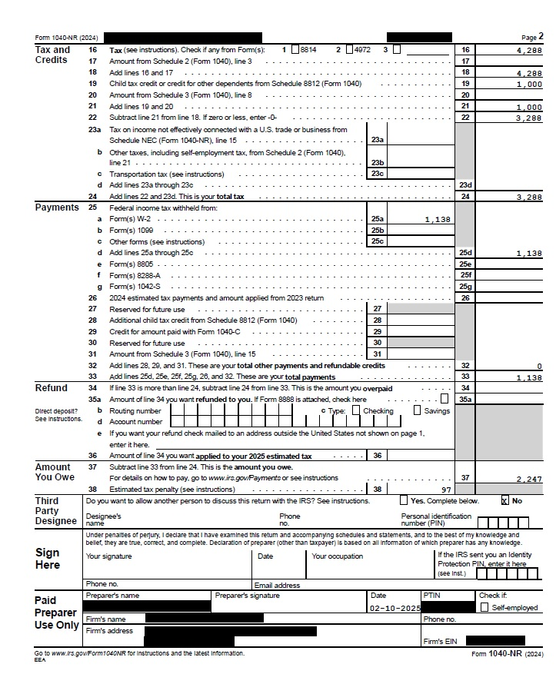
1040-NR (Non Resident Tax Return)

Slide 24
Taxability of Various Types of Incomes
Business Profits (Article 7)
Where Business Profits Are Taxed:
A business’s profits are only taxed in the country where the business is based (home country) unless it has a permanent establishment (PE) in the other country.
If there is a PE in the other country, that country can tax the profits, but only:
Profits directly linked to the PE.
Profits from selling similar goods or services in that country.
Profits from similar business activities carried out in that country.

Slide 27
Permanent Establishment (PE) for Individuals
Types of Permanent Establishments In India, there are several types of Permanent Establishments recognised under the tax laws. These types of PEs determine when a foreign Individual becomes subject to taxation in India. Here are some common types of PEs in India:
1. Fixed Location PE This refers to a physical location, such as an office, branch, factory, workshop, or other fixed premises, where the foreign Individual carries out its business activities in India. Criteria for fixed place PE in India: Fixed and consistent location, availability to foreign entities, and conducting proper commercial activity. → Fixed and consistent location: For a foreign enterprise to have a fixed place PE in India, the business location must be stable and consistent over a reasonable period, excluding passing or casual activities. Consistency and regularity are essential factors. → Availability to foreign entities: The foreign entity must have access to the location, even if it is within another Individual's premises, provided the access is regular. In such cases, the premises may be deemed as a PE in India. → Conducting proper commercial activity: A proper commercial activity must be conducted from the designated location.
2. Construction PE: When a foreign Individual engages in construction, installation, or assembly projects in India for a specified duration, it establishes a Construction PE. If the project exceeds a prescribed threshold period, the Individual becomes liable for taxation in India. This type of PE is applicable to foreign companies involved in significant construction activities within the country, ensuring their income generated from such projects is subject to Indian taxation.

Slide 28
Permanent Establishment (PE) for Individuals
3. Service PE: A Service PE is established when a foreign Individual / Freelancer provides services within India through his presence for a specific period. This can include activities such as consultancy, technical assistance, or other services rendered within India. The presence of a Service PE in India may subject the foreign Individual to taxation on the Income attributable to the services provided in accordance with India's tax laws and relevant double taxation treaties.
4. Dependent Agent PE: Dependent Agent PE refers to a situation where a foreign Individual conducts business in India through an agent who negotiates contracts and has the authority to secure orders on behalf of the Individual regularly. The agent must be legally dependent on the Individual and act exclusively or almost exclusively for the Individual, leading to the establishment of a taxable presence for the Individual in India

Slide 29
Article 23 – Elimination of Double Taxation (India-US DTAA)
US Tax Residents (Relief Provided by the US)
The US allows foreign tax credit (FTC) under Section 901 of the US Internal Revenue Code.
If a US tax resident earns income in India and pays Indian taxes, they can claim a tax credit in the US for the Indian tax paid.
This credit is limited to the amount of US tax that would have been payable on that income.
Indian Tax Residents (Relief Provided by India)
India follows the foreign tax credit (FTC) method under Section 90 of the Income Tax Act.
If an Indian tax resident earns income in the US and pays US tax, they can claim an FTC against Indian tax liability.
The credit is available for taxes paid in the US but cannot exceed the Indian tax payable on that income.

Slide 30
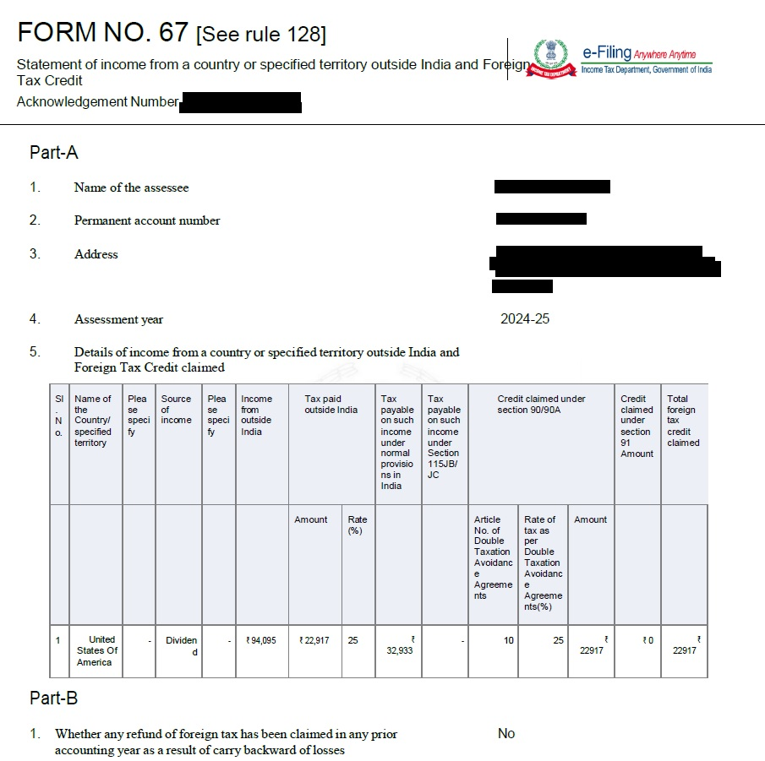
Relief From Double Taxation
Form 67

Slide 31
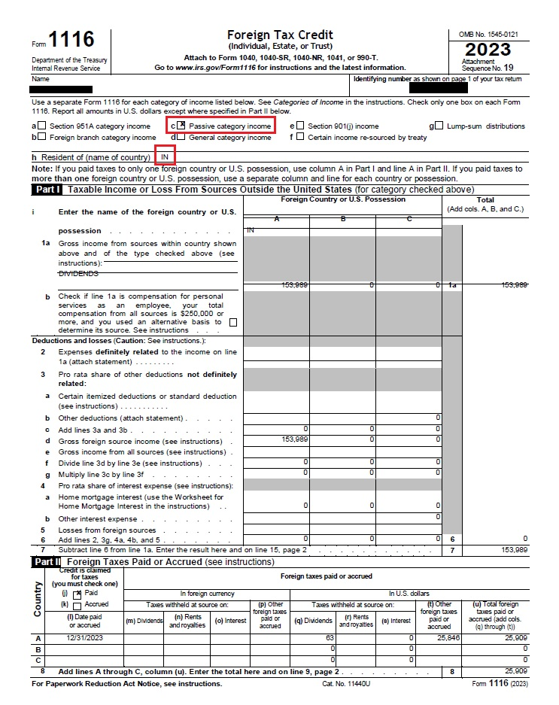
Relief From Double Taxation
Form 1116 (US Tax Return)

Slide 32
Thank You ..!!!

