Slide 1
Manufacturing and
Other
Operations in
Warehouse
Regulations
Punit Prajapati & Co.
Ahmedabad I Rajkot
www.PunitPrajapati.com
CA Punit Prajapati

Slide 2
“Goods Shall be Exported
Services Shall be Exported
Taxes Shall NOT be Exported”

Slide 3
Normal Scenario
Pay BCD +IGST
No Taxes
Import
Export
Manufacture
Domestic Purchase
Pay GST
Domestic Sales

Slide 4
The Problem
Import
Domestic
Export
Cost
BCD 7.5%
IGST 18%
Total
1,00,00,000
7,50,000
19,35,000
1,26,85,000
1,07,50,000
-
19,35,000
1,26,85,000
1,07,50,000
-
-
1,07,50,000

Slide 5
The Problem
Import Duty of Rs. 7.5 L is Cost
BCD
Blockage of Working Capital
BCD + IGST
Refund of IGST is to be claimed
Export

Slide 6
The Solution
Pay BCD +IGST
Pay BCD +IGST
Import
Export
Waiver of BCD&IGST on Import
Manufacture
Domestic Purchase
Domestic Sales
Pay BCD +IGST

Slide 7
The Result Due to Duty Deferment
Import Duty of Rs. 7.5 L is Not Cost if used for Export
BCD
No Blockage of Working Capital
BCD + IGST
No Refund claim required
Export

Slide 8
Comparison of In Bond Manufacturing vs DTA Manufacturing
Comparison of In Bond Manufacturing vs DTA Manufacturing
Import under bond -In Bond Manufacturing
Import on payment of duty — Manufacture
Offshore Supplier
Offshore Supplier
Supply of
Supply of Inputs
Supply of Capital Goods
Supply of Inputs
Outside India
Capital Goods
Outside India
Duty Payment
: 0
Payment of Customs duty on import
Export:
Export:
No duty on export of FG
No duty on
Supply of Inputs
export of FG
Supply of Inputs on payment of
In – bond manufacturing facility
Domestic
Manufacturing Facility
Domestic supplier of goods
supplier of ^{GST} goods
Sale of finished product : Payment of GST
Payment of Customs Duty on Input
Sale of finished product: Payment of GST
Domestic Customers
Domestic Customers
Import of capital goods/ Input … Duty cost Zero (in case of export supply)/ deferment (in case of domestic supply)
Export of FG … No Credit Refund situation
Reduced working capital blockages
Duty Payment on import of Capital Goods & Inputs
Export of FG …..GST Refund on procurement & drawback on Basic Customs Duty
Domestic supplies….. Credit of GST paid on procurement

Slide 9
How it has been Done?
The Warehousing

Slide 10
The Vision behind the Section 65 Scheme
The Press Release made on 15th October, 2019 1:38PM by PIB Delhi, announced that the Central Board of Indirect Taxes and Customs has launched a revamped and streamlined programme to attract investments into India and strengthen Make in India through manufacture and other operations under bond scheme, under Customs Act, 1962.
Section 65 of the Customs Act, 1962 enables conduct of manufacture and other operations in a customs bonded warehouse.
The scheme was expected to play a critical role in promoting investments in India and in enhancing ease of doing business.
It can enable the ‘Make in India’ programme, encourage exports, create hubs for electronics assembly, repair & refurbishment operations, inward and outward processing, facilitate global e−commerce hubs etc.
Refer Page Title | URL: CBIC and Customs launches scheme to attract investment and support Make in India programme | https://pib.gov.in/Pressreleaseshare.aspx?PRID=1588121

Slide 11
SECTION 65.Manufacture and other operations in relation to goods in a
warehouse.(MOOWRs)
Private Warehouse licensed under Section 58
Special Warehouse licensed under Section 58A

Slide 12
The Three types of Customs Warehouses in India
The goods are gold, silver, other precious metals and articles thereof; goods warehoused for the purpose of supply to duty free shops, supply as stores to vessels or aircrafts under Chapter XI, and for supply to foreign privileged persons
Special Warehouses:
For specific class of dutiable goods notified by the CBIC, can be deposited− licensed under Section 58 A of the Customs Act − these goods are specified in Notification 66/2016−Customs (N.T), dated 14th May, 2016 as amended by Notification 61/2020−Customs (N.T), dated 27th July 2020.
Public Warehouse.
This is for businesses who want to store goods belonging to other people also known as depositors − licensed under Section 57 of the Customs Act.
Private Warehouse.
This is for businesses who want to store their Dutiable goods imported by or on their behalf − the licensee and the depositor are the same person − licensed under Section 58 of the Customs Act.

Slide 13
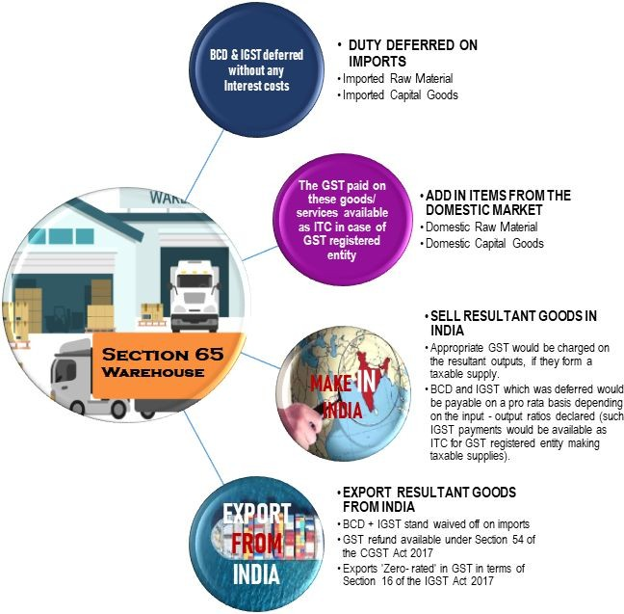
Features of the Scheme under Section 65
** refund of input taxes or IGST paid on
export can be availed of
*** Customs duties to be paid on the value declared at the
time of filing the Warehouse Bill of Entry for these goods.

Slide 14
Customs Act Chapter IX Warehousing
Private Warehouses
Private Warehouses licensed under Section 58 can be permitted on an application being made by the licensee to the Principal Commissioner/Commissioner of Customs, to engage in Manufacture and other operations in relation to goods in a Warehouse – Manufacture and Other Operations in Warehouse (no. 2) Regulations, 2019 – Notification 69/2019-Customs (N.T.) dated the 1st October, 2019
Special Warehouses
Manufacture and Other Operations in Special Warehouse Regulations, 2020 have been issued vide Notification No. 75/2020-Customs (N.T.) dated 17th August, 2020. These regulations allow manufacturing and other operations in a special warehouse licensed under section 58A of the Customs Act, 1962, with regard to warehoused goods specified in clause (1) of Notification No. 66/2016-Customs (N.T.) dated 14th May, 2020 – Circular No. 36 /2020–Customs, dated 17th August 2020

Slide 15
SECTION 65A: Goods brought for operations in warehouse to have ordinarily paid certain taxes- Section 130 of the Finance Act, 2023
(1) Application to Goods for Manufacturing or Other Operations:
Effective from Central Government’s notified date.
Applies to goods eligible for manufacturing or operations under section 65.
65A: Goods brought for operations in warehouse to have ordinarily paid certain taxes- Section 130 of the Finance Act, 2023
(A) Condition for Deposited Goods:
Dutiable goods in the warehouse must have paid integrated tax (sub–section 7) and goods and services tax compensation cess (sub–section 9) under section 3 of the Customs Tariff Act, 1975 (51 of 1975).
Such dutiable goods are considered as warehoused goods for duty purposes.
(B) Removal of Goods for Deposit:
Goods can be removed for deposit in the warehouse under certain conditions:
Entry through electronic bill of entry for home consumption under section 46.
Duty assessed under section 17 or 18, as per section 15(a).
Integrated tax and compensation cess paid under section 47.
If goods are removed from another warehouse (section 67), additional conditions apply – a bill of entry for home consumption under clause (a) of section 68 has been presented and the integrated tax under sub–section (7) and the goods and services tax compensation cess under sub–section (9), of section 3 of the Customs Tariff Act, 1975 (51 of 1975), have been paid before the goods are removed from that other warehouse;

Slide 16
Continue………
(C) Duty Payment Requirement:
Duty payable (excluding integrated tax and compensation cess) for warehoused goods must be paid before removal from the warehouse.
Payment as per prescribed manner.
65A: Goods brought for operations in warehouse to have ordinarily paid certain taxes- Section 130 of the Finance Act, 2023
(2) Exemption for Prior Deposits:
Goods deposited or permitted for deposit in the warehouse before the notified date are exempt from these provisions.
3) Central Government Exemption Authority:
The Central Government can exempt goods from these provisions by notification.
Exemption based on criteria including nature, class, categories of goods, importers/exporters, or industry sector. The supply chain – The Customer knows availability of what he wishes to buy in your stock.

Slide 17
What is the eligibility for application for operating under Section 65? [Private Warehouse Scenario]
In terms of Regulation 4 of the Manufacture and Other Operations in Warehouse (No. 2) Regulations, 2019, the eligibility for application to operate a warehouse under Section 65 is the following: –
A person applying should have been granted a licence for a warehouse under section 58 of the Act, in accordance with Private Warehouse Licensing Regulations, 2016.
In case the person applying for a licence to operate under Section 65 does not already possess a license for a warehouse under section 58 of the Act, he should apply concurrently for a license under Section 58 (to set up a private warehouse) and to undertake manufacturing or other operations in that warehouse under section 65 of the Act.
65A: Goods brought for operations in warehouse to have ordinarily paid certain taxes- Section 130 of the Finance Act, 2023
The regulations do not mandate that a structure fully closed from all sides is a pre-requisite for grant of license.
[Authority: Paragraph 13 of Circular No. 34/2019–Customs, dated 1st of October 2019)

Slide 18
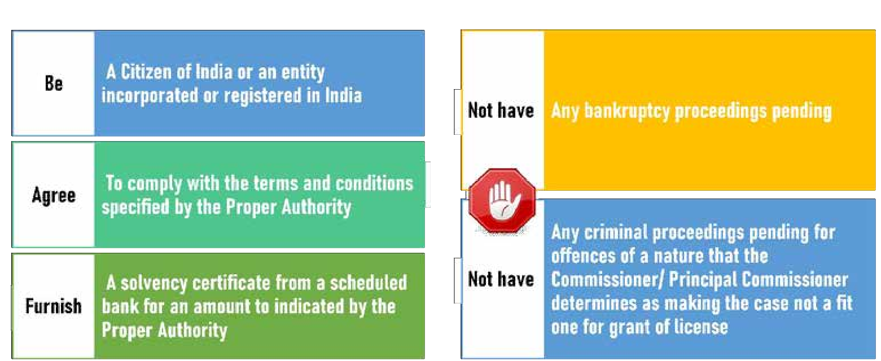
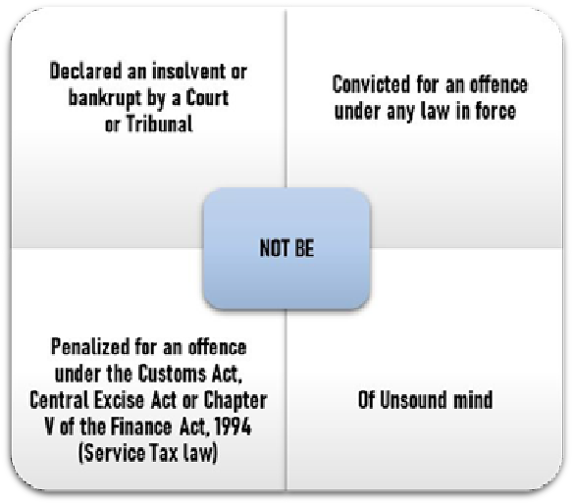
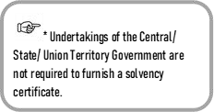
To operate a Private Warehouse under Section 58 of the Customs Act, you should:
65A: Goods brought for operations in warehouse to have ordinarily paid certain taxes- Section 130 of the Finance Act, 2023

Slide 19
How to Do It?
Create Facility for PvtWH
Apply and Obtain MOOWRs License
Convert Your Factory (or Part) into a Pvt. Warehouse
Transfer Import Cargo from Port to Factory
Manufacture Finished Goods
Export Goods
Or Sale Domestically
Pay BCD + IGST on Imported Goods Used for Domestic Sales
BCD +IGST on Imported goods used in Exported Goods is waived
Keep Records and File Monthly Returns
65A: Goods brought for operations in warehouse to have ordinarily paid certain taxes- Section 130 of the Finance Act, 2023

Slide 20
Benefits
Deferred Duty on Inputs Imported inputs, can be brought into the warehouse without payment of Customs Duties (BCD and IGST) and stored in the warehouse.
Export: If the imported goods are used for exported (either as such, after subjecting to manufacturing or other processes), no need to pay Customs duties on the imported inputs.
Domestic Supply : If imported goods are used for domestically supplied finished goods, pay import duties without interest
Other Operations: Not only Manufacturing but Other Operations like Packing, Repacking, Labelling, Assembling, Polishing, Resizing etc. are also allowed
65A: Goods brought for operations in warehouse to have ordinarily paid certain taxes- Section 130 of the Finance Act, 2023

Slide 21
Benefits
No Export Obligations or Positive Net Forex
No need to pay any interest till the permitted warehousing period.
Payment of Customs duties postponed to a future date.
Paves way for greater cash flow.
Self appointed warehouse keeper and no physical control by “Bond officer”.
Trading also possible
65A: Goods brought for operations in warehouse to have ordinarily paid certain taxes- Section 130 of the Finance Act, 2023

Slide 22
Benefits
Goods can be sent to Job Work
No Interest on BCD/IGST on import if used for domestic clearance of Finished Goods
No Need to pay Storage Charges/Demerges at Public Warehouse/Port
Better Inventory Management as non-duty paid goods are in factory itself
IGCR (Import of Goods at Concessional Rate of Duty) allowed
Self declared Input Output norms (Unlike SION)
65A: Goods brought for operations in warehouse to have ordinarily paid certain taxes- Section 130 of the Finance Act, 2023

Slide 23
Capital Goods
Capital Goods can also be imported without duties
Long term Capital investment may be reduced for imported Capital Goods (average 25-30% of total cost)
No BCD/IGST if Capital Goods are reexported after usage
No time limit to export or remove Capital Goods if under usage
65A: Goods brought for operations in warehouse to have ordinarily paid certain taxes- Section 130 of the Finance Act, 2023

Slide 24
Procedures
Application in form “Annexure-A” to be given before Commissioner.
Records to be maintained in form “Annexure-B”.
Bond to be executed in form “Annexure-C”. (3 times the duty)
If resultant goods are exported – Shipping Bill and GST invoice to be prepared. No need to pay Customs duties on imported goods.
If resultant goods are cleared for domestic consumption – GST invoice to be prepared. Ex-bond BOE to be filed and customs duties to be paid on imported goods, at the time of supply of goods for domestic consumption.
65A: Goods brought for operations in warehouse to have ordinarily paid certain taxes- Section 130 of the Finance Act, 2023

Slide 25
Procedures
Domestic procurements can be made as usual on payment of applicable GST.
Imported goods can also be cleared for domestic consumption as such (trading).
Goods otherwise exempted from customs duties can also be imported and brought into the warehouse.
Prior permission of proper officer, for removal, export, removal to another warehouse – not required.
Inform input-output norms.
65A: Goods brought for operations in warehouse to have ordinarily paid certain taxes- Section 130 of the Finance Act, 2023

Slide 26
Procedures
Permission once granted, valid unless it is cancelled or surrendered. No renewal required.
A “warehouse keeper” to be appointed by the applicant, who has knowledge in warehousing and customs procedures.
Signage – Customs Bonded warehouse.
Computerized stores records.
Proper security measures.
65A: Goods brought for operations in warehouse to have ordinarily paid certain taxes- Section 130 of the Finance Act, 2023

Slide 27
Procedures
Transportation from Customs Station to warehouse, warehouse to another warehouse, warehouse to Customs Station (export) shall be made under a secure One Time Lock (OTL).
Upon receipt of goods in warehouse, the OTL shall be verified and any discrepancy to be notified.
Endorsement of receipt of goods in BOE and Transport documents and intimation to Bond officer.
Filing of monthly return in Form B, in case of non Section 65 operations.
65A: Goods brought for operations in warehouse to have ordinarily paid certain taxes- Section 130 of the Finance Act, 2023

Slide 28
Warehousing Period
Capital goods – till they are cleared from the warehouse.
Other than capital goods (inputs) – till their consumption or clearance from the warehouse. (At the time of clearance of the resultant products – Para 8 of Circular 34/2019).
For trading though warehousing period is one year, interest payable after 90 days.
BOE shall be filed and Customs duties shall be paid for the warehoused inputs / capital goods, as above. No interest. Any further delay in payment of customs duties would invite interest.
65A: Goods brought for operations in warehouse to have ordinarily paid certain taxes- Section 130 of the Finance Act, 2023

Slide 29
Treatment of waste
Waste attributable to the final products cleared for home consumption.
- Appropriate GST to be paid on sale.
- Import duties to be paid for the inputs contained in waste (even if destroyed)
Waste attributable to the final products exported.
- Import duties on inputs need not be paid, if destroyed.
- Otherwise, import duty to be paid, “as if the waste is imported”.
- Upon sale, appropriate GST to be paid.
65A: Goods brought for operations in warehouse to have ordinarily paid certain taxes- Section 130 of the Finance Act, 2023

Slide 30
Warehoused Goods
Exported out of India (deferred duties not collected)
Manufacture and Other Operations
Warehoused Goods cleared for Home Consumption
Regulation 4 of Manufacture and Other Operations in Warehouse (no. 2) Regulations, 2019: Inform the input-output norms, wherever considered necessary for raw materials and the final products and to inform the revised input−output norms in case of change therein.
Manufacture and Other Operations in Warehouse (No. 2) Regulations, 2019 – FORM
-(See clause (iv) of
sub-regulation (1) of regulation
2) Part A/ Part B
Annexure B & C to Circular 34/2019- Cus., dated 1st October 2019
Resultant Goods for Export (no duty is required to be paid in respect of the imported goods contained in the resultant product)
Resultant Goods for Home Consumption (import duties payable on the imported goods contained in the resultant products)
Waste ( Section 65(2)(a) refers)
Waste (Section 65(2)(b) refers)

Slide 31
Comparison With Other Schemes
Feature | MOOWR | SEZ | EOU
Export Obligation | No | +Net Forex | +Net Forex
Geographical Limit | None | Yes (Notified) | Yes
Duty Benefit | Deferral +Waiver | Waiver but not for Domestic | Waiver but not for Domestic
Domestic Supply | Allowed | Limited | Limited
65A: Goods brought for operations in warehouse to have ordinarily paid certain taxes- Section 130 of the Finance Act, 2023

Slide 32
Procedural Benefits under MOOWR as compared with
AA and EOU/SEZ
A single application for conversion.
No application and subsequent redemption of various licenses like in AA. Once converted into MOOWR, free flow of duty-deferred inputs and subsequent exports. Even no renewal of warehouse license is required
Monthly Returns are easy since no NFE calculations are involved
Norms only need to be ratified by Jurisdictional Commissioner and not by Norms Committee or SION notified.
No restriction on availment of benefits under FTP
65A: Goods brought for operations in warehouse to have ordinarily paid certain taxes- Section 130 of the Finance Act, 2023

Slide 33
Scenario if same input is imported as well as domestically procured
A unit may use both imported and domestically procured identical inputs. Domestically procured inputs are used in export business and imported inputs are used in domestic business.
EOU: Domestic inputs are duty-free since AIR given to DTA supplier. Hence, exports are free of taxes. Imported inputs when used in DTA business need to surrender taxes. So it is neutral.
AA: It is neutral since benefit extended to post-export imported inputs (through legally disputed)
MOOWR: There is a problem. Domestic inputs have suffered inherent duties which are not reimbursed since final exports are not eligible for AIR( All Industry Rate). Imported inputs when used in domestic business need to surrender duties.
This effectively means that MOOWR has pre-import condition to avail benefit. Also, the quantum of imported raw material should be more than domestic raw material.
65A: Goods brought for operations in warehouse to have ordinarily paid certain taxes- Section 130 of the Finance Act, 2023

Slide 34
Transferring imported capital goods to Supporting Manufacturer location
Under MOOWR, job work is allowed. But capital goods imported cannot be shifted to job worker premises. Only tools, moulds and drawings etc. can be provided to job worker and not main machinery.
Under EPCG Scheme, facility of installing the machinery at supporting manufacturer location is also provided.
Even EOU/SEZ scheme does not allow shifting of main machinery to supporting manufacturer
65A: Goods brought for operations in warehouse to have ordinarily paid certain taxes- Section 130 of the Finance Act, 2023

Slide 35
Who Should OPT for MOOWAR? A few cases
Heavy investment in imported P&M.
High percentage of imported raw materials vs. domestic raw materials.
Good DTA business along with Export business.
Inverted duty structure (CG can be imported under this scheme to reduce accumulated ITC).
Period of operations
65A: Goods brought for operations in warehouse to have ordinarily paid certain taxes- Section 130 of the Finance Act, 2023

Slide 36
PPC
Punit Prajapati & Co.
Ahmedabad I Rajkot
Thank You
Sp. Acknowledgment for Assistance
Brij Thakkar and Ajay Singh
Punit Prajapati & Co.
Chartered Accountants
www.PunitPrajapati.com
Ahmedabad I Rajkot
CA Keyur Kamdar
CA Raj Marvaniya
CA Vismay Shah
CA Punit Prajapati
CA Raksha Prajapati
CA Himanshu Jangid
1119-20, Iconic Shyamal,
Nr. Shyamal Cross Road,
Satellite, Ahmedabad15
73594 01648
1101, R K Prime, 150ft Ring Road, Nr. Nana Mava Circle, Rajkot.
091 79904 17534

