Slide 1
TAXVISION – A Series on Decoding the New Income Tax 2025
Income from Business or Profession
ITA 1961 vis-à-vis ITA 2025
CA Parshva Mehta

Slide 2
Agenda
What shall we discuss today
01
02
Major Changes under the PGBP head
Addition and Deletion of Sections
03
04
Section by Section Analysis
Q&A
2
2

Slide 3
Major Changes
Noteworthy Changes
3

Slide 4
Generic changes in PGBP head
Sections Merged
Use of Tables and Schedules
Similar sections (like presumptive taxation for NRs) merged to simplify content, concise, and consolidate related scenarios
Provisions having multiple scenarios like determining Actual Cost, have been organized into a table
1
2
3
4
5
Revision of Flow
Formulas Added, Redundant sections deleted
Consolidation of similar Sections
To improvise coherence, logical links, smoother progression
Formula based explanations added to clarify complex concepts like WDV, Redundant and sun-set provisions removed
Sections on similar topics have been grouped together
4

Slide 5
Major Changes under the head PGBP - Continued
Presumptive Taxation
Depreciation on Goodwill
Presumptive taxations schemes consolidated for R (without changes) and NR (with changes) into tables
Goodwill adjustments for depreciation removed and definition of intangibles tweaked slightly
Cost of Asset
Bad Debts
Actual cost of an asset excludes GST if input tax credit is claimed.
Table explaining bad debts for banks and NBFCs
Partially used Assets
Tax deemed to include Surcharge
Depreciation and expenses on assets not fully used for business will be allowed only proportionately, as determined by the AO.
Tax deemed to include Surcharge in corresponding Sections to 40(a)(ii)

Slide 6
Major Changes under the head PGBP - Continued
For computing 95% threshold, possible view that receipts and payments not part of core business may be excluded to determine tax audit limit for Section 44AB
No claw back provision on investment linked expenditure claimed under ITA 1961 u/s 35AD.
Tax paid on any income including foreign income, cannot be claimed as an expense, earlier limited to tax on business
Major Changes
Provisions relating to Site Restoration Fund, Tea/Coffee/Rubber Development Account moved to Schedules
D
“Information Technology” and “CS” have been explicitly included in the list of specified professions, which were previously notified separately. Further, an AR and firm artist have been proposed to be removed.

Slide 7
Amendment in Budget 2026
Budget 2026 - Employees’ contribution to PF now allowed if deposited on or before due date of filing return of income
Employees’ contribution to PF/ESI was governed by two provisions:
Section 36(1)(va) – allowed deduction only if employees’ contribution was deposited within the due date under the PF/ESI law.
Section 43B – allowed deduction for employer contributions if paid before the due date of filing the income tax return.
In Checkmate Services Pvt. Ltd. v. CIT, the Supreme Court held that Employees’ contribution is separate from employer contribution. If the employee PF/ESI is not deposited within the PF/ESI due date, deduction cannot be allowed, even if it is paid before filing the income-tax return.
Budget 2026 neutralizes the impact of the Supreme Court ruling in Checkmate Services by allowing deduction of employees’ share of PF/ESI contribution if deposited up to the due date of filing the income-tax return.
Interestingly the amendment is made only in ITA 2025 and not ITA 1961, thus delay in FY 2025-26 will be subjected to disallowance if deposited after due date under respective Act.
7

Slide 8
Deletion and addition of new provisions
What is dead and what is born?

Slide 9
Old Redundant provisions are deleted from the ITA 2025
Group | Old sections | Why not retained in 2025 Act
Old investment allowances | 32A, 32AB, 32AC, 32AD | Schemes sunset/phased out; policy shift to fewer, targeted incentives and standard depreciation/cost rules.
Development / area based incentives | 33, 33A, 33AC, 33B | Time bound incentives; removed as part of pruning >300 redundant provisions.
Depreciation on machinery and special IP costs | 34, 34A, 35A, 35AB | Concepts either obsolete or now embedded into integrated depreciation/actual cost clauses, making separate sections unnecessary.
Approved project / rural / conservation donations | 35AC, 35CCA, 35CCB | Weighted/approved project deductions sunset; simplification and move away from exemption heavy model.
Presumptive for small retailers | 44AF | Already withdrawn; folded into unified presumptive scheme replacing 44AD/44ADA/44AE style fragmentation.
Royalty/FTS for foreign companies | 44D | Replaced in substance by modern non-resident and special rate provisions plus treaty-based taxation; considered redundant in new code.
9

Slide 10
Why did MoF provide deductions/incentive?
2
Identified area for growth
4
1
They could incentivize specific sectors and not give away the higher tax rate for normal businesses
Profit linked and investment linked
3
India wanted to develop
The benefit impacted net cash inflow but did not mean additional outflow
Defined terms – only valid claims to be approved
The deductions were mainly used to boost – infrastructure and manufacturing in backward areas
They tried to put clearer conditions
10

Slide 11
Why did the policy fail?
Eligibility Failures
Taxpayer Abuses
Reasons for failure of deduction scheme
Interpretation Disputes
Denial by AO
Long drawn Litigation
Procedural lapses
Revisions/ Re-assessment
High Admin Cost

Slide 12
Insertion of New Provision for Interpretation – Section 66
Why
01
04
When
Provides definition of various terms for the PGBP Chapter
Specific cases and consideration for each provisions provided earlier now included here
What
02
03
How
Various definition like “plant”, “paid”, “service”, “speculative transactions”, etc. is included
Future clarificatory amendments likely to be made vide this Section.

Slide 13
Data Center Services
Income of foreign company procuring services of Indian data centers proposed to be exempted
Data Center Scheme to be notified by CG
Foreign companies also to be notified by CG
Certain conditions prescribed
Sales to Indian users to be made only through an Indian reseller entity
Data centers to be owned & operated by Indian company
Foreign company must not own or operate any of physical infrastructure or resources
Subject to prescribed information and compliance requirements
Exemption available up to Tax Year ending March 31, 2047
13

Slide 14
Capital goods supplied to contract manufacturer
Income of foreign company from following supplies exempted
Supply of capital goods, equipment and tooling
Goods should be under control and direction of Indian manufacturer
Ownership remains with Foreign Company
Conditions prescribed –
Use by Indian contract manufacturers for electronic manufacturing in India
manufacturing on behalf of foreign company for a consideration and
Contract manufacturer should be located in custom bonded area
Exemption upto tax year 2030-31
Aimed at giving a boost to Electronics Manufacturing Services ecosystem in India
Proposal may result in nominal tax loss to Indian exchequer – TP?
14

Slide 15
Exemption from MAT to certain non-residents
MAT normally applicable to foreign companies having a presence in India
Presumptive taxation provided for certain businesses (also exempted from MAT)
Business of operation of ships other than cruise ships
Business of operation of aircraft
Business of civil construction / erection / testing / commissioning of P&M in connection with turnkey project approved by CG
Business of providing services / facilities for prospecting, extraction or production of mineral oils
Benefit of exemption from MAT extended to following businesses taxed on presumptive basis
Business of operation of cruise ships
Business of providing services / technology in India for purpose of setting up an electronics manufacturing facility, or in connection with manufacturing / producing electronic goods
15

Slide 16
Section by Section Analysis
In depth Analysis
16

Slide 17
Charging provision
17

Slide 18
Section 28 of ITA, 1961 / S. 26 Income from PGBP r.w.s. S. 66 of ITA, 2025 - Interpretation
It is a charging section for PGBP. It specifies the incomes chargeable under the head PGBP, which includes:
Business Profits: Profits and Gains of any business / profession carried on at any time in tax year
Compensation: Compensation / payment in connection with termination of management, office, or agency, or contract received / due to a person wholly / substantially managing affairs of Indian Co or in India of another Co, or holding agency in India for business activities of other person, or for any contract relating to business, or for vesting of management of any property or business in Govt.
Trade Associations: Income derived by trade, professional, or similar association.
Export Incentive: Profits on sale of import license, cash assistance against export, duty drawback / remission, or any other export incentive.
Benefits and Perquisites: Value of benefit or perquisite arising from business or profession.
Partners Income: Interest, Salary, Bonus, Commission, or Remuneration due to received by partner of firm.
18

Slide 19
Section 28 of ITA, 1961 / S. 26 Income from PGBP r.w.s. S. 66 of ITA, 2025 - Interpretation
Non-Compete fees: Any sum under agreement for not carrying out any activity in relation to any business or profession except sum received for “transfer of right to manufacture or carry on business or profession” chargeable under the head CG or sum from Multilateral fund of Montreal Protocol.
Intangible Assets: Any sum under agreement for not sharing know-how, patent, copyright, etc
Keyman Insurance: Sum received under a Keyman Insurance Policy
Inventory: FMV of Inventory on date of its conversion into capital asset
Demolished Capital Asset: Sum received when capital asset, except land or goodwill or financial instrument, is demolished / destroyed and of which whole expenditure is allowed u/s 35AD of ITA 1961 or 46 of ITA 2025
Speculative Transactions: Speculative transactions of such nature to constitute business
It is also clarified that income from letting out of residential house is taxable only under HP.
Definitions are transferred to Section 66 of the Act.
19

Slide 20
Section 28 of ITA, 1961 / S. 26 Income from PGBP r.w.s. S. 66 of ITA, 2025 - Interpretation
Changes | ITA, 1961 vis-à-vis ITA, 2025
Export Incentives & Duty Remission | Similarly, in ITA 1961 only cash assistance 28(iiib) and duty drawback (iiic) were taxable on receipt or accrual basis. Now in ITA 2025, in every kind of export incentive is taxable on a right to receive basis as word used is received or receivable. Possible issue of timing mis-match. Earlier the specific schemes were mentioned which were taxable, now the word any other is included covering all forms of export incentives.
Non-Compete/CG Interplay | In 1961, the term used was sum “received or receivable” in connection with transfer of right to manufacture or carry on business or profession which is chargeable under the head CG, is not chargeable under PGBP. In 2025, the term used is sum “received” in connection with such transaction which is chargeable under the head CG, is not chargeable under PGBP. One may develop an argument that sum “receivable” for such transaction shall not chargeable under CG, but may be chargeable under PGBP.
20

Slide 21
Capital Assets and everything around them
21

Slide 22
Section 30 & 31 of ITA 1961 / Section 28 of ITA, 2025 – Rent, rates, taxes, repairs and insurance
Section deals with deduction in respect of Rent, Rates, taxes, repairs and insurance
Analysis of change: Merely clubbing of provisions and language simplification.
Following amount shall be allowed as deduction in respect of premises, machinery, plant, or furniture used for business or profession:
Rent for premises occupied as tenant
Cost of repairs (not being capital expenditure) where it has been undertaken to bear said cost, of premises occupied as tenant or otherwise
Land revenue, local rates, or municipal taxes
Insurance Premium against risk of damage or destruction
Current repairs of machinery, plant or furniture (not being capex)
22

Slide 23
Section 32 of ITA 1961 / Section 33 of ITA 2025 – Deduction for depreciation r.w.s. Section 66 - Interpretation
Owned wholly or partly and used “wholly & exclusively” for the purpose of business or profession
Depreciation allowed on buildings, machinery, plant, or furniture
Know-how, patents, copyrights, trademarks, or licenses or franchises or any other “similar” business or commercial rights but not being goodwill of a business or profession
“First” put to use by the assessee for the purposes of business

Slide 24
Section 32 of ITA 1961 / Section 33 of ITA 2025
Analysis of change | ITA, 1961 vis-à-vis ITA, 2025
"Wholly & Exclusively" Condition | Under 1961, words “wholly & exclusively” were not used in Section 32 however the same was always deemed by virtue of Section 38(2) which relates to proportionate deduction. Now in 2025, the same is rephrased and the words used in 38(2) of 1961 have been inserted in Section 33 itself
"First Put to Use" vis-à-vis additional depreciation | 1961 Act did not explicitly mention that new machinery is to be ‘first put to use’ for business for the purpose of claiming additional depreciation. However, provisos made it crystal clear that said new machinery should be put to use for business in that previous year in which it was acquired. Now to impart more clarity, 2025 has inserted condition that new machine shall be ‘first put to use’ for business instead of mere ‘put to use’. The intent indicates that claim of additional depreciation is now more stricter. Eg. New Machine was put to use for any other purpose and then put to use for business. In this case under 1961 Act he would qualify for additional depreciation but not under 2025 Act.
24

Slide 25
Section 38 of 1961 / Section 28 & 33 of 2025 – Deduction for expense on assets partly used for business
Earlier as per Section 38(2), the power of AO to proportionate the expenses incurred for building or plant and machinery or furniture was limited to cases where the part of the premises was “partly used or not wholly and exclusively used for the purposes of the business or profession”
Section 28 now removes the word “partly used” and includes all cases where such premises, building , machinery is not “exclusively used for the purpose of business or profession.”
Deduction for rent, rates, taxes , repairs and insurance along with depreciation will be restricted to the fair proportionate part thereof as may be determined by AO but having regard to the usage for the purpose of business.
The deduction is restricted to a fair and reasonable proportion based on extent of use, facts, and circumstances as decided by AO.
Analysis of change:
The words used in ITA 1961 was either partly used or not wholly and exclusively used for the purpose of business or profession. The scope is now widened by removing the word partly and rephrasing the sentence as not exclusively used for the purposes of the business or profession
25

Slide 26
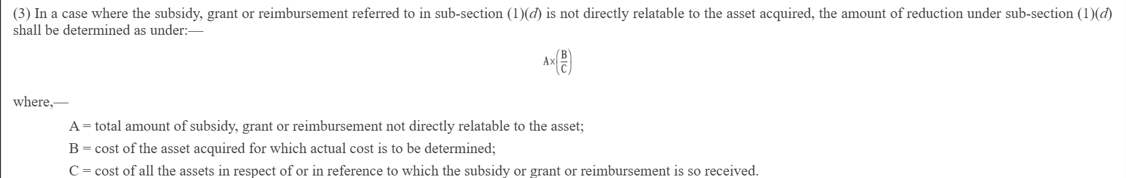
Section 43(1) of ITA 1961/ Section 39 of 2025 – Computation of Actual Cost
This section provides for how the cost of the asset is determined for the purpose of computing WDV of a capital asset.
Specific reduction of “goods and services tax paid in respect of which credit of input tax has been claimed and allowed under the relevant law;”. In case credit is not available, the same may be claimed as part of cost?
Subsidy, grant or reimbursement by whatever name called to be specifically reduced. If the same is proportionate use the following formula, earlier it was provided by way of explanation.
What about cases where assessee could not claim credit but was allowable under law
26

Slide 27
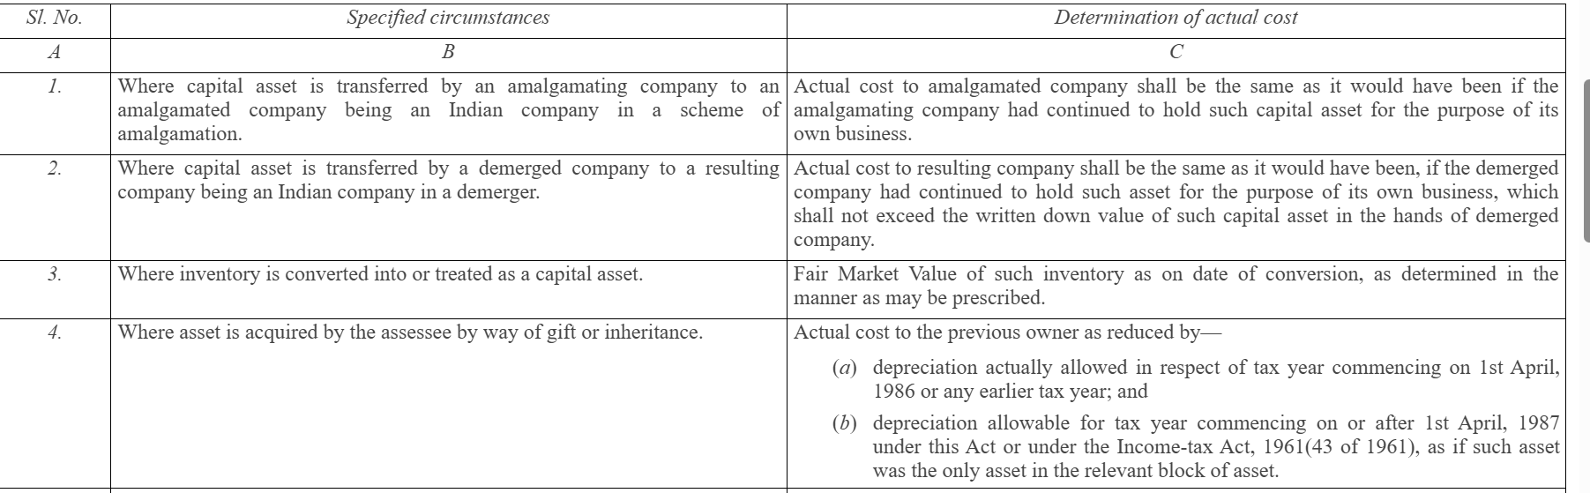
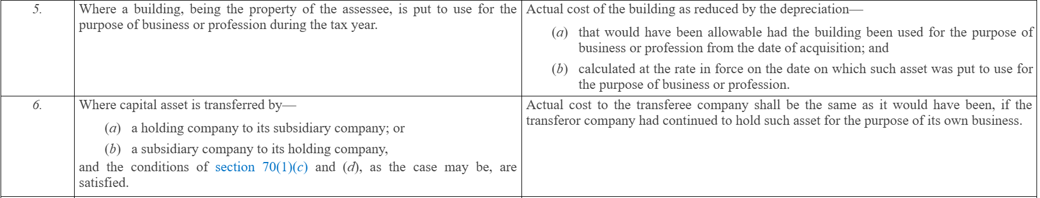
Section 43(1) of ITA 1961/ Section 39 of 2025 – Computation of Actual Cost
27

Slide 28
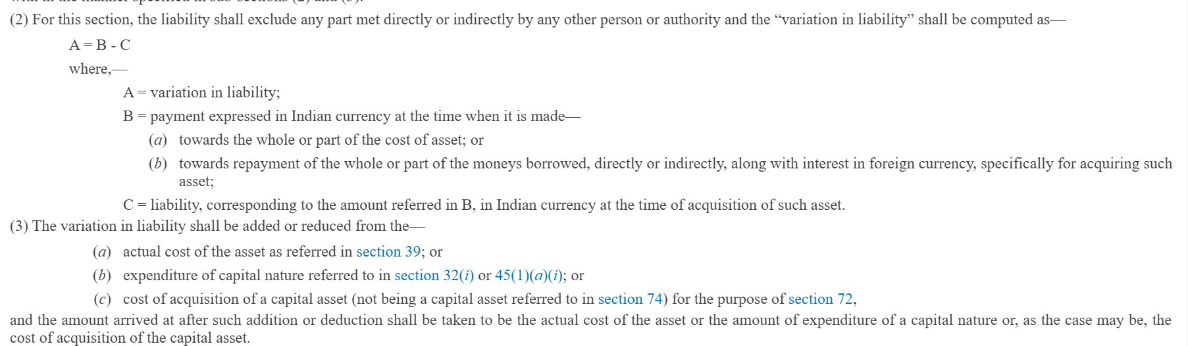
Section 43A of ITA 1961/ Section 42 of 2025
Section 43A provides for adjustment in the actual cost (or WDV) of a capital asset acquired from outside India due to fluctuation in foreign exchange rates at the time of making payment in foreign currency.
Instead of using various clauses to define what amount is to be adjusted in the cost of the asset due to foreign exchange, now a formula is prescribed wherein the variation.
Analysis of change: Language simplification and formula based presentations for ease of understanding.
28

Slide 29
Normal Deductions under PGBP
29

Slide 30
Section 36 of 1961 / Sections 2, 29, 30, 31, 32, & 66 of 2025
Section specifies specific deductions allowable in respect of business-related expenses, contributions, and losses, provided the prescribed conditions are fulfilled. Some of the key deductions are:
Stock Insurance: Insurance Premium of stock in trade.
Employee Benefits: Insurance, Bonus, Commission relating to Employees.
Interest on Borrowing: Interest on borrowed capital for business purpose.
Welfare Contributions: Employer’s contribution to funds, Gratuity, Superannuation funds.
Bad Debts: Amount of bad debts written off.
Banking Provisions: Provision for bad & doubtful debts for banks / financial institutions
Analysis of change: In 1961 the provisions were scattered such as expenses for contribution to PF 36(1)(iv) (va), Gratuity 40A/43B, Superannuation, etc. Now the same has been consolidated at one place and language is simplified.
Similarly, the deduction for provisions for bad debts has been consolidated into one separate section and for banks and financials institutions, the allowance for bad debts provisions have been presented in tabular format.
30

Slide 31
Section 36 of 1961 / Sections 2, 29, 30, 32, & 66 of 2025
Section specifies specific deductions allowable in respect of business-related expenses, contributions, and losses, provided the prescribed conditions are fulfilled. Some of the key deductions are:
Stock Insurance: Insurance Premium of stock in trade.
Employee Benefits: Insurance, Bonus, Commission relating to Employees.
Interest on Borrowing: Interest on borrowed capital for business purpose.
Welfare Contributions: Employer’s contribution to funds, Gratuity, Superannuation funds.
Banking Provisions: Provision for bad & doubtful debts for banks / financial institutions
Analysis of change: In 1961 the provisions were scattered such as expenses for contribution to PF 36(1)(iv) (va), Gratuity 40A/43B, Superannuation, etc. Now the same has been consolidated at one place and language is simplified.
31

Slide 32
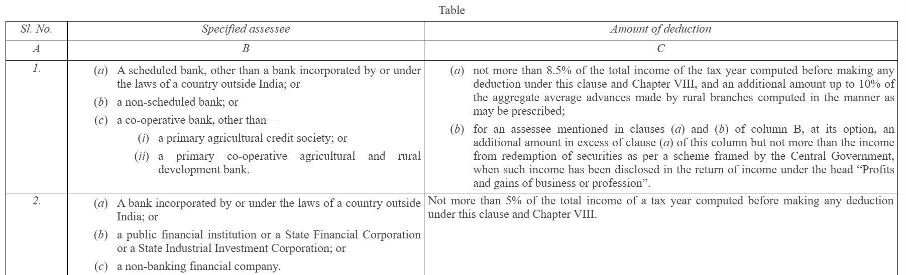
Section 36 of 1961 / Sections 31 of 2025 –Bad debts
The deduction for provisions for bad debts has been consolidated into one separate section and for banks and financials institutions, the allowance for bad debts provisions have been presented in tabular format.
Rest provisions remain same, only the tax year in which the such amount is written off as irrecoverable in the accounts of the assessee
32

Slide 33





Section 37 of 1961 / Section 34 of 2025
Section allows deduction of expenditure (other than capital and personal nature expenditure), incurred wholly and exclusively for the business / profession, which not covered under Sections 30 to 36, ensuring that genuine business expenses are not denied merely because they are not specifically listed elsewhere, except expense for offence or act prohibited by law or advertisement in any souvenir, brochure, tract, pamphlet or the like, published by a political party.
Analysis of Change | ITA, 1961 vis-à-vis ITA, 2025
CSR Expenses | 1961 Act provided that “CSR Expenses shall not be deemed to be an expenditure incurred for the purpose of business” i.e. if it can be proved that CSR Expense is for business purposes, then the deduction of same can be claimed u/s 37. The ITA 2025, it is mentioned that “CSR Expenses shall be deemed to be an expenditure incurred not wholly and exclusively for business or profession” putting an end to the controversy.
33

Slide 34
Section 40 of 1961 / Section 35 of 2025
Section specifies certain expenses which are expressly disallowed while computing income under the head PGBP, even if such expenses are otherwise genuine.
Some of such deductions not permissible are:
Tax on profits.
Salary / Bonus / Remuneration to Partners subject to Section 40(b).
Interest to Partners.
Payment to NR / Foreign Co, where TDS is deductible and same is not deducted or deducted but not paid with due date of filing ITR.
30% of payment to Resident, where TDS is deductible and same is not deducted or deducted but not paid with due date of filing ITR
34

Slide 35
Section 40 of 1961 / Section 35 of 2025 – Contd.
Analysis of Change | ITA, 1961 vis-à-vis ITA, 2025
TDS on Salary to Non-Resident | Under 1961, salary payment to NR was not allowable as deduction when TDS has not been deducted AND not paid on such payments Under 2025, salary payment to NR is not allowable as deduction when TDS has not been deducted OR notpaid on such payments Unlike other provisions where disallowance is triggered when TDS is deductible and same is deducted but “not paid with due date of filing ITR”, in case of TDS on salary payment to NR, the disallowance is triggered when TDS is deductible and same is deducted but not paid. Whether the benefit of deduction is to be granted in case the same is paid within the due date of furnishing ITR?
35

Slide 36
Section 40A of 1961 / Section 36 & 29 of 2025
Section specifies expenses or payments which cannot be claimed as deduction in certain circumstances. Some of the major are:
Excessive or unreasonable payments (40A(2)).
Cash payments exceeding prescribed limit (40A(3)).
Provision for Gratuity (40A(7)).
Payment to Employees’ Welfare Funds (40A(9)).
Analysis of change: Provisions were scattered and now the same has been consolidated at one place. Further tabular presentations have been made, and language simplification is done.
Payment to be made through “specified banking or online mode”, earlier words used were “an account payee cheque drawn on a bank or account payee bank draft, or use of electronic clearing system through a bank account or through such other electronic mode as may be prescribed”
36

Slide 37
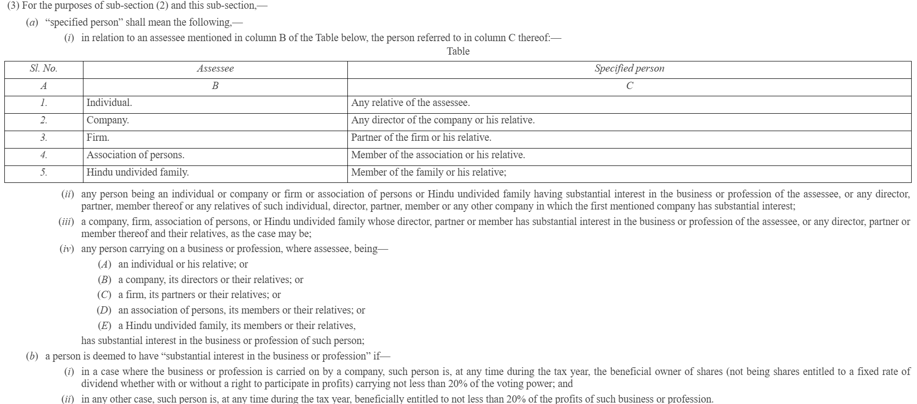
Section 40A of 1961 / Section 36 & 29 of 2025
37

Slide 38
Section 41 of 1961 / Section 38 of 2025
Section brings to tax certain receipts or benefits which arise after a deduction or allowance has been claimed earlier, by treating them as deemed business income.
Some of the key insights of Section 41 are:
Remission or cessation of Trading Liability.
Recovery of Bad Debts or other deductions or loss or expenditure.
Withdrawal of allowance for scientific research or sale of capital asset used for scientific purpose.
Recovery of amount from special reserve.
Analysis of change: Language simplification and formula presentations is done.
Erroneously, they have not referred to the provisions of earlier section pertaining to scientific research in Section 38(1)(c), only reference is made to Section 45 of ITA 2025, anomaly likely to arise if such assets whose full cost was deducted u/s 35AD of the ITA 2019
38

Slide 39
Section 43AA of 1961 / 43 of 2025
Section 43AA provides a uniform method for computing gains or losses arising from foreign exchange fluctuations in respect of specified foreign currency transactions, aligning tax computation with notified accounting standards.
Income or Expenditure arising from foreign currency transactions
Monetary items, non-speculative forward exchange contracts, other foreign currency transaction related to business
Section still refers to ICDS which may undergo a change once the same is merged with Ind-AS or vice-versa.
Analysis of change: Language simplification and formula based presentations is done
39

Slide 40
Section 43B of 1961 / Section 37 of 2025
Section restricts deduction of specified expenses only on actual payment basis (on or before due date of filing ITR), even if the Assessee follows the mercantile system of accounting. This section was introduced to curb the practice of claiming deductions without making actual payments.
Some of the major expenses covered are:
Any tax, duty, cess, fee, or surcharge (GST, Excise, Professional tax, etc)
Employer Contribution to PF, Gratuity, etc.
Bonus or Commission to Employees
Leave Encashment.
40

Slide 41
Section 43B of 1961 / Section 37 of 2025 – Contd.
Analysis of Change | ITA, 1961 vis-à-vis ITA, 2025
Non-obstante clause strengthened | “Notwithstanding anything contained in any other provision of this Act,” – ITA 1961 “Irrespective of— (a) any provision to the contrary in this Act; or (b) method of accounting regularly followed; or (c) the tax year in which the liability was incurred.” – ITA 2025
Surcharge | In 1961, Surcharge was not explicitly mentioned under tax, duty, fees, etc. Now surcharge is mentioned in 2025 and hence deduction of surcharge will be allowed in year in which same is actually paid.
Requirement of Evidence | In 1961, if sum covered u/s 43B (other than 43B(h)) was paid before due date of filing ITR, then to claim deduction the Assessee was required to furnish evidence of such payment along with ITR. In 2025, the said condition has been parted with. This was a mechanical provision no longer possible under electronic filing, so was removed from the Act.
Does this mean that earlier it could be claimed as deduction even if not paid?
41

Slide 42
Presumptive Taxation
42

Slide 43
Section 44AA of 1961 / Section 62 of 2025
Section prescribes who is required to maintain books of account, what type of books, and the conditions under which such books must be kept to enable the AO to compute taxable income correctly.
Covers profession such as Legal, medical, engineering, architectural, accountancy, technical consultancy, interior decoration, information technology, company secretary, and other profession as notified by CBDT.
Assessee who claimed their income to be lower than the profit deemed u/s
44AE (58(2) of 2025),
44BB (61(2) of 2025),
44BBB (61(2) of 2025),
44AD (58(2) of 2025),
44ADA (58(2) of 2025)
shall be mandatorily required to maintain books.
43

Slide 44
Section 44AA of 1961 / Section 62 of 2025 – Contd.
Analysis of Change | ITA, 1961 vis-à-vis ITA, 2025
Scope Expansion | In ITA 1961, profession of ‘information technology’ and ‘company secretary’ were notified by way of a CBDT notification No. 2675/385(E). Now in 2025, the same is included in the section itself. However profession of ‘authorised representative’ and ‘film artist’ notified vide SO 17(E) is not mentioned in the section. It may be separately notified in future.
Maintenance of Books | In 1961, the assessees who claimed their income to be lower than the profit deemed u/s 44AE, 44BB, and 44BBB were required to maintain books of account. The scope now seems to be extended to provisions of Section 44AD and 44ADA as well.
Does this mean that AR and Film Artist will not be covered under the provisions of Section 44AA?
44

Slide 45
Section 44AB of 1961 / Section 63 of 2025
Section mandates tax audit of accounts for certain persons carrying on business or profession.
Business – If total sales / turnover > Rs.1 Cr. Limit will be Rs.10 Cr is cash receipts & payments up to 5% ; Profession – If total sales / turnover > Rs.50 lacs.
Presumptive Taxation u/s – If income declared in lower than the presumptive rate and income exceeds basic exemption limit
As per Section 44AB of ITA, entities are exempt from tax audits if their total turnover is Rs. 10 crore or less and at least 95% of all receipts and payments are done through banking channels (i.e., non-cash transactions). The language of this provision is such that it takes into account even non-business receipts and payments for calculating the 95% threshold.
In the ITB, it seems that the exemption criteria remain the same but provide that receipts and payments from business will be considered for the 95% threshold. This means receipts and payments that are not part of the core business operation (for example, dividends or interest incomes) will not be included in determining whether a tax audit is required.
45

Slide 46
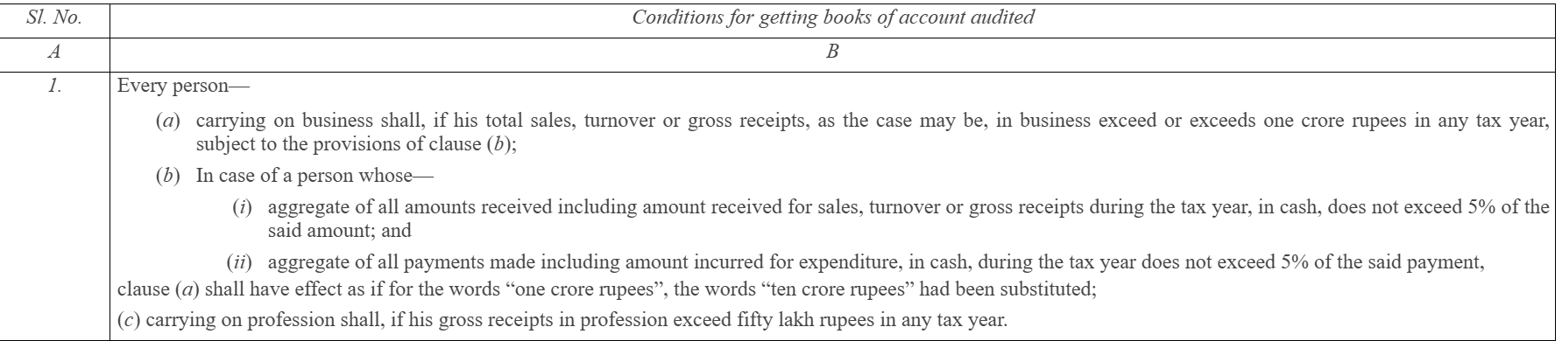
Section 44AB of 1961 / Section 63 of 2025
Analogy will have to be cleared by the department
46

Slide 47
Section 44AD & 44ADA of 1961 / Section 58 of 2025
Section provides a simplified scheme of taxation for small businesses, allowing income to be computed on a presumptive basis, thereby reducing compliance burden like maintenance of books and tax audit.
Resident Individual, HUF, or Firm engaged in any business other than plying, hiring, or leasing goods carriage, or agency business, or commission / brokerage earning business whose turnover does not exceed Rs.2 Cr.
If once opts out of 44AD, then same cannot be opted for next 5 years and audit becomes mandatory.
Section provides a simplified presumptive taxation scheme for small professionals, reducing compliance requirements such as maintenance of books of account and tax audit provided gross receipts does not exceed Rs.50 Lacs
Analysis of change: 1961 Act had overriding effect over provisions of Section 28 to 43C. However in 2025, the scope has been increased to Section 44A (50 of 2025) and 43CA (53 of 2025).
47

Slide 48
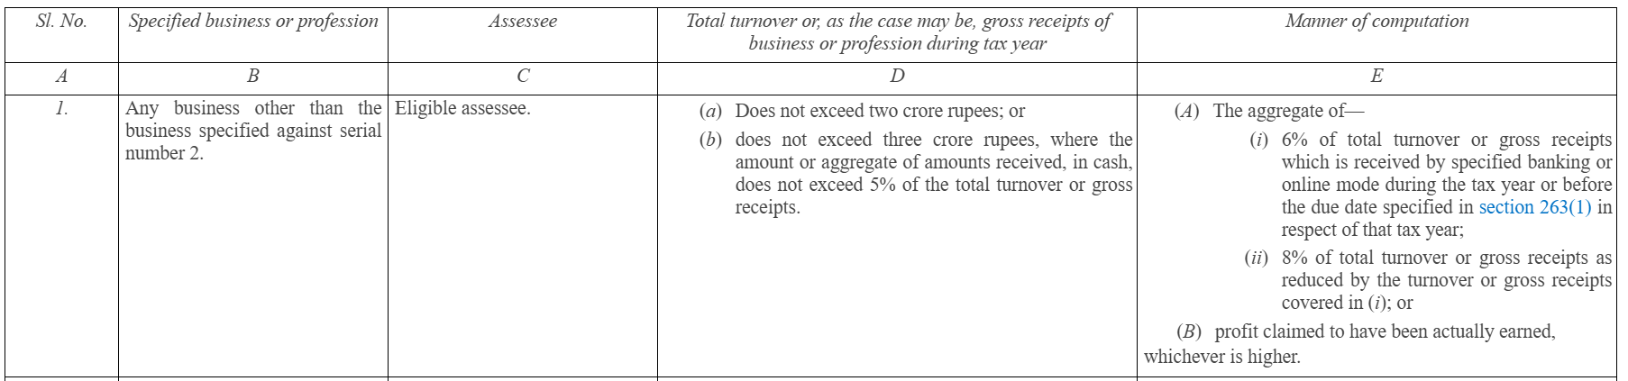
Section 44AD & 44ADA of 1961 / Section 58 of 2025
48

Slide 49
Section 44AE of 1961 / Section 58 of 2025
Section provides a presumptive taxation scheme for small taxpayers engaged in the business of plying, hiring or leasing goods carriages (owns < 10 vehicles), to simplify income computation and reduce compliance requirements
Analysis of Change | ITA, 1961 vis-à-vis ITA, 2025
Expansion of Scope | 1961 Act had overriding effect over provisions of Section 28 to 43C. However in 2025, the scope has been increased to Section 44A (50 of 2025) and 43CA (53 of 2025).
Maintenance of Books of accounts | In 1961, requirement of maintaining books of account and getting the same audited u/s 44AB was required if income is claimed to be lower of presumptive income. However in 2025, such requirement is there if income is claimed to be lower of presumptive income and the total income exceeds the basic exemption limit.
Thus if the income is less than the amount as computed u/s 58 but the income is lower than basic exemption limit then no requirement to maintain books or get accounts audited
49

Slide 50
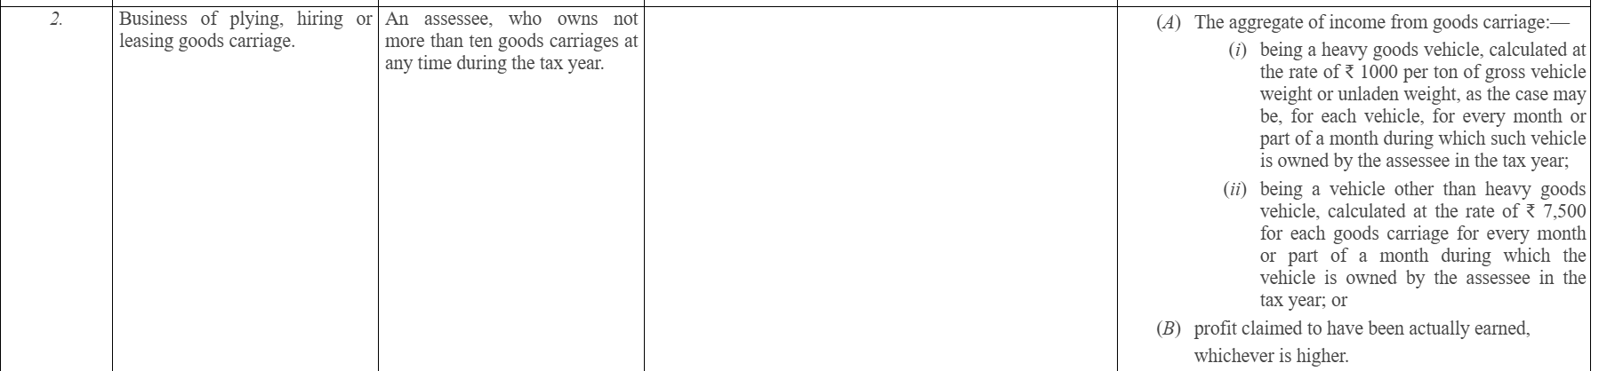
Section 44AE/ Section 58 of 2025
50

Slide 51
Section 44B, 44BBA, 44BBC of 1961 / Section 61 of 2025
Section 44B provides presumptive scheme for computing income of NR engaged in business of operation of ships, being 7.5% of gross receipts.
Section 44BBA provides a presumptive taxation scheme for non-residents engaged in the business of operating aircraft.
Section 44BBC provides a presumptive taxation scheme for Non-Residents engaged in business of operation of cruise ships (subject to conditions as prescribed).
Analysis of change: 1961 Act had overriding effect over provisions of Section 28 to 43A. However, in 2025, the scope has been increased to Section 43B (37 of 2025), 43C (40 of 2025), 43AA (43 of 2025), 44A (50 of 2025), and 43CA (50 of 2025).
51

Slide 52
Section 44BB, 44BBB of 1961 / Section 61 of 2025
Section 44BB provides a presumptive method for computing taxable profits & gains for certain non-resident businesses engaged in activities relating to mineral oil exploration, extraction, or production.
Section 44BBB provides a presumptive taxation scheme for foreign companies engaged in business of civil construction or erection or testing or commissioning, of plant or machinery in connection with turnkey power project (approved by CG).
Analysis of Change | ITA, 1961 vis-à-vis ITA, 2025
Compulsory requirement to get books of accounts audited | In 1961, the following assessee were not required to get their books of accounts audited – Section 44B and 44BBA. The exclusion now seems to be extended to provisions of Section 44BBC, 44BB, 44BBB as well.
52

Slide 53
Section 44BBD of 1961/ Section 61 of 2025
Section 44BBD provides a presumptive taxation scheme for Non-Residents engaged in business of providing services or technology in India, for the purposes of setting up an electronics manufacturing facility or in connection with manufacturing or producing electronic good, article, or thing in India to a resident company.
Non-residents engaged in the business of shipping or aircraft can declare income lower than the presumptive income if books are maintained and audited. In A. Sanyasi Rao v. Government of Andhra Pradesh [1989] 43 Taxman 271 (AP) (affirmed by Supreme Court in [1996] 219 ITR 330), the Court held the presumptive tax provisions are constitutional and observed that it would be upon the assessee to prove in the assessment proceedings his real assessable income. If the option is not given to rebut the presumptive income, the provisions can be challenged on Constitutional grounds. This option is not given in the case of provisions corresponding to Section 44BBD.
53

Slide 54
Section 44BB, 44BBB and 44BBD of 1961 / Section 61 of 2025 – Contd.
Analysis of Change | ITA, 1961 vis-à-vis ITA, 2025
Increase in Scope | 1961 Act had overriding effect over provisions of Section 28 to 43A. However, in 2025, the scope has been increased to Section 43B (37 of 2025), 43C (40 of 2025), 43AA (43 of 2025), 44A (50 of 2025), and 43CA (50 of 2025)
 | In 1961, no set off of unabsorbed depreciation and brought forward loss were allowed. In 2025, as per words used, apart from above, any loss, allowance, or deduction allowable in 2025 shall not be allowed.
The Ministry has replied to the Select Committee observation that against the presumptive income, claiming losses to be set off which are derived from the books is an anomaly. So no intra head losses are allowed to be set off against presumptive income.
54

Slide 55
Set off of inter-head losses and unabsorbed depreciation
“(4) Any loss, allowance or deduction allowable under the provisions of this Act, shall not be allowed against the income computed in the manner specified in sub-section (2).” – Words used in the provision.
Does this mean that the inter head set-off of losses and set off od unabsorbed depreciation shall not be eligible to be set off?
No – As overriding effect is only in place in respect of PGBP provisions and not Set off and carry forward of losses.
“(1) The provisions of sections 26 to 54, to the extent contrary to this section, shall not apply to the manner of computation of profits and gains of the specified business in sub-section (2)”
Doe
55

Slide 56
Section 44C, 44DA, & 44DB of 1961 / Section 60, 59 of 2025
Section 44C provides a limit with respect to deduction which a Non-Resident can claim for head office expenditure when computing income under the head PGBP.
Analysis of change: 1961 Act had overriding effect over provisions of Section 28 to 43A. However, in 2025, the scope has been increased to Section 43B (37 of 2025), 43C (40 of 2025), 43AA (43 of 2025), 44A (50 of 2025), and 43CA (50 of 2025)
Section 44DA provides for method of computing income of a NR or Foreign Company in the nature of Royalty or Fees for Technical Service (FTS) when such income is effectively connected with a Permanent Establishment (PE) or fixed place of profession in India.
Section 44DB provides rules for allowing certain deductions for a co-operative bank that has undergone business reorganization (such as amalgamation, demerger, or conversion) during a financial year.
Analysis of change: Language Simplification
Special section for interpretation of Section 64 – Section 65
56

Slide 57
Special Deductions – The ones which are left
57

Slide 58
Section 33ABA of ITA 1961 / Section 49 & Sch. X of ITA 2025
Section permits deduction (on the basis of deposit into site restoration account) to taxpayer who is carrying on business of prospecting, extracting, or producing petroleum or nature gas in India and who has agreement with Central Govt.
Deduction Amount: Lower of:
Sum deposited in Site Restoration Fund Account,
Amount utilized for site restoration, or
20% of profits of eligible business (before this deduction & set off of loss)
Condition: Sum needs to be deposited in Site Restoration Fund with SBI or notified financial institution on or before due date u/s 139(1) and ITR should be accompanied with prescribed form / audit report.
“Site Restoration” includes dismantling of structures, removal of installations, or restoration of land used for petroleum / gas operations
Deduction claimed will be taxed as business income if withdrawn for non-specified purpose or after completion of business (except for site restoration).
Analysis of change: Mere language simplification and transfer of content to Schedule.
58

Slide 59
Section 35 of ITA 1961 / Section 45 of ITA 2025
Section promotes scientific research by allowing specified deduction (subject to terms & conditions and approvals) to any Assessee who incurs revenue / capital expenditure which is related to his business.
Section permits deduction of revenue expenditure and contribution to approved research institutions.
In-house scientific research: Expenditure on In-house scientific research is deductible by specified companies, mainly manufacturing companies.
Capital Expenditure: Capital Expenditure for scientific research (other than land) is 100% permissible as deduction
Analysis of Change | ITA, 1961 vis-à-vis ITA, 2025
Procedural Aspect | 1961 Act specifies various procedural aspects such as making applications, seeking approvals, filing forms, etc as mentioned in 1st proviso to Section 35(1)(iv), furnishing docs / information before granting approval under 2nd proviso of 35(1)(iv), filing statements u/s 35(1A), feasibility satisfaction u/s 35(2AA). However, here in 2025 Act, all such terms and conditions shall be prescribed in the rules made by the CBDT, which are yet awaited. This leads to reduction of content in the 1961 Act and same shall be mentioned in the Rules.
59

Slide 60
Section 35ABA & 35ABB of ITA 1961 / Section 52 of ITA 2025
Sections permits deduction to any Assessee who has incurred capital expenditure for acquiring any right to use spectrum for telecommunication services (Technical Know-How) or any right to operate telecommunication services (License) for which is for the purpose of his business.
The equal amount of deduction shall be permitted in number of years commencing from the initial tax year and ending in the tax year up to which the spectrum for which the fee is paid remains in force.
Section also deals with various scenarios under which said spectrum or license is transferred and accordingly determines the quantum of taxability.
Analysis of Change | ITA, 1961 vis-à-vis ITA, 2025
Payment Condition | 1961 Act uses words “payment has actually been made” however 2025 Act used words “Actually Paid”. 1961 Act meant actual payment irrespective of year of incurring liability. But in 2025 Act “actually paid” also means ‘payable in such manner, as prescribed’. Thus CBDT can now prescribe a manner which shall be deemed as “actually paid”.
60

Slide 61
Section 35AD of ITA 1961 / Section 46 of ITA 2025
Section provides 100% deduction of capital expenditure (other than land, goodwill, and financial instruments) incurred wholly & exclusively for specified businesses, to promote investment in key infrastructure and priority sectors
Business should not be formed by reconstruction or splitting up. Further, new plant & machinery should be used, and old machine up to 20% value is allowed. Some of the Eligible Specified Business are (subject to specified date of commencement of operations):
Cold Chain facility
Warehousing for agriculture produce
Laying & operating cross border pipeline for oil, gas, crude
Building and operating hotels of 2 star or above
Developing and maintaining hospital with more than 100 beds
Fertilizer production
Bee-keeping and honey production
Analysis of change: Language Simplification
61

Slide 62
Section 35CCC & 35CCD of 1961 / Section 47 of 2025
Deduction u/s 35CCC : Section encourages agricultural extension activities by allowing 100% deduction for expenditure (excluding cost of land or building) incurred on notified agricultural extension projects
Deduction u/s 35CCD : Section encourages skill development projects by allowing 100% deduction for expenditure (excluding cost of land or building) incurred on notified skill development projects by Company
Analysis of change: Language simplification
62

Slide 63
Section 42 & 43 of 1961 / Section 54, 39, 41, & 66 of 2025
Section 42 provides special tax allowances to entities engaged in the business of prospecting, extraction or production of mineral oil or natural gas (which are agreed & approved by Central Govt), recognizing the high-risk and capital-intensive nature of such operations.
The allowances include infructuous or abortive exploration expenses, abandonment or depletion expenditure, Expenditure on drilling, exploration and development.
Section 43 provides statutory definitions of important terms used in Sections 28 to 41 of 1961, ensuring uniform computation of income under the head PGBP
The section defines some of the important terms such as Actual Cost, WDV, Plant, Sale / Discard / Demolish / Destroy, Scientific Research, Speculation Transaction, Paid, etc.
Analysis of change:
Language simplification and formula / tabular presentations is done.
Provisions in respect of Goodwill adjustment has been removed.
63

Slide 64
Section 35D, 35DD, 35DDA, & 35E of 1961 / Section 44, 51, & 52 of 2025
Section 35D provides for amortization (5 equal instalments) of specified preliminary expenses incurred before commencement of business or after commencement, in respect of extension of industrial undertaking or setting up of new unit
The deduction is subject to monetary cap i.e. 5% of cost of project or capital employed, whichever is higher
Deduction u/s 35DD: Section provides for amortization (5 equal instalments) of expenditure incurred wholly and exclusively for amalgamation / demerger
Deduction u/s 35DDA: Section provides for amortization (5 equal instalments) of expenditure incurred on payments made to employees on Voluntary Retirement Scheme (VRS).
Deduction u/s 35E: Section provides for amortization (5 equal instalments) of expenditure (other than land, building, incurred on prospecting, extraction or production of specified minerals, recognising the high initial costs involved in mining activities.
Specified minerals include coal, lignite, iron ore, bauxite, chromite, copper, gold, etc
Analysis of change: Language simplification
64

Slide 65
Section 33AB of ITA 1961 / Section 48 & Sch. IX of ITA 2025
Section permits deduction (on the basis of deposit into special account) to taxpayer who is carrying on business of growing & manufacturing tea, coffee, or rubber in India.
Deduction Amount is lower of:
Sum deposited in special account
Amount actually utilized for “specified purposes”
40% of profits of eligible business (before this deduction)
Condition: Sum needs to be deposited in Tea / Coffee / Rubber Development Account with NABARD or notified financial institution on or before due date u/s 139(1) and ITR should be accompanied with prescribed form / audit report.
“Specified purposes” means replantation of bushes, replacement of old plants, development of plantation, or other purposes notified
Deduction claimed will be taxed as business income: if withdrawn without approval, used for non-specified purposes, or not utilized within time.
Analysis of change: Mere language simplification and transfer of content to Schedule.
65

Slide 66
Section 43C, 43CA, 43CB, 43D of ITA 1961
Section | Particulars
43C of 1961 / 40 of 2025 | Special provision for computation of cost of acquisition of certain assets. – Cost of acquisition in case of asset becoming a property of the company post amalgamation held as stock in trade or where asset is received via gift/will or irrevocable trust, or partition of HUF
43CA of 1961 / 53 of 2025 | Section aims to prevent understatement of sale consideration in transactions involving land or building held as stock-in-trade by deeming the stamp duty value as the full value of consideration for computing business income, subject to difference exceeding 10%.
43CB of 1961 / 57 of 2025 | Section provides specific rules for computation of income arising from construction and service contracts by mandating recognized accounting methods and standards. The section refers to recognition of revenue as per ICDS for on POCM basis on SLM basis for other cases, ICDS, any other method, etc.
43D of 1961 / 56 of 2025 | Section provides relief from taxation of unrealised interest income by allowing specified entities (financial institutions, scheduled banks, state industrial / financial corporations, etc.) to tax certain interest only on receipt basis, even if they follow the mercantile system of accounting.
66

Slide 67
Section 44 & 44A of 1961 / Section 55 & 50 of 2025
Section 44 provides a special method for computation of income of persons carrying on insurance business, overriding the normal provisions relating to computation of business income. (Altogether different schedule is provided for same)
Analysis of change: Scope of overriding effect has been widened. In 1961, section overrides 28 to 43B. However, in 2025 section additionally overrides Section 40 (43C of 1961), 50 (44A of 1961), and 53 (43CA of 1961)
Section 44A governs the allowability of deductions in respect of subscriptions and contributions received by certain associations or institutions from their members, ensuring transparency and preventing misuse of mutuality principles.
Analysis of change: Language Simplification
67

Slide 68

Questions?
68

Slide 69
69

