Slide 1
Income Tax Return Forms
AY 2026-27
By CA. Darshak M. Thakkar

Slide 2


Slide 3
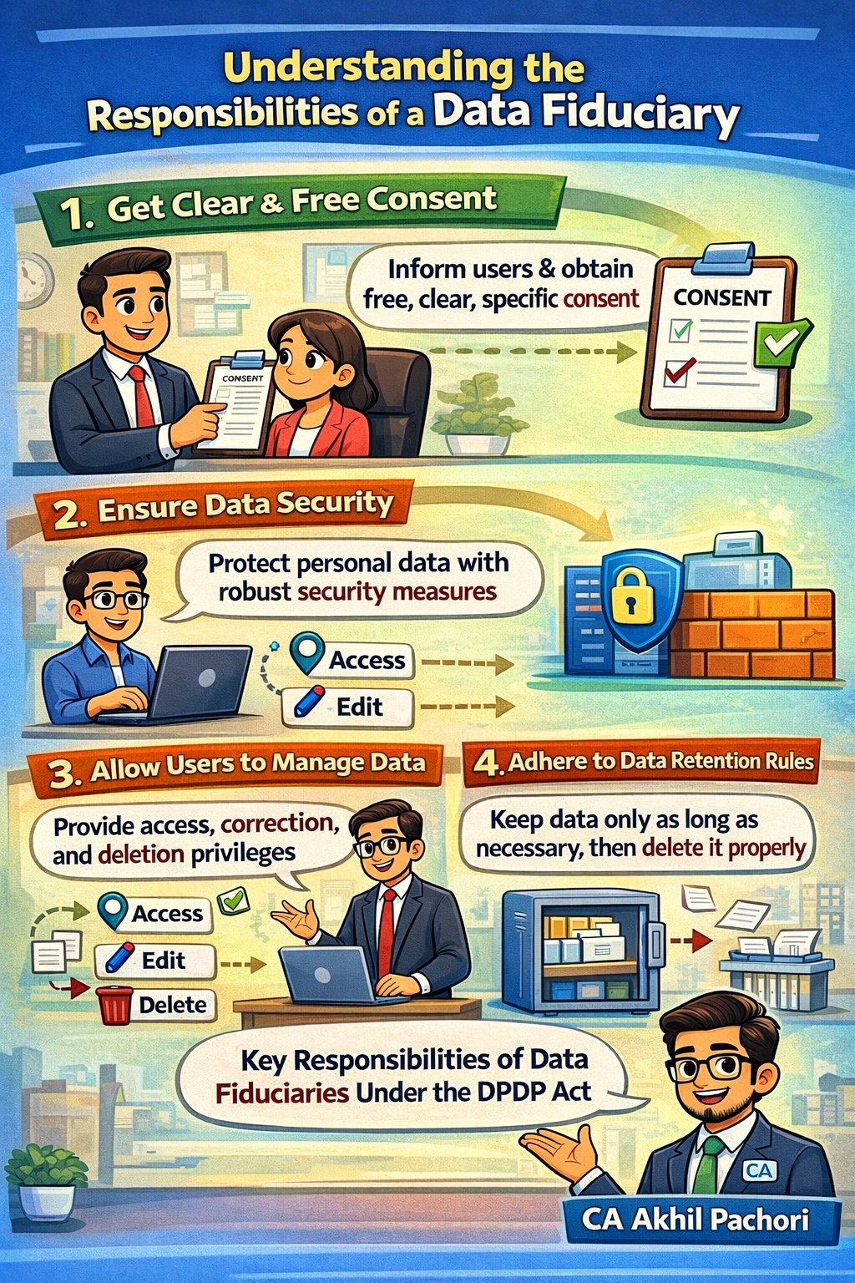

Slide 4
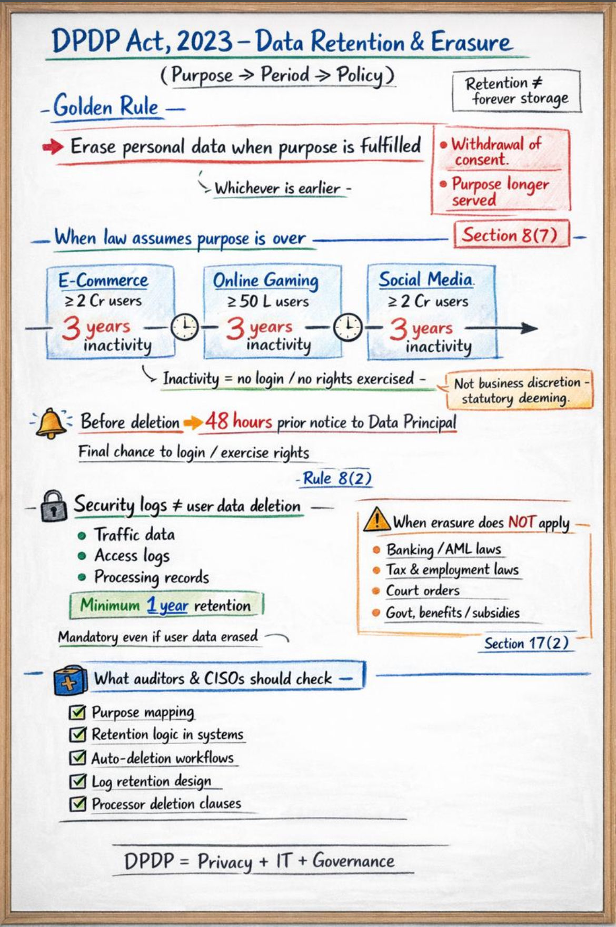

Slide 5
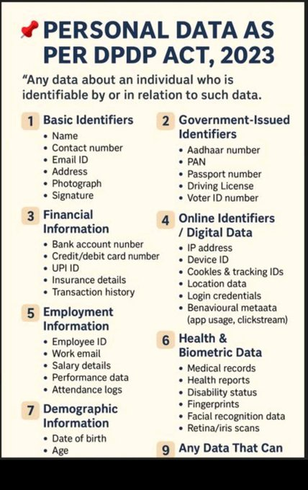

Slide 6


Slide 7
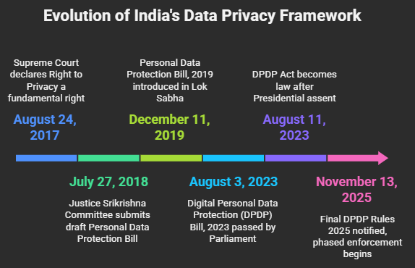

Slide 8
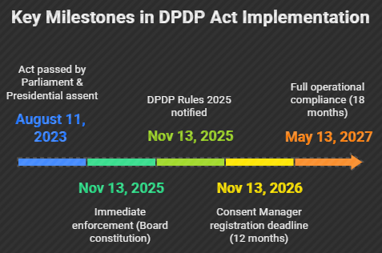

Slide 9
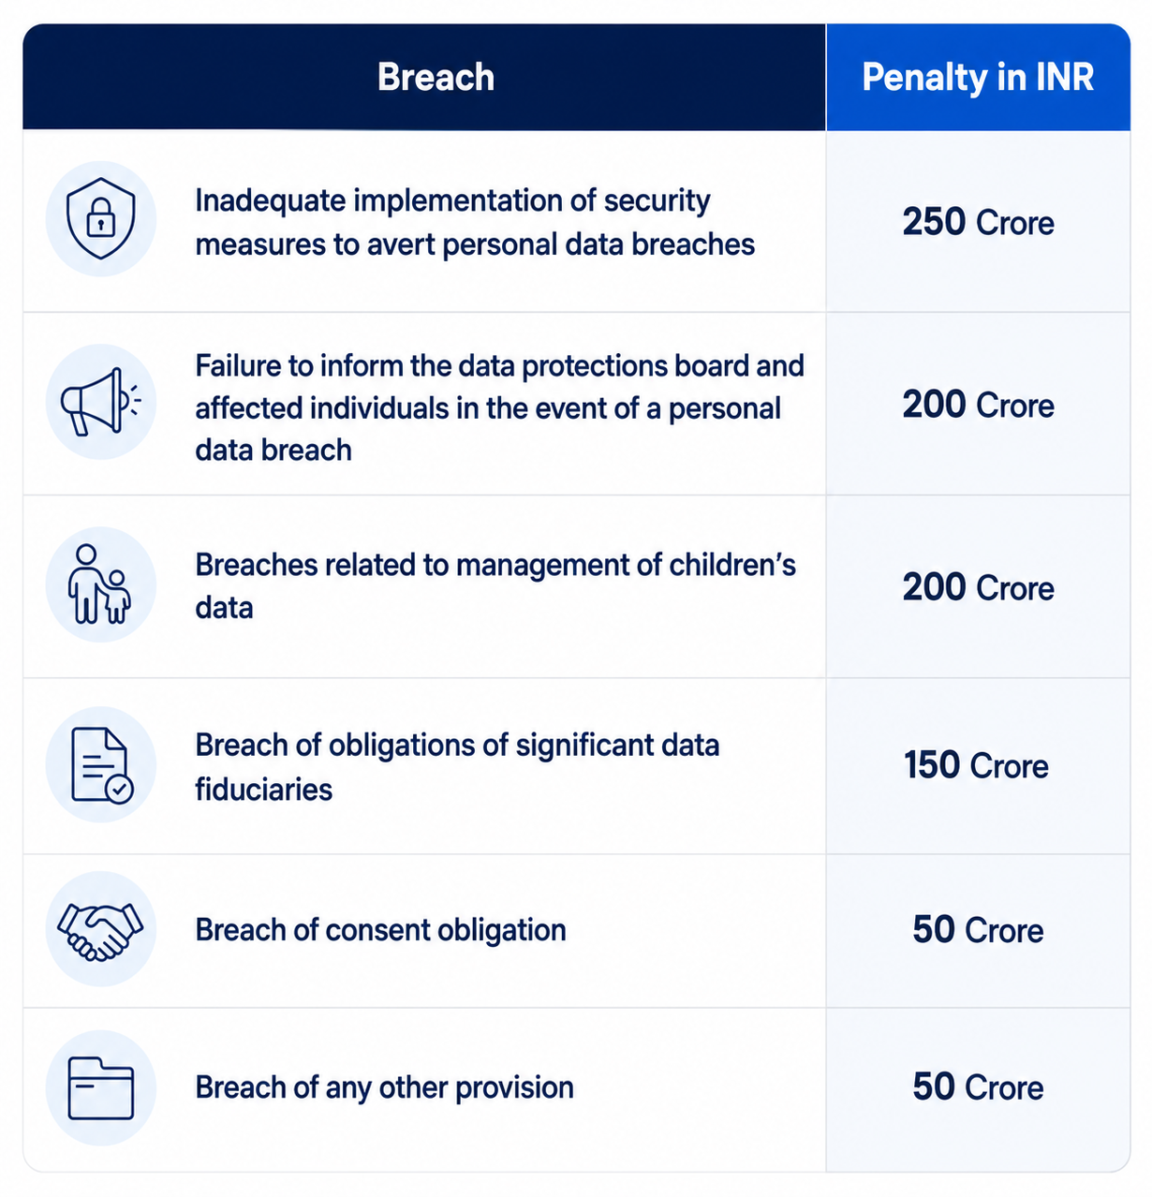

Slide 10
📅 Phase 1: November 13, 2025
The government set up the Data Protection Board of India
The "police" who will check if companies are protecting your data properly started working

Slide 11
📅 Phase 2: November 13, 2026
Consent Managers must register with the government
Companies that help you say "yes" or "no" to sharing your data need to get official permission

Slide 12
📅 Phase 3: Deadline: May 13, 2027
ALL companies must follow ALL rules completely
Every business must:
Ask permission before using your data properly
Tell you within 72 hours if your data is leaked
Delete your data when you ask (or when they don't need it anymore)
Keep your data safe with proper security

Slide 13
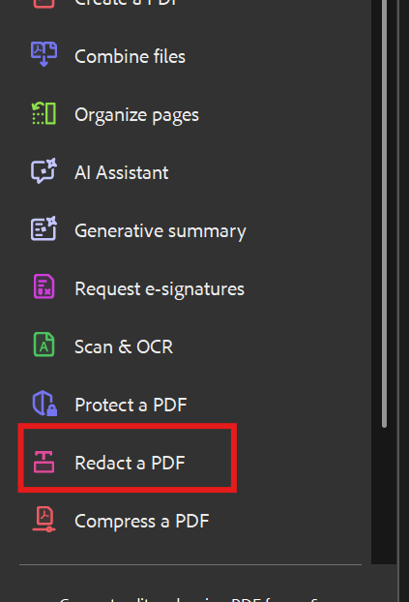
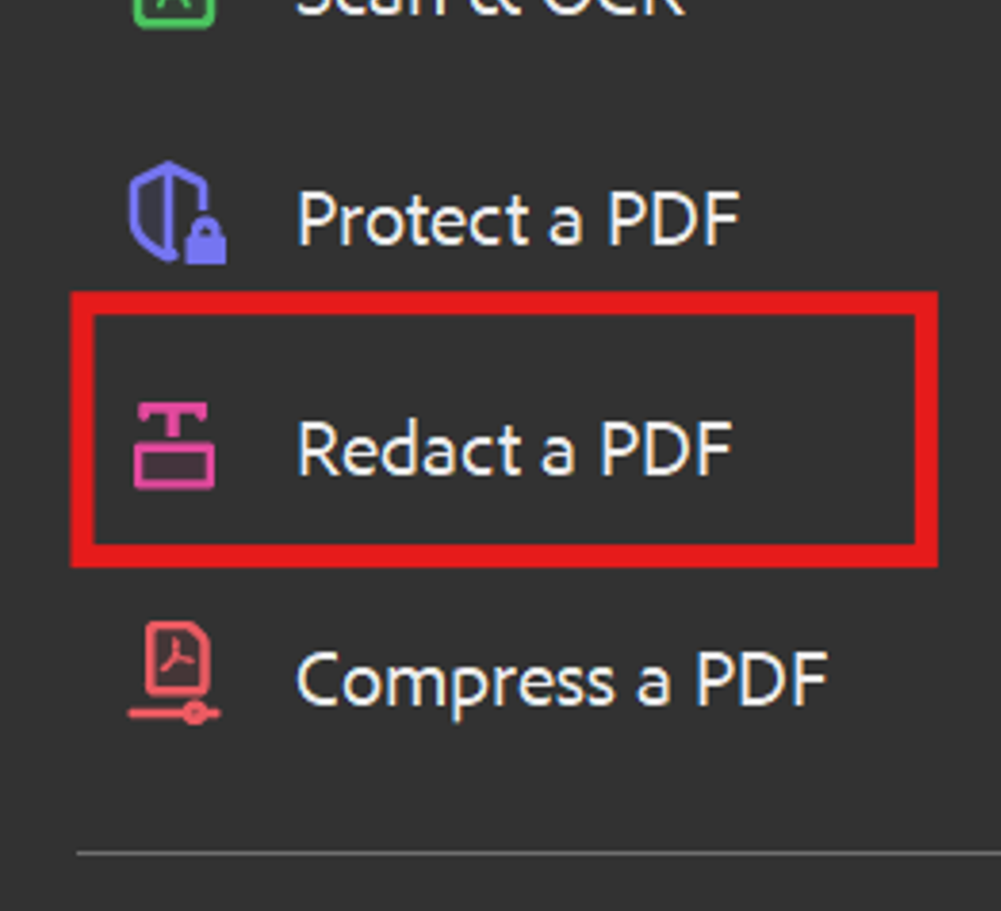

Slide 14
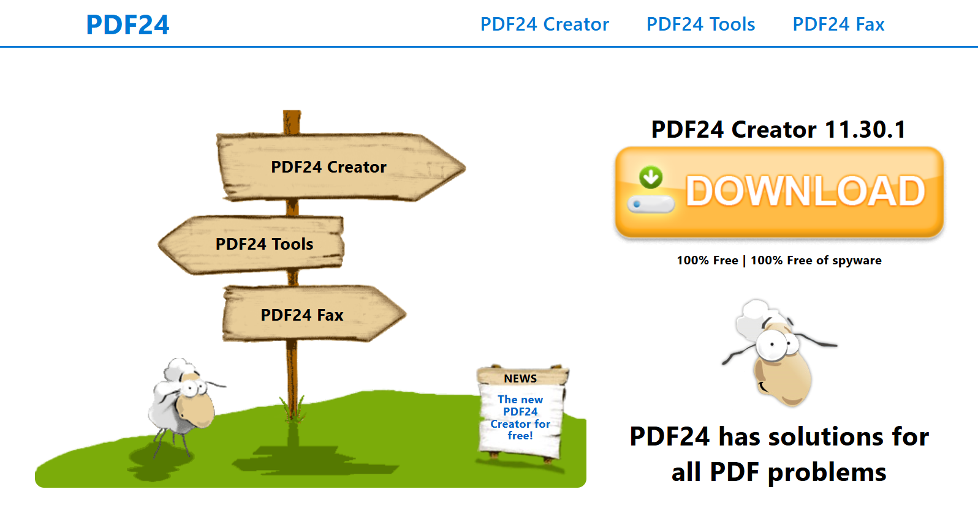

Slide 16
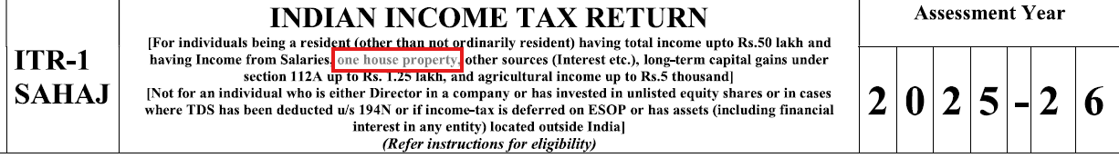
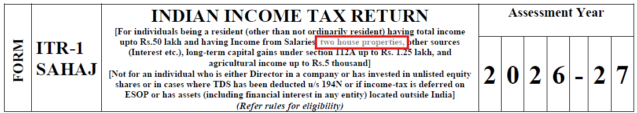

Slide 17
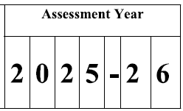

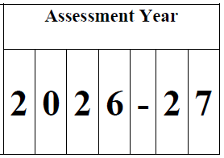
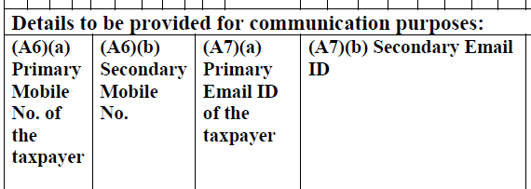
ITR 1 to 7 - Email and Mobile

Slide 19
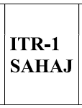
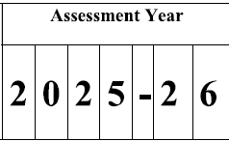
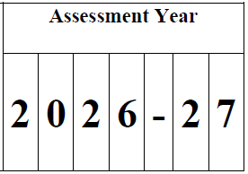
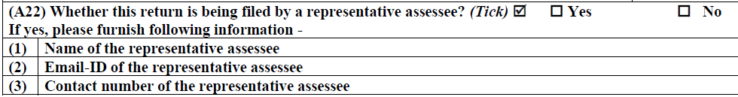
Representative Assessee - ITR 1

Slide 20
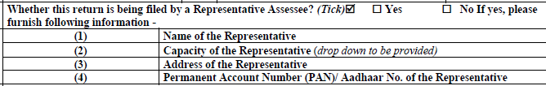

Representative Assessee - ITR - 2 to 7

Slide 22

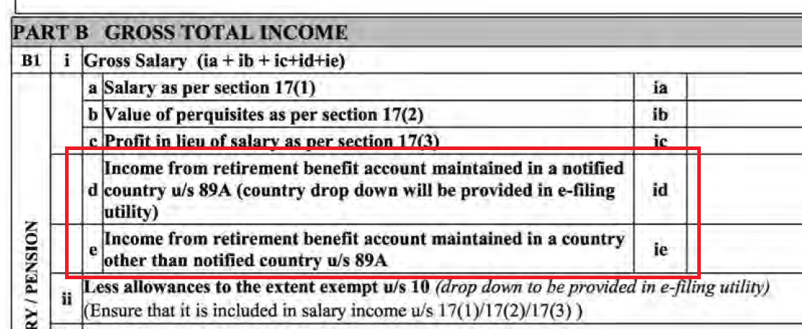
Salary Schedule – Section 89A Foreign Retirement Income

Slide 23
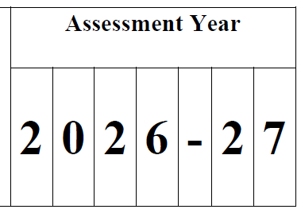
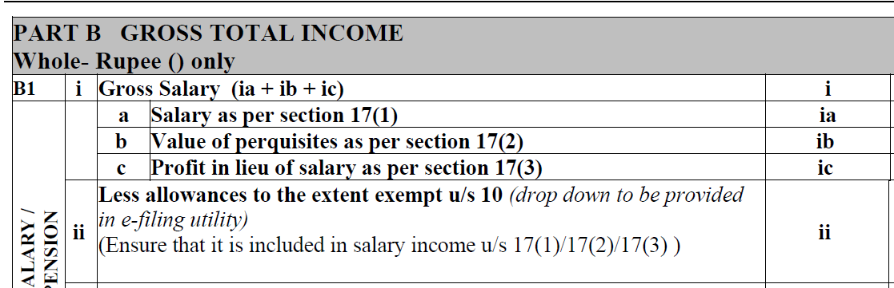
Salary Schedule – Section 89A Foreign Retirement Income

Slide 26
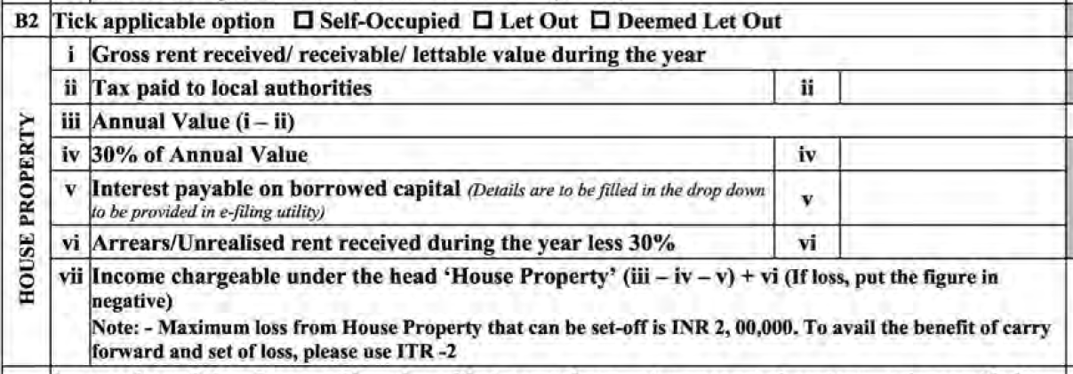
House Property

Slide 27
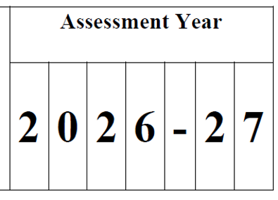
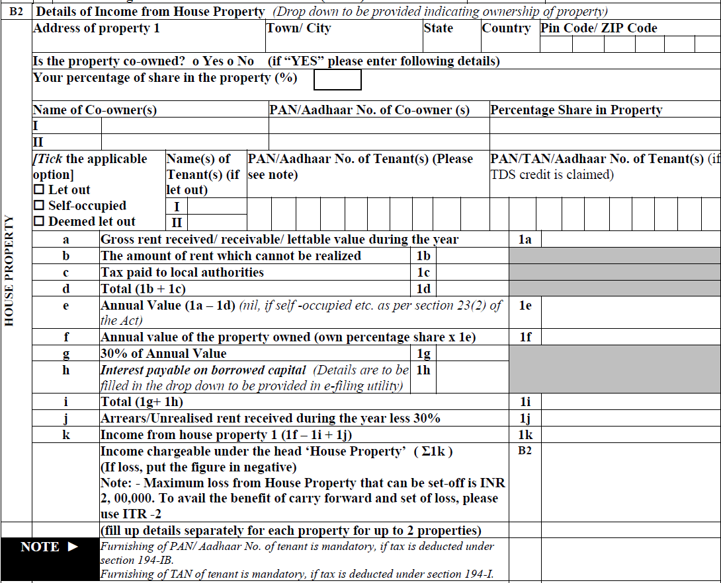
House Property
Notes:
New requirement to furnish detailed property-wise information separately for up to 2 properties.
Address of property including city, state, country and PIN now mandatory.
New disclosure of co-ownership, co-owner name, PAN/Aadhaar and percentage share introduced.
Tenant name, PAN/Aadhaar/TAN disclosure added where applicable.
Separate field introduced for unrealisable rent deduction.
Separate field added for annual value attributable to assessee’s ownership share.
Detailed structured computation introduced for better property-wise disclosure.

Slide 28
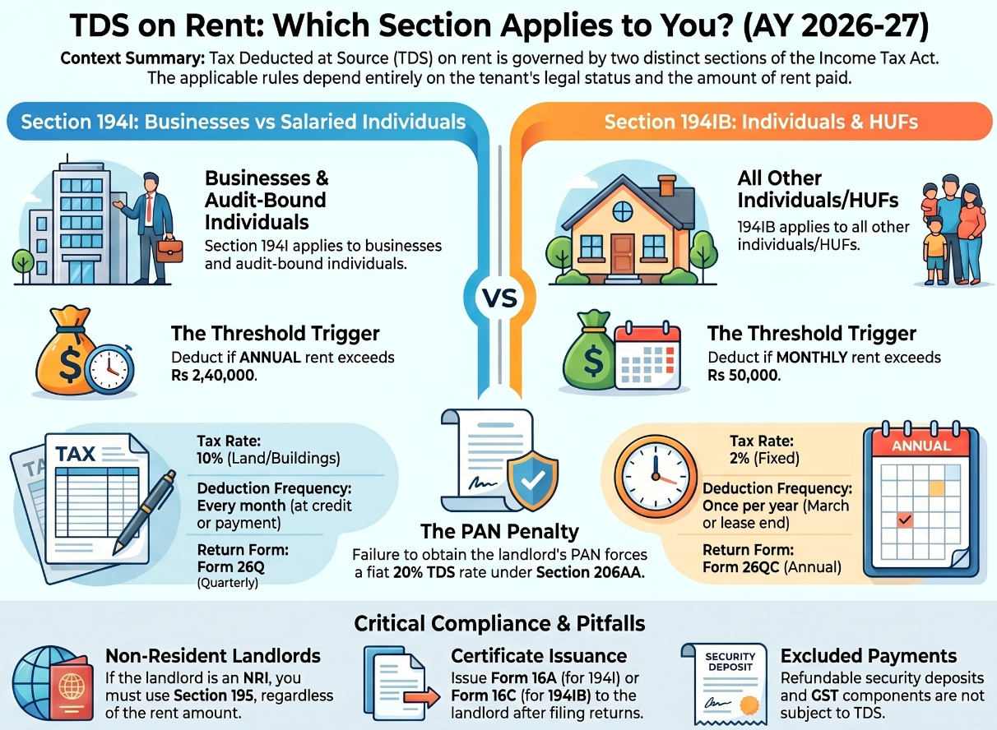

Slide 30

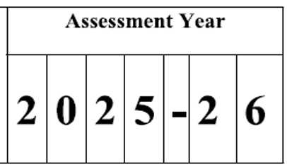
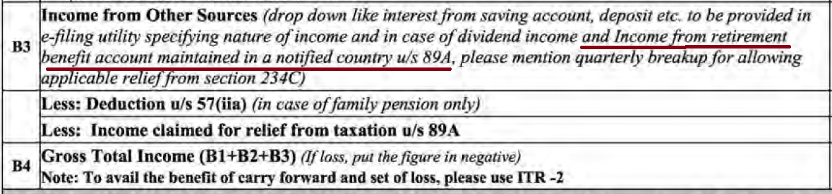
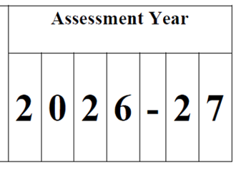
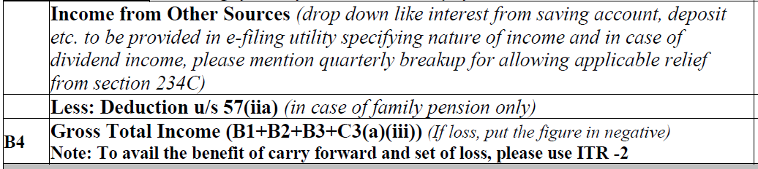

Slide 32
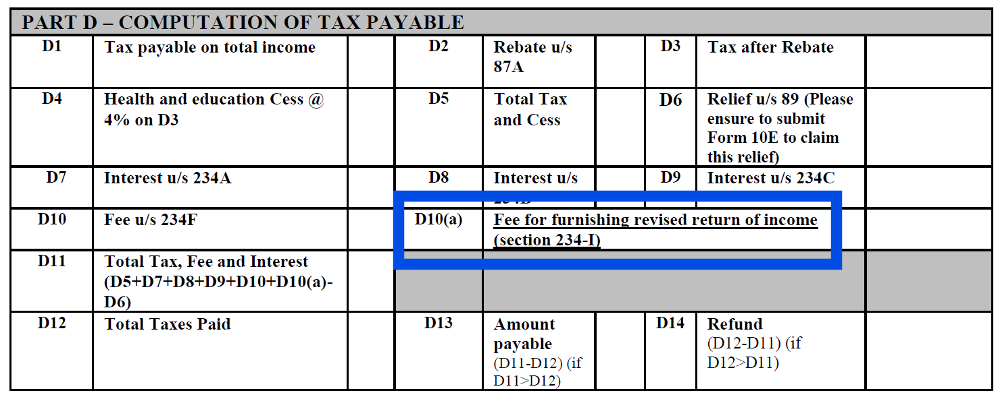
Section 234I
Notes:
New field D10(a) added for fee for furnishing revised return u/s 234-I.

Slide 34
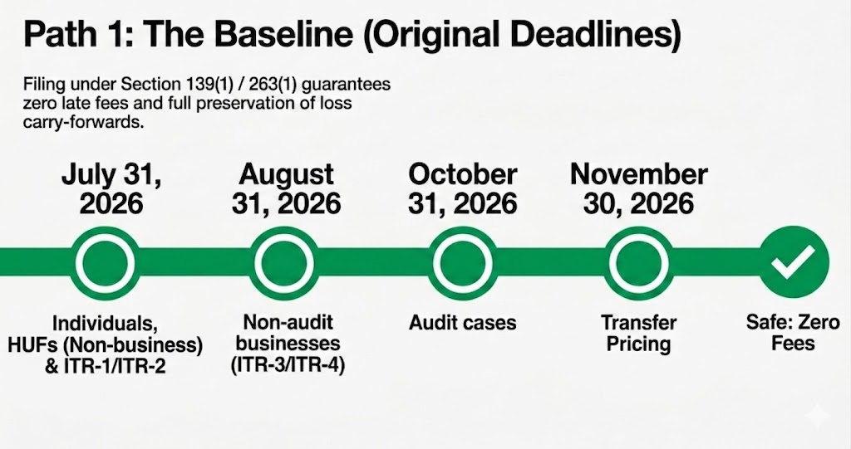

Slide 35
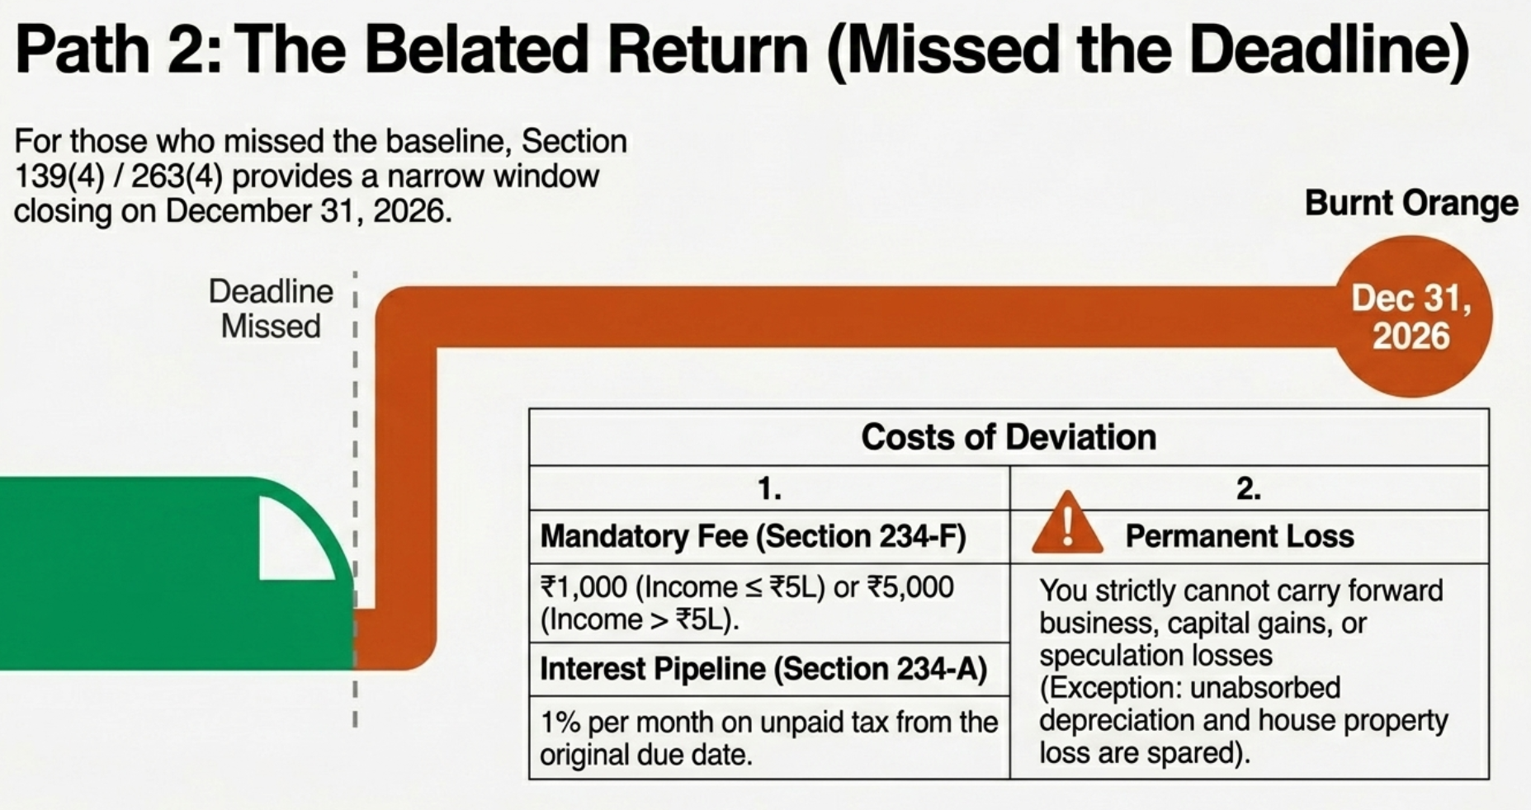

Slide 36
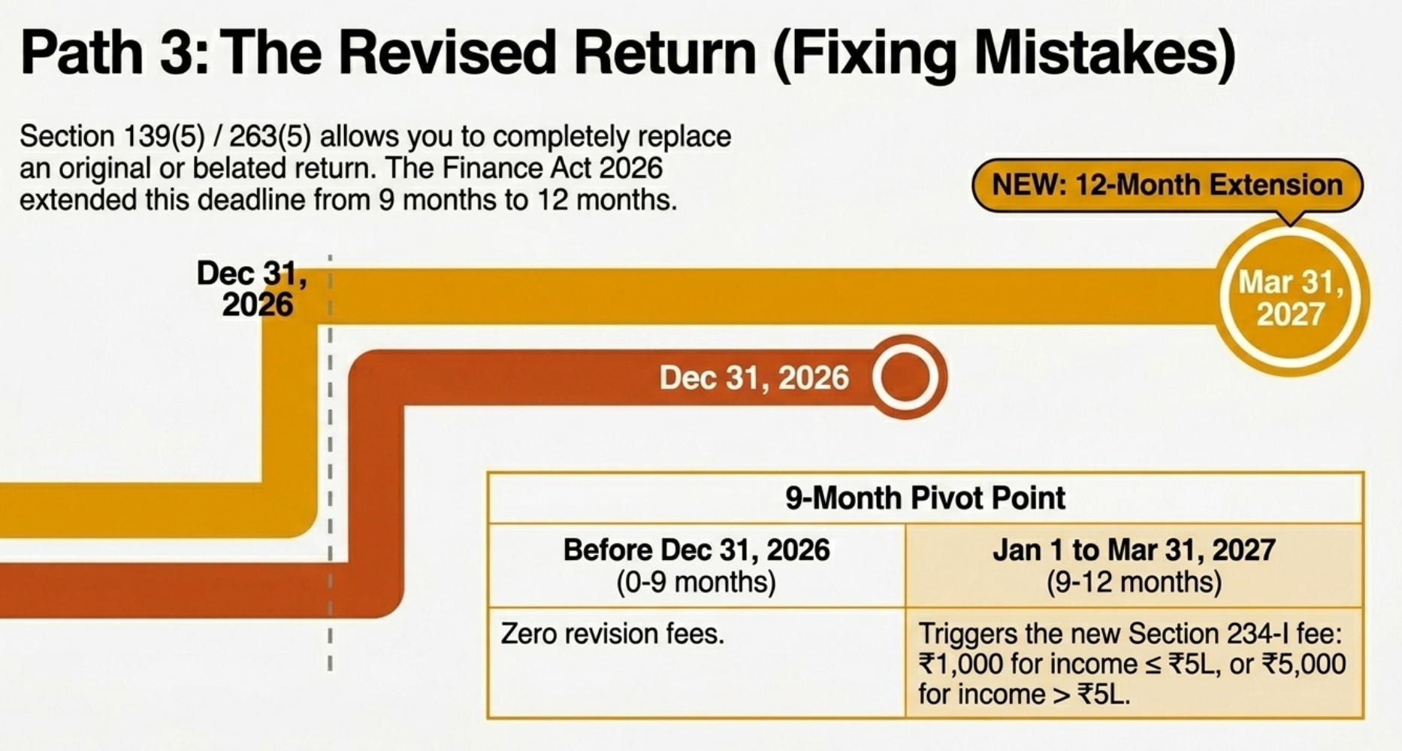

Slide 37
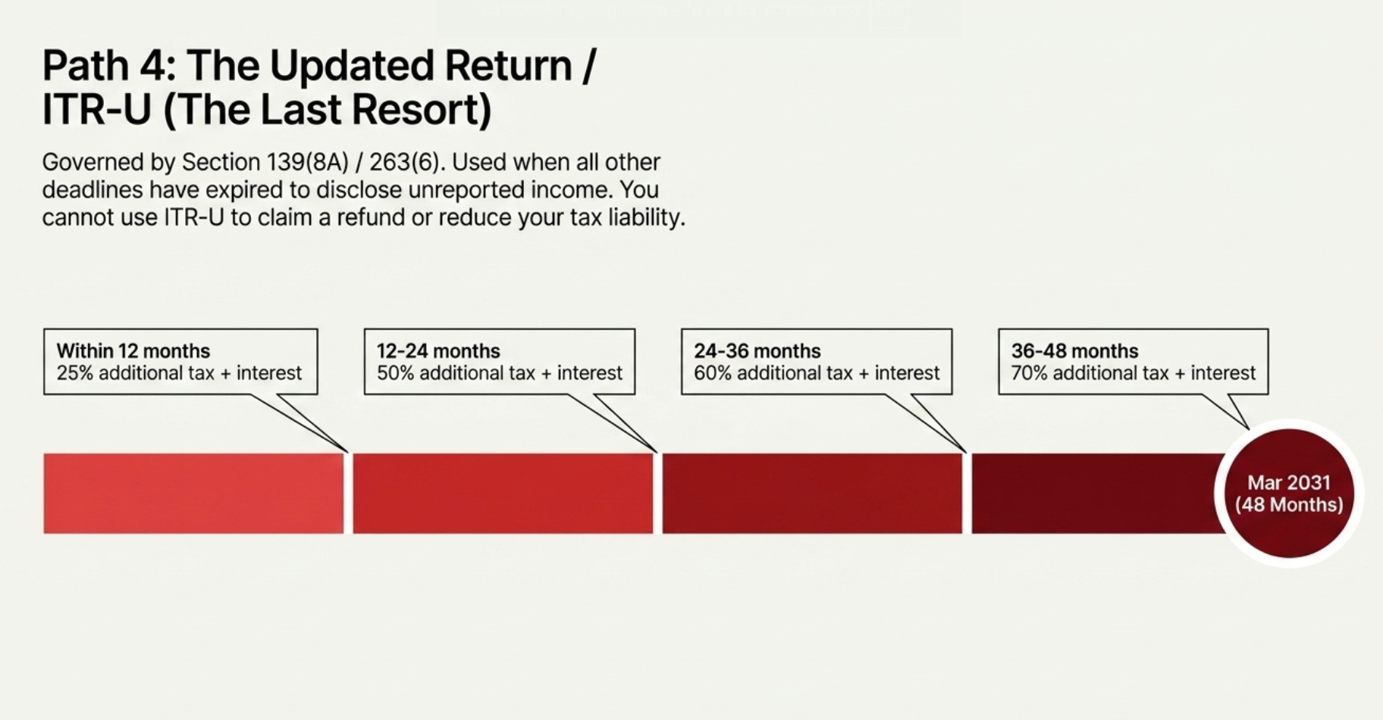

Slide 38
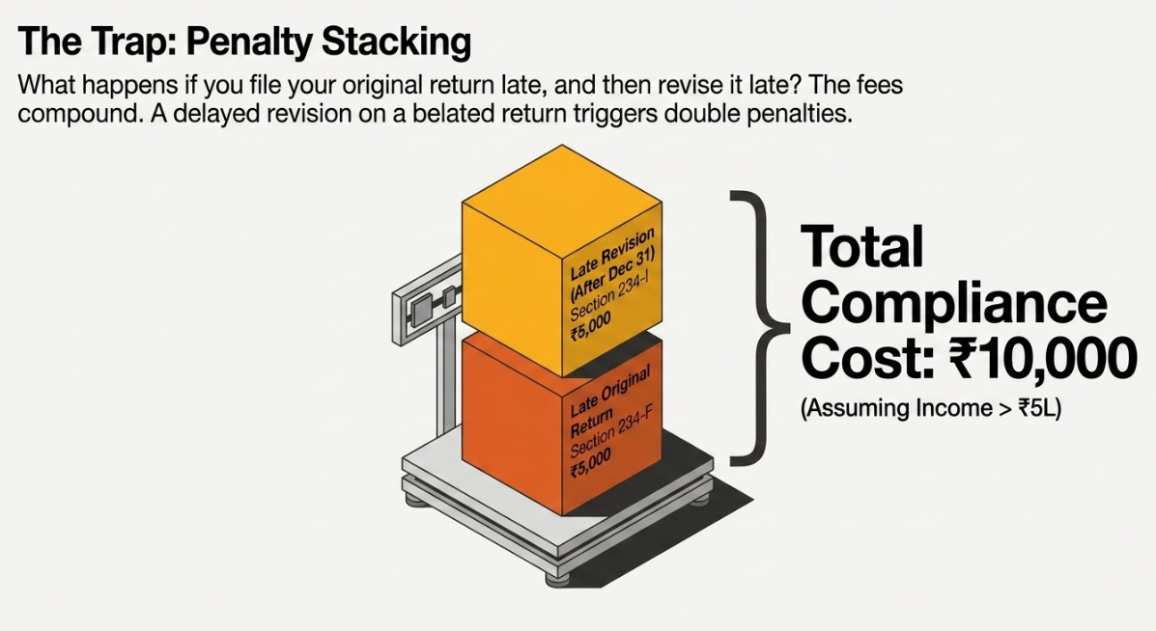

Slide 39
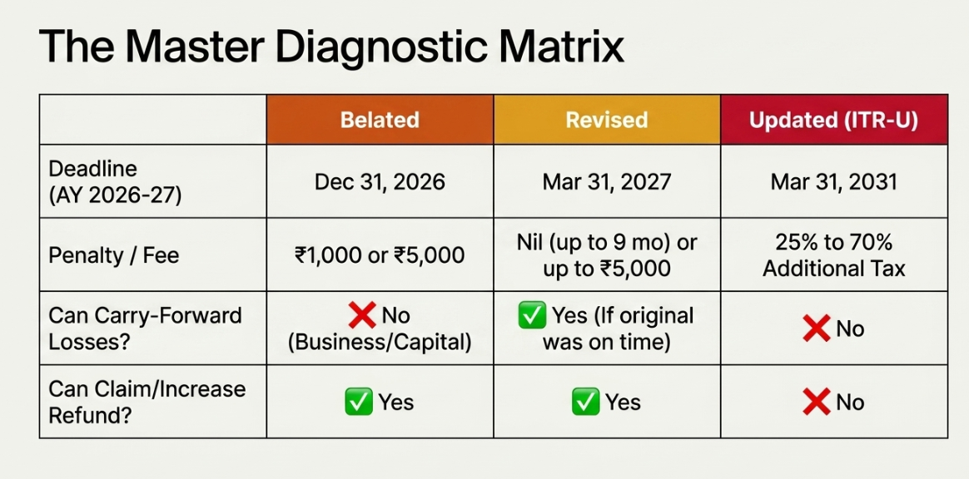

Slide 40
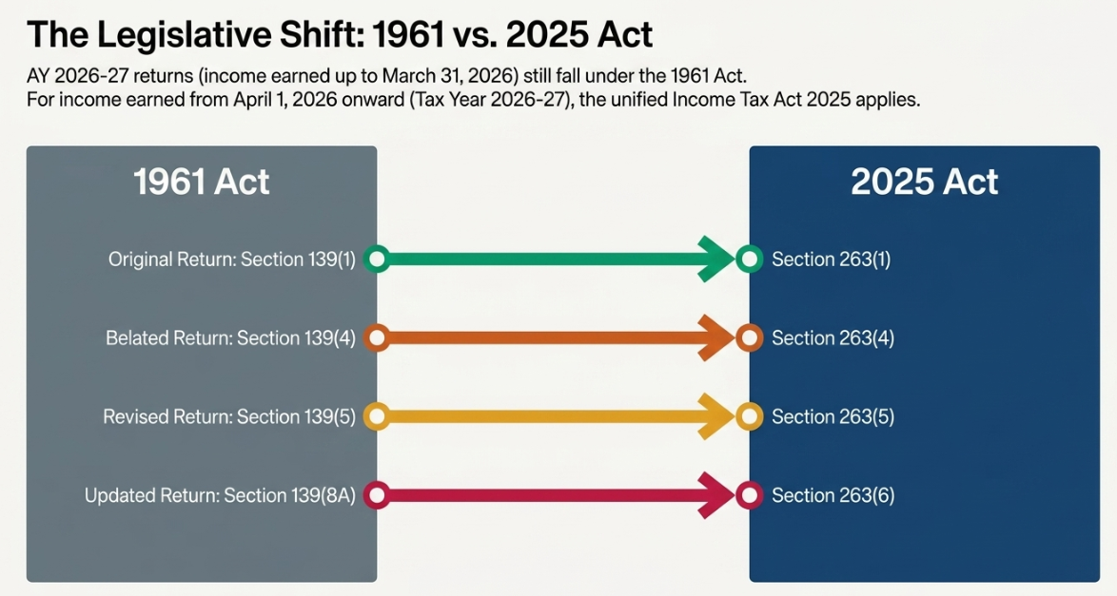

Slide 42

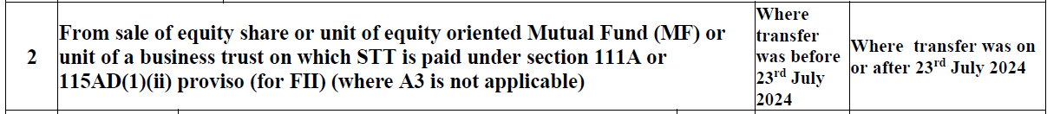
Notes:
[ITR 2, 3, 5, 6 and 7]

Slide 43
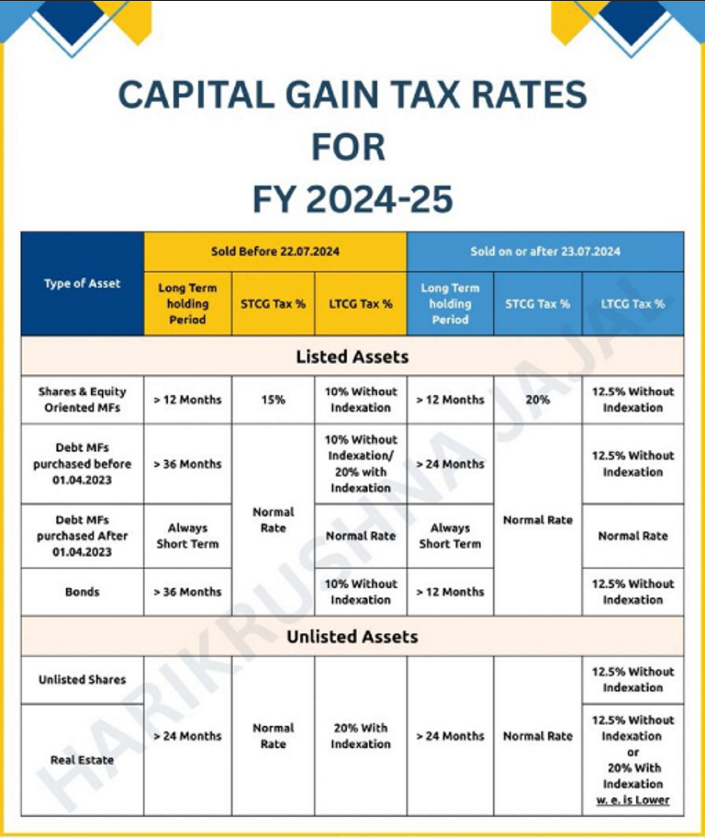

Slide 44
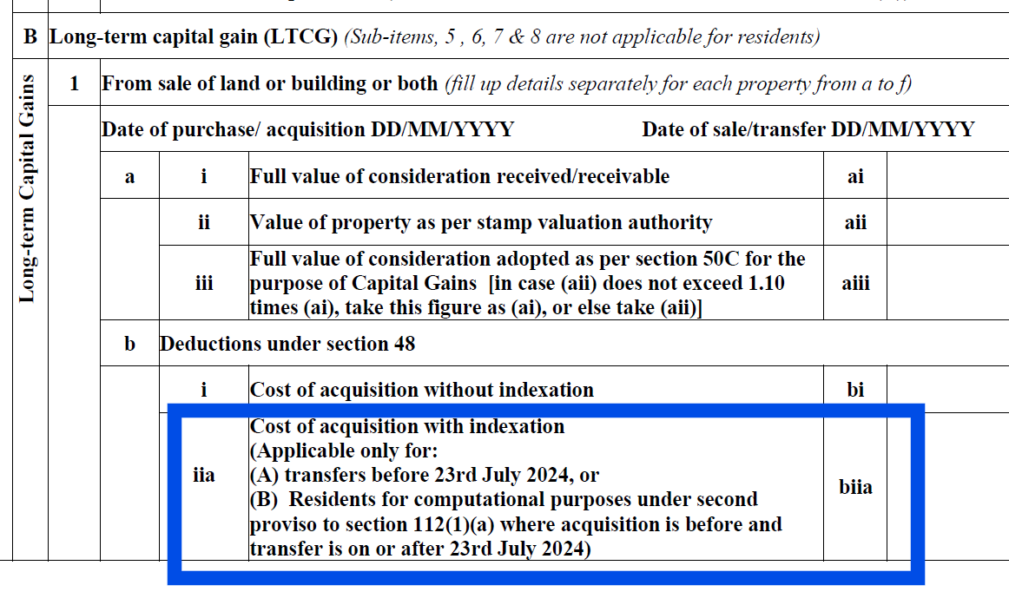

Slide 45
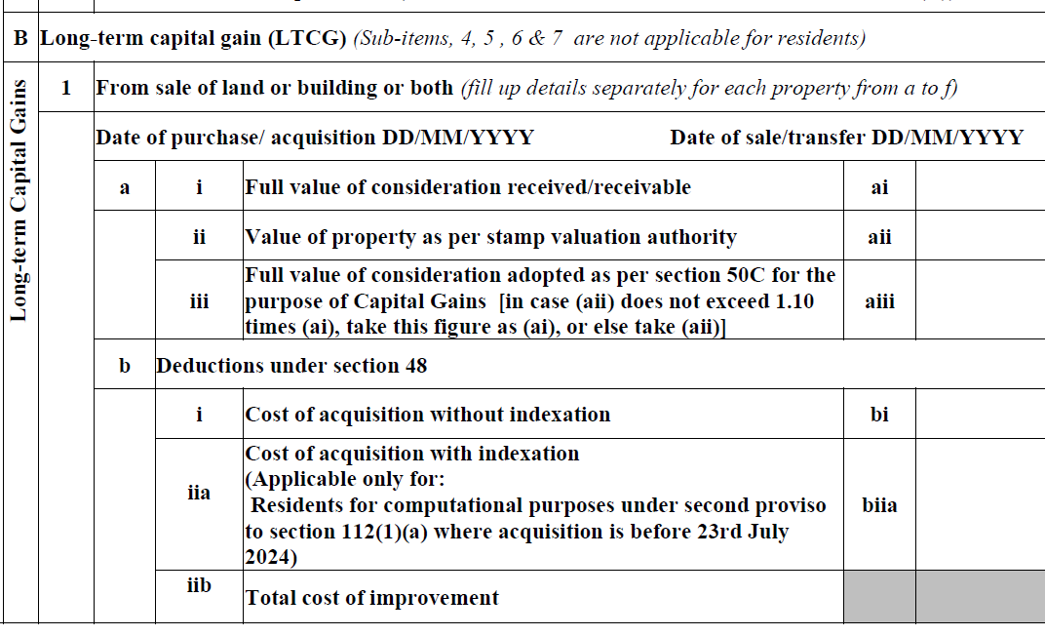

Slide 47
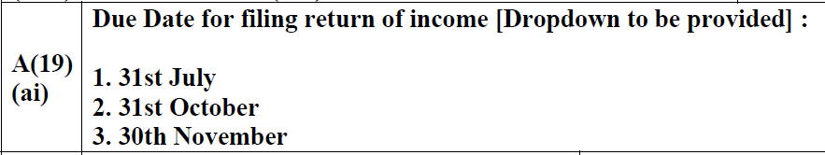
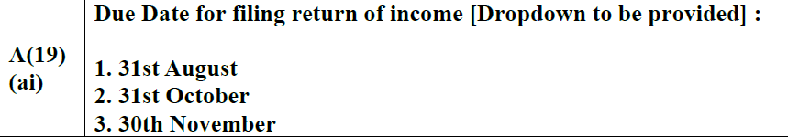
ITR – 3 Due date of filing for non audit cases

Slide 49
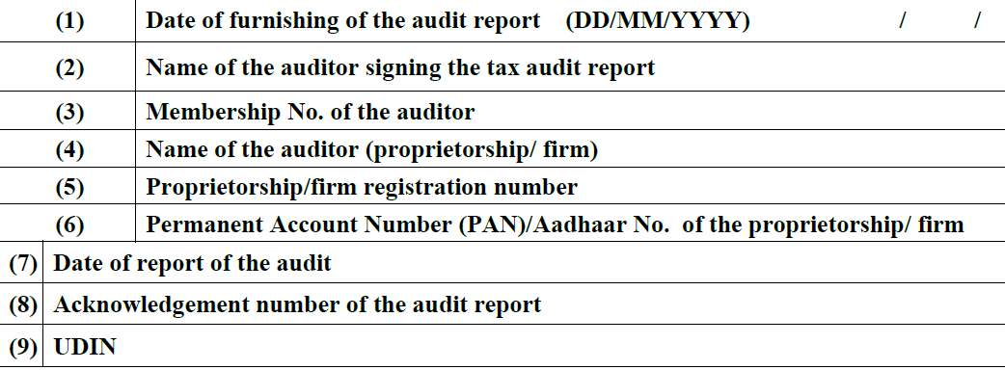
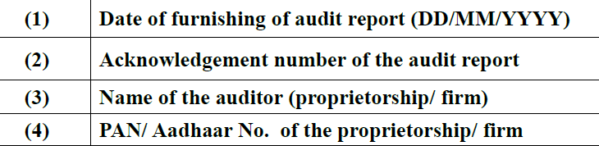
Auditor details - ITR 3, 5, 6 and 7

Slide 51
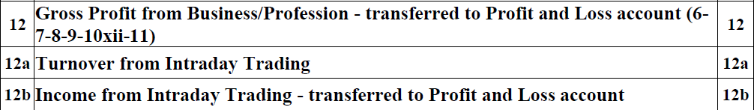
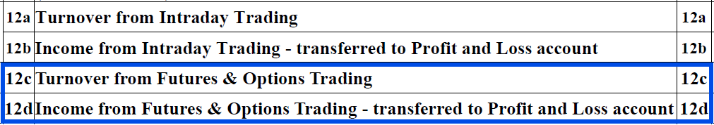
Requires the reporting of turnover & income from futures & option trading - ITR 3, 5 and 6

Slide 53
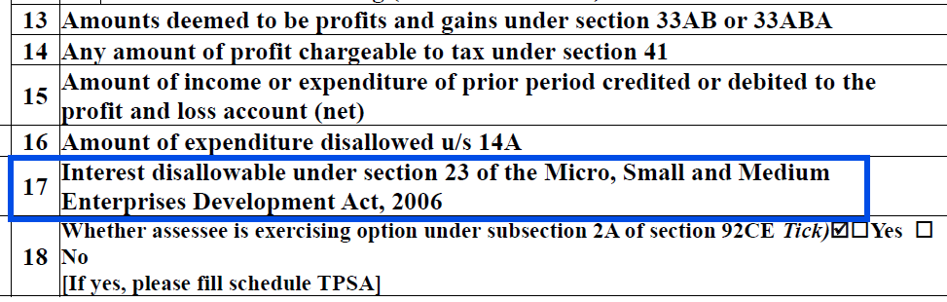
Disallowance of MSME interest - ITR 3, 5 and 6
Notes:
Section 43B(h) provides that any sum payable to Micro or Small Enterprises (MSEs) shall not be allowed as a deduction on an accrual basis if such payment is not made within the time limits prescribed under Section 15 of the MSMED Act, i.e., within the agreed period (not exceeding 45 days) or within 15 days where no agreement exists. If payment is made beyond this period, the deduction is allowed only in the year of actual payment. Further, as per Section 16 of the MSMED Act, delay in payment attracts compound interest with monthly rests at three times the bank rate notified by the Reserve Bank of India.
Additionally, Section 23 of the MSMED Act, 2006, specifically disallows deduction of such interest paid or payable for delayed payments to MSEs while computing income under the Income-tax Act, 1961.
To capture this disallowance, a new reporting column has been introduced in Part A - OI (Other Information) in ITR forms applicable for the Assessment Year 2026–27, requiring taxpayers to disclose the amount of such non-deductible interest.

Slide 55
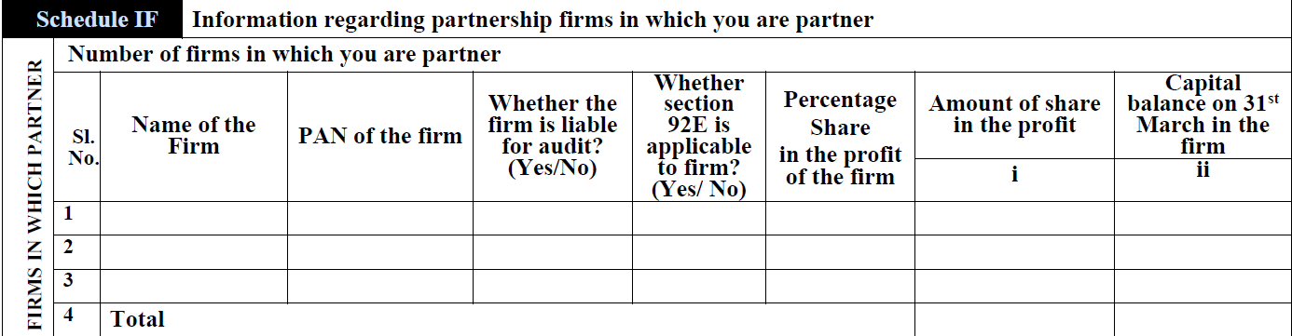

Disclosure of interest and remuneration due or received from partnership firm - ITR 3, 5 and 6

Slide 57


Name and PAN of the political party to be furnished under Schedule 80GGC – 1 TO 6

Slide 59

Schedule 80G seeks the IFSC and Transaction Reference Number

Slide 61


Disclosure of the authority to whom the report is submitted by the political party – ITR 7

Slide 63


ITR 4 - Assessees opting for the presumptive tax scheme are required to disclose the investment made by them

Slide 65


Validity period of registration obtained under other laws – ITR 7

Slide 66
Thank you

